Slide 1
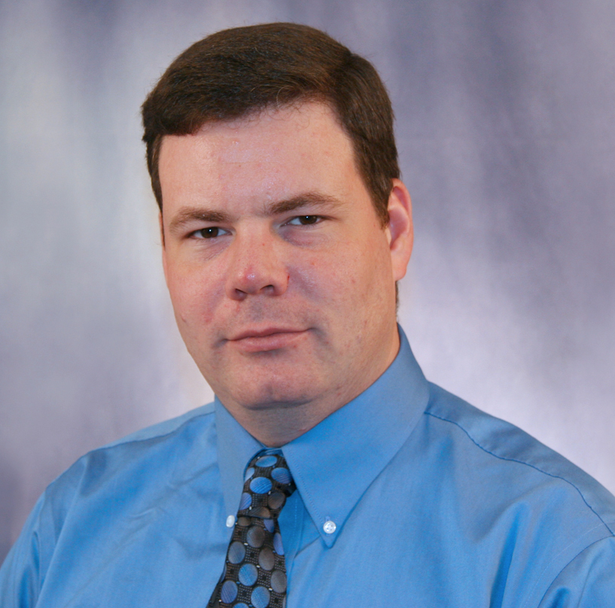
Samuel Grant
Chemical and Biomedical Engineering
scgrant@fsu.edu
Using relaxation-enhanced MRspectroscopy (RE-MRS), we are measuring targeted metabolites during ischemic stroke & migraine (Rosenberg et al., Magn Reson Med. 2016, Shemesh et al., J Cereb Blood Flow. Metab. 2014, Shemesh et al., Nat Comm. 2014; )
We are using labeled stem cell therapies to treat neurodegenerative diseases by employing native targeting to deliver local cytokines (Yan et al., Biotechnol Prog. 2015; Sart et al., Cytotherapy; Rosenberg et al. Cytotherapy 2013)
We evaluate novel high field contrast and theranostic agents for labelling implanted cells and targeting neurodegeneration. (Agyare et al., J Controlled Release 2014; Rosenberg et al., Contrast Med. Mol. Imag. 2014; Jaruszewski et al., Biomaterials 2014)
We employ high field MR microscopy and spectroscopy across a range of nuclei (¹H, ²³Na, ¹³C, ³¹P, etc.) to investigate neuro- and muscular degeneration in pre-clinical models from cells to in vivo, with a particular focus on ionic homeostasis and excitotoxicity.
With the resources of the National High Magnetic Field Laboratory, we have the highest magnetic fields available to MRI and MRS
In collaboration with neurologists, clinicians, chemists, biologists and physiologists, we make use of genetic, toxic and surgical animal models to identify biomarkers of disease progression.
We evaluate potential treatments (e.g. stem cell and drug therapy) with MR techniques to judge efficacy in restoring normal function.
We have facilities and staff to culture cells, implant constructs, perform surgeries, house, train, and characterize animals prior to MRI/MRS experiments.

