Slide 1
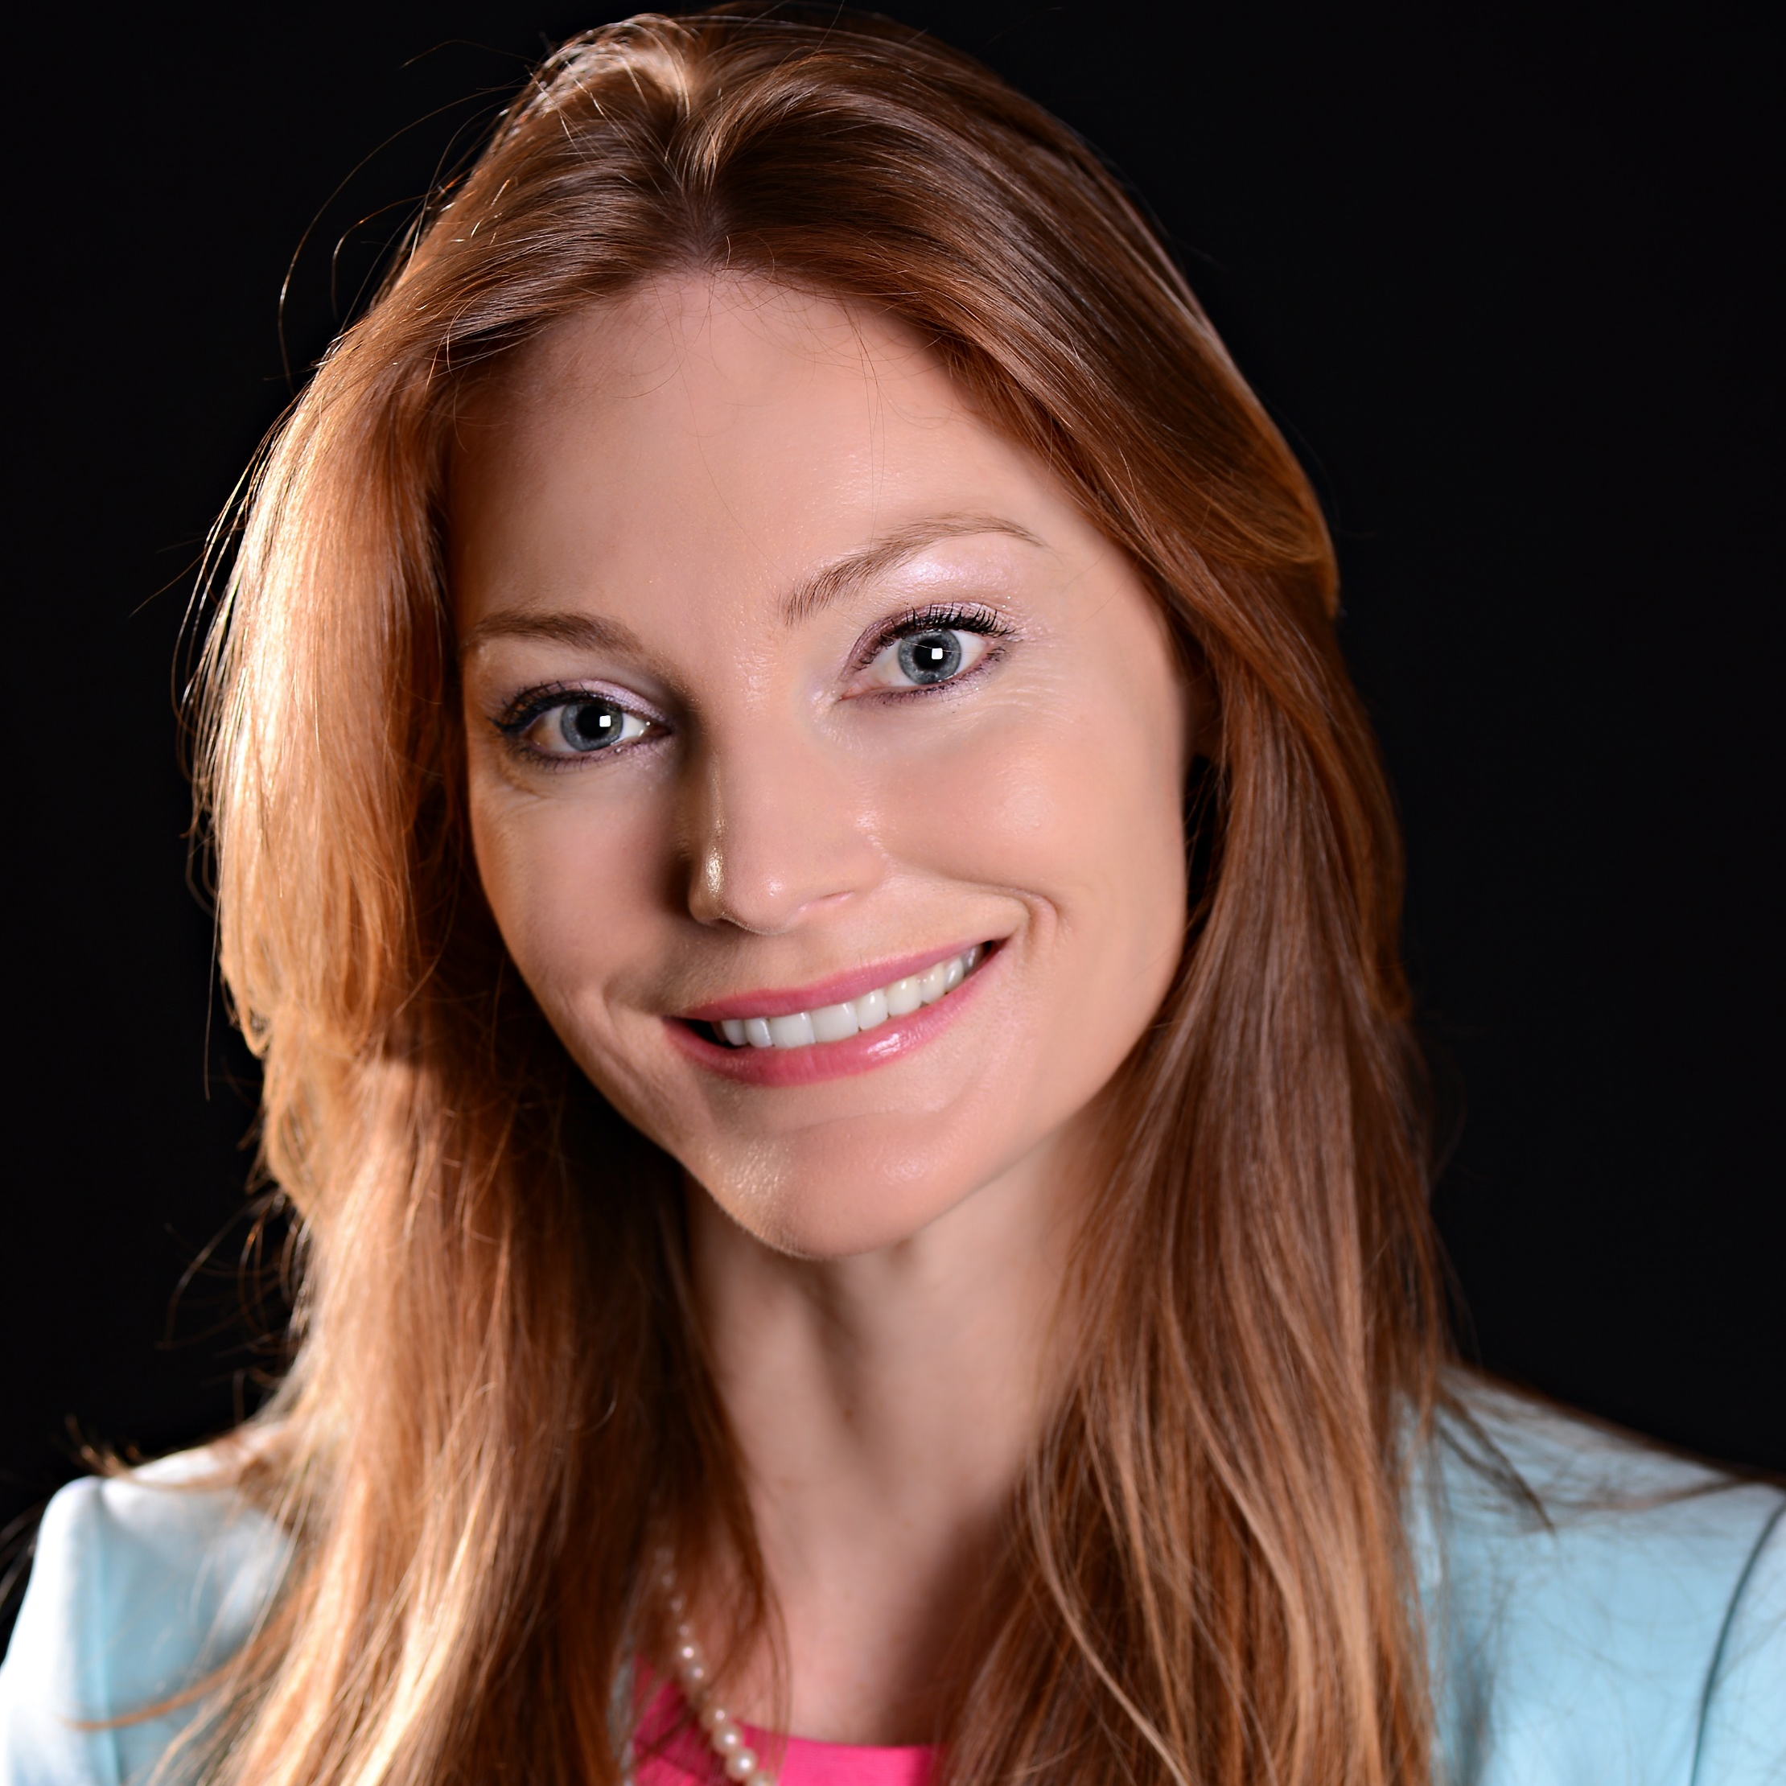
Scarlett Hinson
Nurse Anesthesia Program
shinson@pc.fsu.edu
Dr. Carr Smith and I are currently collaborating with a Stanford University Researcher to develop preoperative and postoperative cognitive assessments to recognize dementia and explore POCD and emergence delirium association.
I am interested in Aging, Cognition, Disease, Education, and Patient Care.
Dr. Carr Smith and I are currently working on identifying several quality improvement projects which will be implemented at our local Panama City clinical sites. Our Nurse Anesthesia Program is housed in the College of Applied Studies at the Panama City Campus.

