Slide 1
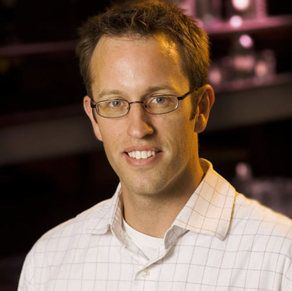
Scott Stagg
Chemistry and Biochemistry
sstagg@fsu.edu
Tools for High-Throughput High-Resolution 3D Electron Microscopy. Funded by NIH/NIGMS
The Structure and Assembly of the COPII Coat. Funded by NIH/NIGMS
Regulatory Mechanisms that Control Vesicle Secretion at the Endoplasmic Reticulum. Funded by NIH
Structural biology of the secretory pathway. Electron microscopy methods development. Solutions for big data processing
As a structural biologist, I am interested in determining the structures of the molecules that make up the cell in an effort to determine how they work. My lab is always looking for new challenging molecules that we can use to refine our technique to make it faster, more systematic, and higher-resolution.

