Slide 1
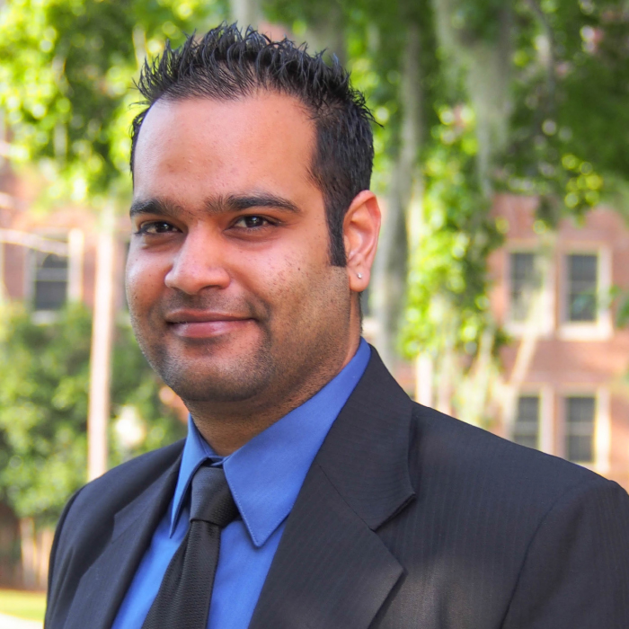
Srikant Manchiraju
Retail, Merchandising, and Product Development
smanchiraju@fsu.edu
Materialism and Well-Being
Technology Addiction and Well-Being
Body Image and Well-Being
Ethical/Sustainable Consumption
Consumer Psychology
Broadly speaking, my interests are related to psychology and marketing. I am open to [any] ideas, which are related to aforementioned disciplines. Also, I am a quantitative researcher, with a strong background in various statistical analyses.

