Slide 1
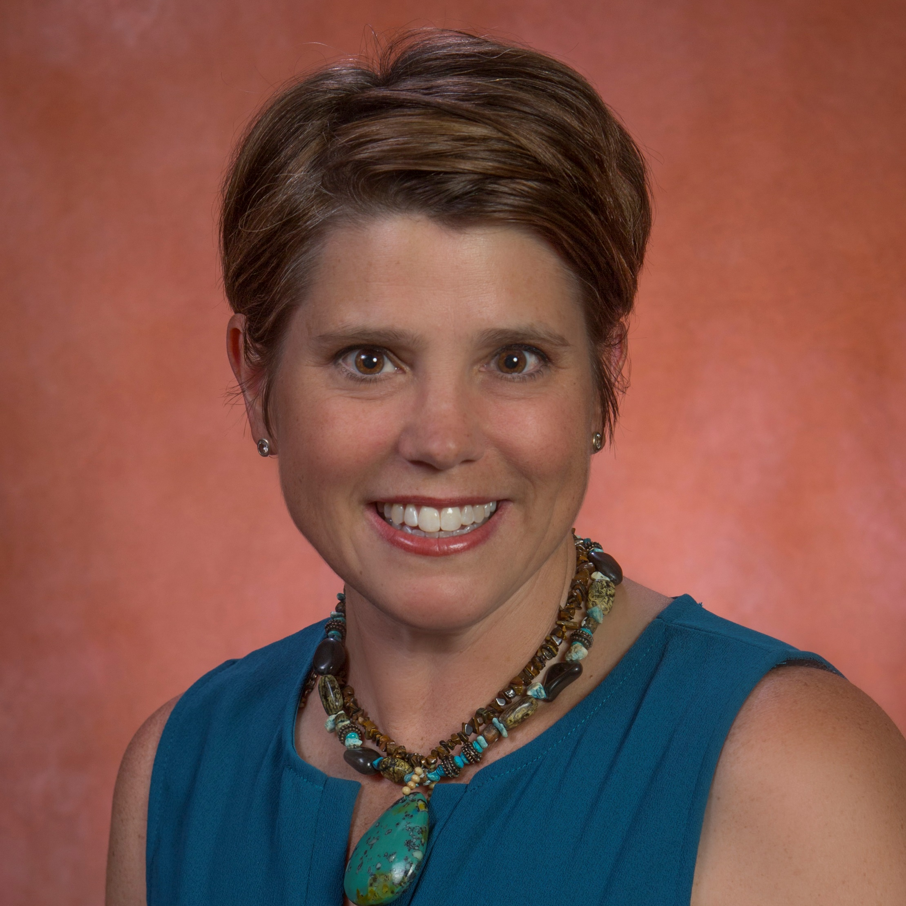
Susan Shelton
College of Nursing
sshelton@fsu.edu
Examination of factors that influence exercise in the postpartal period
Engaging mental health resources and community partners in care of perinatal women
Exercise in childbearing women and mood disorders
As a Certified Nurse-Midwife (CNM), I am familiar with care of women during preconception, prenatal, and postpartal periods. I combine my experience as a nurse and educator to deliver patient-friendly education and wellness care. I support collaborative approaches to planning and delivering patient-centered interventions and translational research.

