Slide 1
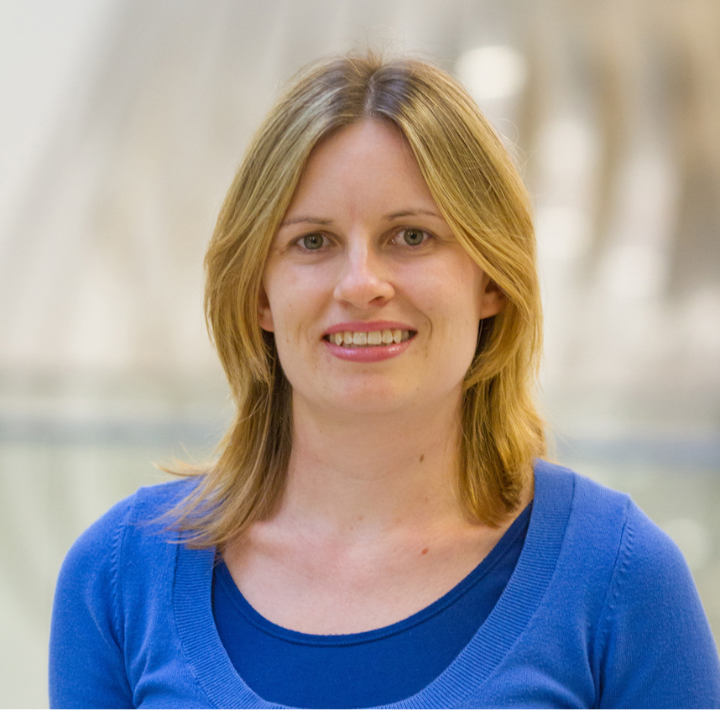
Theresa Van Lith
Art Education
tvanlith@fsu.edu
Impact of art therapy for children with Autism Spectrum Disorder (funded by AATA).
Exploring current research gaps on the impact of art therapy for mental health.
The impact of art-based programs on mental health and quality of life.
As an art therapist I have specialized in researching how art therapy can benefit people who experience mental illness using mixed methods. This research topic has expanded into studies and publications about art therapy service delivery models within mental health services, art therapy evaluation models for mental health services, art therapy professional development in mental health systems, as well as evidence-based practices in art therapy.

