Slide 1
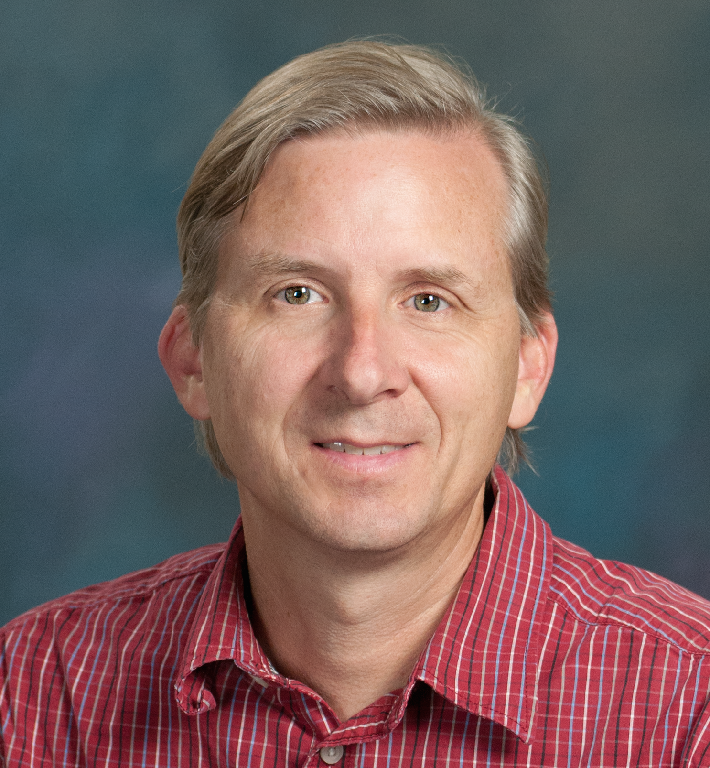
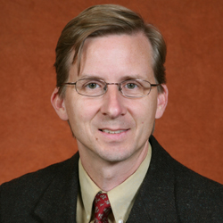
Tim Megraw
Biomedical Sciences
timothy.megraw@med.fsu.edu
Functions of centrosomes and their roles in microcephaly syndromes. Funded by NIH/NIGMS
Functions of centrosomes in autophagy. Funded by NIH/NIGMS
Connections between centrosome dysfunction and Zika virus impact on fetal brain development.
Cilia and ciliopathies.
Centrosomes in cell division, development and disease.
Expertise in cell biology, cell imaging including live-cell imaging, model organism manipulation for in vivo studies and genetic engineering.

