Slide 1
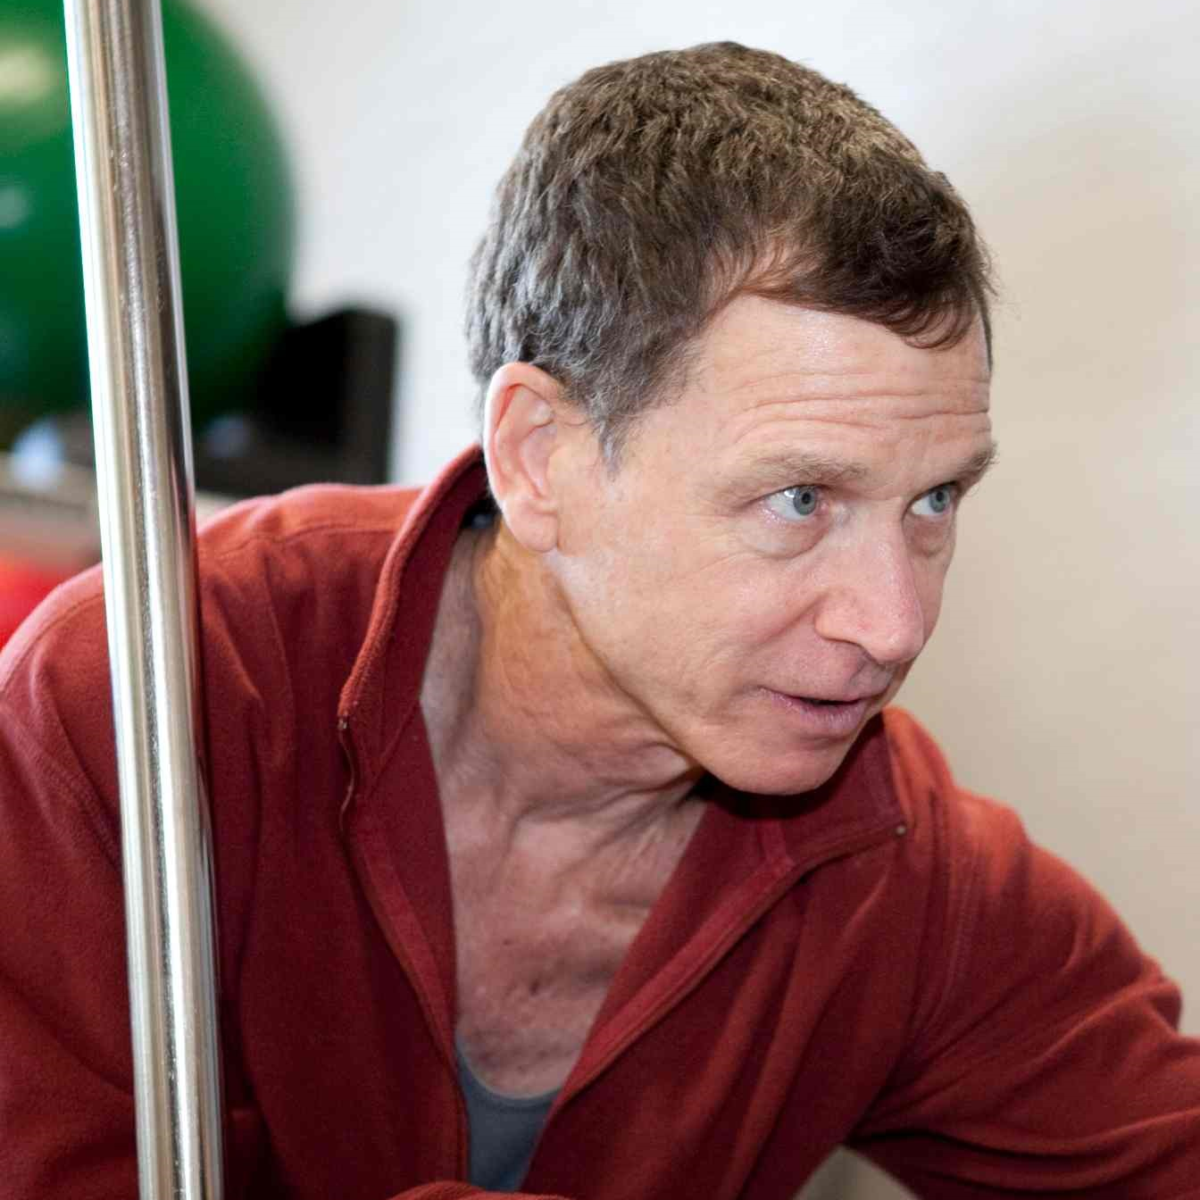
Tom Welsh
School of Dance
twelsh@dance.fsu.edu
Improving dancers’ performance of développé à la seconde (hip flexion, abduction and external rotation)
Improving dancers’ ability to control turnout (hip external rotation)
Strategies for improving pelvic alignment in dancers
Improving dancers’ back strength
My collaborators and I develop and evaluate healthy approaches to training pre-professional dancers.
Designing and analyzing Within-Subject experiments
Collaborating with and (co)mentoring researchers in a variety of performance domains (performance of technical dance skills, nutrition & hydration in dancers, psychology, education, and the movement sciences)

