Slide 1
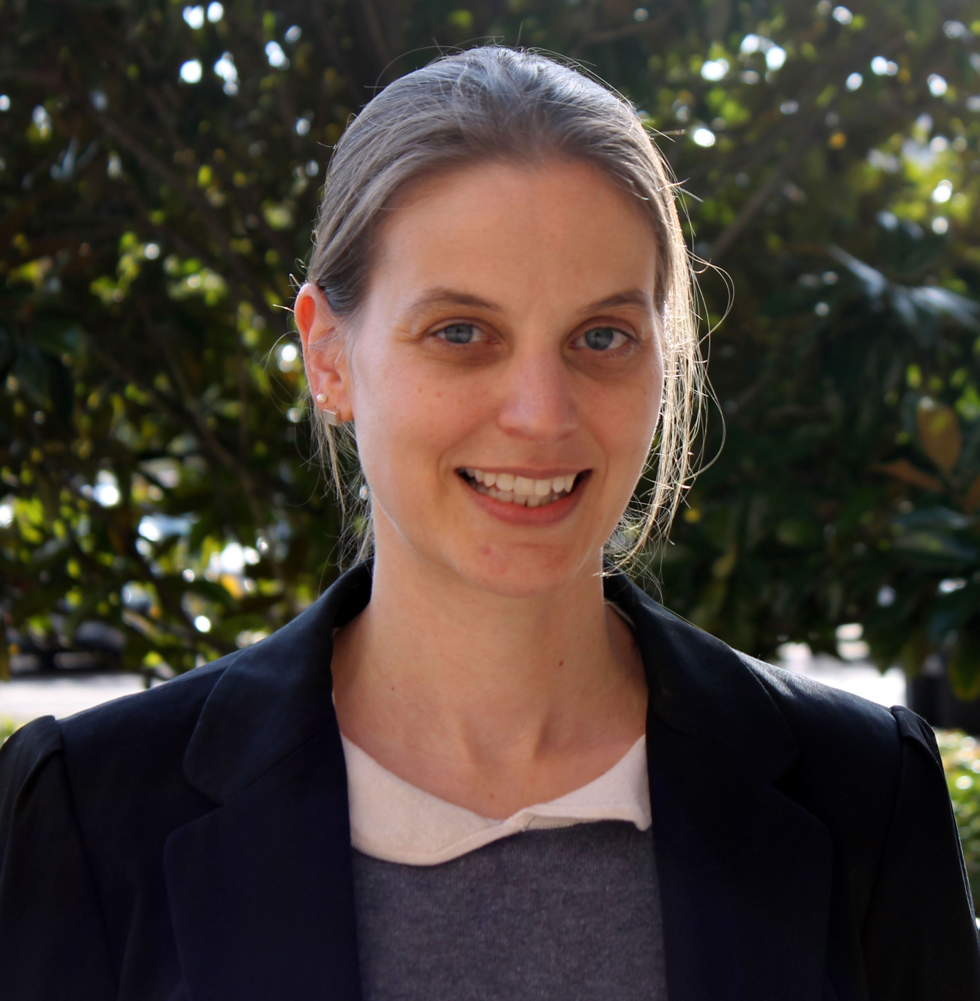
Ulla Sypher
School of Communication
usypher@fsu.edu
Several studies on technology fluency/literacy and digital divide (completed)
Study on grandparent/grandchild relationship and the technology/media used (completed)
Web usability assessment by groups with different expertise levels (completed)
Connecting technological literacy (including motivation, access, skill, age, usability, and similar factors) with health topics
Organized, goal-oriented, good with deadlines
GIS visualization skills, allowing integration of geographical aspects
Open to expanding into new directions
Focus on quantitative methodology and analysis, with some training in qualitative methods

