Slide 1
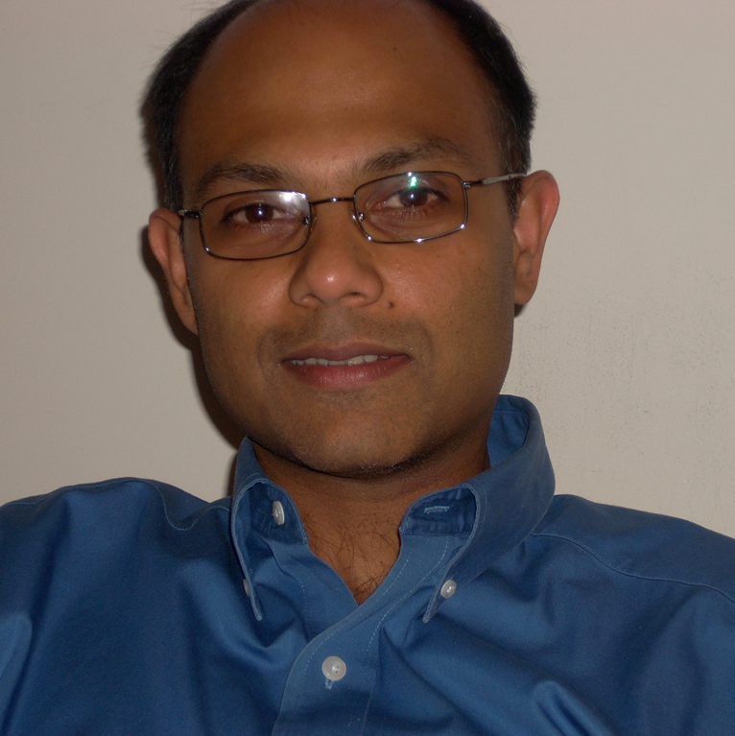
Vasu Misra
Earth, Ocean and Atmospheric Science
vmisra@fsu.edu
Climate projections over Puerto Rico over mid-21st century—funded by USGS
Seasonal climate prediction over India-funded by Ministry of Earth Sciences, India
Understanding low frequency variations of Atlantic tropical cyclones-funded by NOAA
Characterizing MesoAmerican summer monsoon rainfall-funded by NASA
Simulation, Prediction, and Projection of regional climate
As a climate scientist I can provide climate input to public health risks related to heat stress, vector borne diseases, and some water borne diseases. I can collaborate in proposals where climate simulations or projections or predictions at regional to global scales are required to understand or anticipate public health risks from climate variability and change.

