Slide 1
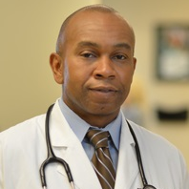
Wade Douglas
Clinical Sciences
wade.douglas@med.fsu.edu
Current research includes tissue procurement as it is vital to the advancement of research in patient care. By working with both the FSU College of Medicine and Tallahassee Memorial HealthCare, this program will increase patient-related research by providing researchers with both malignant and normal tissue for molecular, biochemical, and pathological studies.
I am interested in providing an institutional resource to facilitate translational research, specifically at helping procure tissues to study at the cellular level.
I have spent significant time in oncology research, specifically on head and neck cancers and cytokine pathways.

