Slide 1
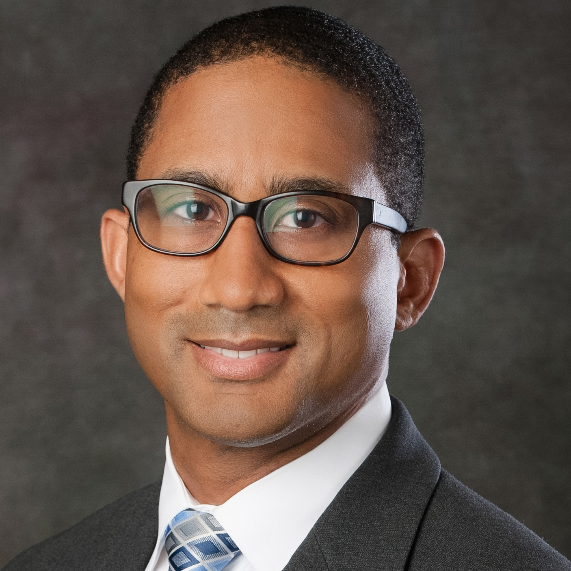
Wayne Batchelor
Clinical Research Network
wabat@southern-med.com
PLATINUM DIVERSITY STUDY. National Co-PI. The first U.S. national study prospectively evaluating the clinical outcomes of 1,500 women and minorities undergoing coronary artery stenting. Enrollment completed. Fully funded by Industry
PRAGMATIC STUDY. A prospective single site randomized clinical trial comparing a sheathless vs standard approach to radial artery access coronary artery stenting. Full Industry Funding.
SARCOPENIA TAVR STUDY. A study evaluating sarcopenia (as measured by CT) as a predictor of clinical outcomes and length of stay after transcatheter aortic valve replacement in the elderly. (study ongoing)
A variety of other clinical trials and observational studies in cardiovascular medicine
Interested in pursuing clinical and translational research within a broad range of fields within cardiovascular medicine, including coronary, peripheral arterial and structural/valvular heart disease. Particular interest in collaborating with other FSU faculty who wish to pursue clinical or basic science research ideas but need an experienced clinician/investigator with whom to collaborate.
I am a busy interventional cardiologist with formal training (Duke/NIH Master’s of Health Science Research) and broad experience in clinical research, including health outcomes research and clinical trials. Have participated in over 100 clinical trials, including site study PI on many and even as a National PI. I currently serve as the President of the Tallahassee Research Institute and have access to a large number of patients with CV disease within a very well established clinical practice. Have broad experience and understanding of all aspects of clinical research, including protocol development, research methodology, IRB submission, regulatory processes and grant/manuscript development. Have access to a broad range of new technologies within CV interventions. Looking forward to work with FSU collaborators who share an interest in pursuing research within CV medicine.

