Slide 1
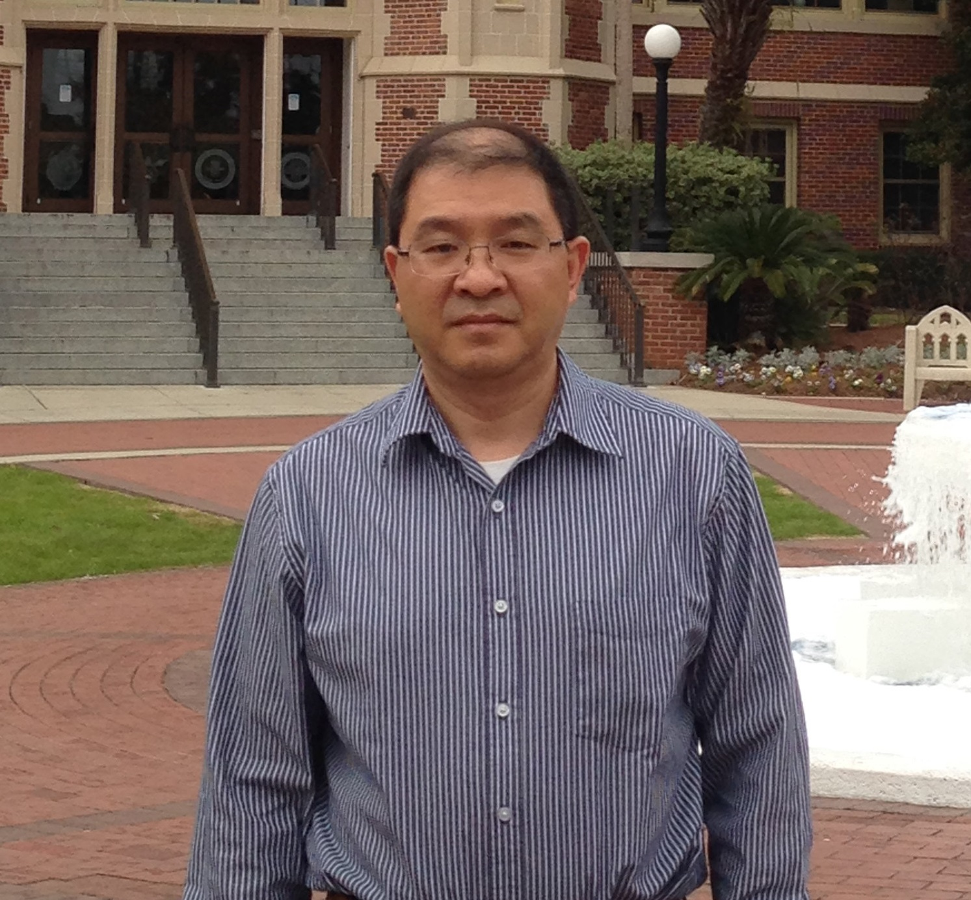
Yanchang Wang
Biomedical Sciences
yanchang.wang@med.fsu.edu
The regulation of chromosome segregation
The mechanism of misfolded protein clearance and neurodegenerative diseases
Using budding yeast as a model organism for drug screen
Neurodegenerative diseases
As a cell biologist, my lab can utilize multiple genetic, biochemical, cell biological, and imaging tools to dissect the biological processes in eukaryotic cells. I can collaborate with neurodegenerative research groups to investigate the roles of disease-relevant genes in the clearance of misfolded or damaged proteins.

