Slide 1
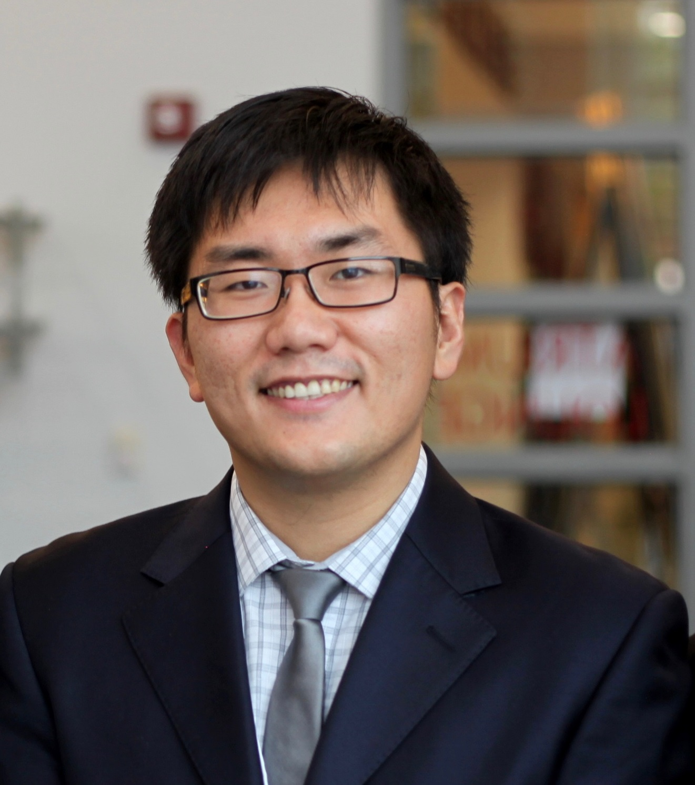
Zhe He
School of Information
zhe.he@cci.fsu.edu
Assessing the Generalizability of Clinical Trials, Funded by FSU CRC and Amazon Inc.
Bridging the Terminology Gap between Health Professionals and Consumers
Improving the Quality of Biomedical Terminologies / Ontologies
Representation of older adults in clinical trials; Multiple chronic conditions; Health disparity; Health information seeking on social media; Data mining / machine learning; Natural language processing
As a biomedical informatician, I can apply and design informatics approaches to solve biomedical and health related problems. I have deep understanding of knowledge representation, biomedical ontologies, health data analytics, and electronic health records. I can collaborate on proposals and projects using ontologies, machine learning, data mining, and natural language processing.

