Slide 1
FYAP WORKSHOP may 5, 2016
The Award Process
(Negotiation & Acceptance)
Russ Lentz
Associate Director, Sponsored Research Administration

Slide 2
SRA receives award (grant, contract, P.O.)
PI reviews award for technical aspects
SRA reviews for contractual/compliance issues
Negotiations
Full-execution
Project ID issued and spending starts

Slide 3
Initial Considerations
Grant/Contract awarded to FSU – Authorized signatory signs for FSU, not the PI, chair, or dean
No project ID = should not perform work, start spending, and/or deliver results to a sponsor prior to receiving an award
No human subjects research may commence until approved by the human subjects committee

Slide 4
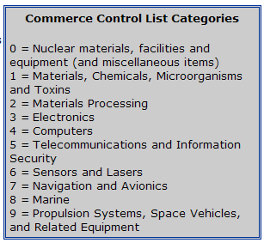
Terms & Conditions
Intellectual Property (copyrights, patents, etc.) – university retains IP rights
Export Controls – can limit the personnel on your project or international dealings

Slide 5
Terms & Conditions
Disputes – ability to resort to the courts, choice of laws, and jurisdiction
Damages/Sanctions – FSU cannot agree to pay damages above state limits
Warranty of work – FSU cannot warrant its work; instead, we promise to use a reasonable best effort to perform the work

Slide 6
Terms & Conditions
Time is of the essence – not acceptable, because it is a breach with damages if university is even a day late in performing

Slide 7
Terms & Conditions
Indemnification – FSU cannot agree to indemnify (in Florida it is against the law)

Slide 8
Terms & Conditions
Payment/Invoicing terms – terms must be crystal clear

Slide 9
Terms & Conditions
Insurance – required insurance levels in award cannot exceed limits in FSU’s insurance policy, and sponsor cannot be listed as additional party on insurance policy

Slide 10
Terms & Conditions
Incorporated prime contract – when FSU is a subcontractor, we generally receive not only a subcontract but also a prime contract incorporated as well
No unilateral changes to contract/grant – important that award ensures no changes to project can occur without both parties’ agreement in writing

Slide 11
Post-Award functions in Pre-Award
Time-extensions
Amendments
Changes in % effort
Changes in key personnel
Rebudgeting if sponsor´s approval is needed

