Slide 1
The Office of Research
CRC Grant Workshop
5 May 2016
W. Ross Ellington, Associate VP for Research & Greenberg Professor of Biological Science

Slide 2
Mission of the Office of Research
Encourage and facilitate our faculty’s efforts to obtain sponsored research funding
Provide all the needed support prior to (pre-award) and after (post-award) receipt of external funding
Protect and commercialize FSU’s intellectual property.
Broaden the awareness of FSU’s research and creative talents locally and beyond
Nurture and support research and creative activities across the disciplines

Slide 3
The Office of Research is here to serve you.
We are responsive to concerns and criticisms.
Our funding base is derived from the indirect cost revenues generated by your grants and contracts.

Slide 4
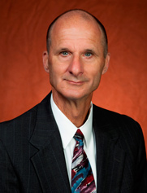
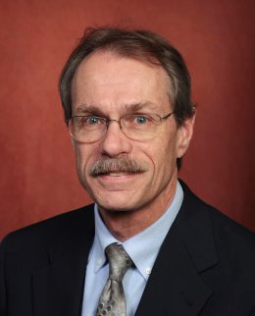
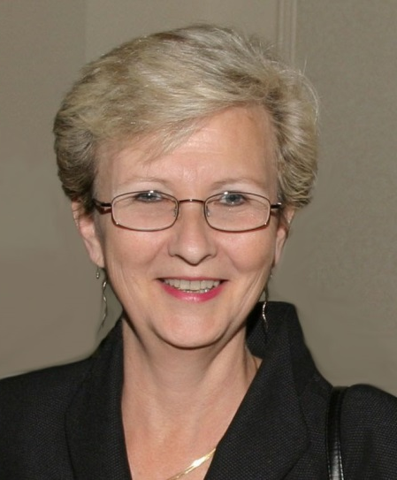
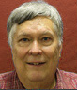
Office of Research: Administration
Gary Ostrander
Vice President
Ross Ellington Associate
Vice President
Olivia Pope
Associate
Vice President,
Administration, Compliance & Finance
Eric Holmes
Assistant
Vice President,
Biomedical portfolio

Slide 5
Office of Research: Where we fit in
President
VP Finance
Vice President Research
$
EH&S
Sponsored Research Administration (SRA)
FSU Research Foundation (FSURF)
Compliance
Proposal Development (OPD)
Commercialization
Laboratory Animal Resources (LAR)
Facilities Design & Construction
Legal & Legislative Affairs
Research Units
Communications
Human Subjects/ IRB
FFI
NHMFL
AME
FSUCML
HPMI
CAPS
ASC
FCAAP

Slide 6
Why apply for external funding?
It’s a great intellectual exercise as it provides focus and crystallizes ideas
Provides peer-reviewed validation of the quality of your scholarship and recognition in the community
Provides freedom, flexibility and resources
Supports students
Often catalyzes collaborations within and outside of the University

Slide 7
Workshop Schedule
8:50 a.m. Where to Find Funding
9:05 a.m. Grants Cradle to Grave: Pre-Award
9:50 a.m. Break
10:05 a.m. Grants Cradle to Grave: Post-Award and FSURF
11:00 a.m. Break Out Sessions
12:30 p.m. Lunch and Poster Session with 2014 FYAP faculty

