Slide 1
First year assistant professor workshop alumni Center ballroom May 5, 2016
Finding Funding
Beth Hodges
Director, Office of Proposal Development

Slide 2
Today’s Discussion
Identifying Funding Sources
Tips & Considerations

Slide 3
Ways to Locate Funding
Agency websites
Word of mouth: colleagues on campus and elsewhere
Speaking with agency program officers
The Web
Funding Databases & Listservs
Searching literature to learn where colleagues in your area are obtaining funding

Slide 4
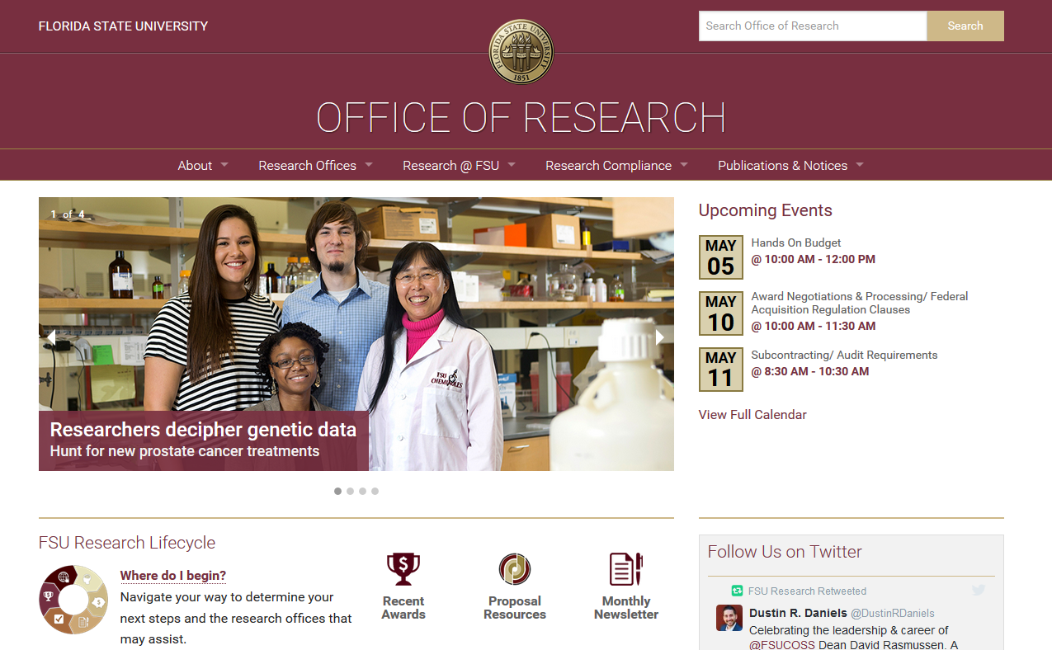
www.research fsu.edu
Notes:
Research.fsu.edu

Slide 5
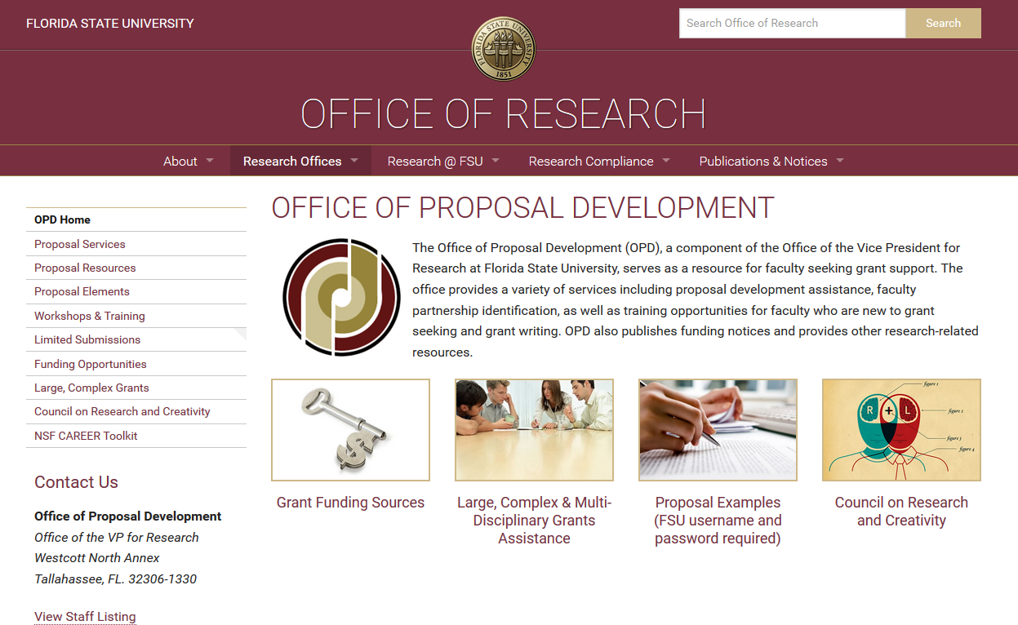
Office of Proposal Development Site
Notes:
Began Fall, 2013 at FSU
Similar Office at Research Universities across the US
Research.fsu.edu/opd

Slide 6
Resources available from OPD
Access to Funding Resources, Databases
Access to Listservs
Proposal Resources, Tutorials
Workshops/Training Information
Examples of Successful Proposals
Large grant and multi-disciplinary proposal assistance
Council on Research and Creativity

Slide 7
Other Resources
The Office of Research Newsletter
Research Development & Grant Writing News

Slide 8
Funding Databases
Why use a funding database?
One stop searching
Setting up searches and alerts
Funding Opportunities=27,000+ records
Scholarly profiles= 3.2 million profiles
Pivot suggests funding based on Pivot profile…and vice-versa

Slide 9
Applying for Funding: Tips

Slide 10
Current Climate
Overall, proposals are increasing and dollars are decreasing
The vast majority of proposals are declined.
More than half (60%) of the proposals are rejected on the first reading because:
The proposal did not match the program
Applicant did not follow directions

Slide 11
What can be done to improve my odds?
Verify the Match (discussion with program officer)
Follow the format provided by the sponsor and all instructions exactly*
Pay attention to your budget
Rule of Three
Heilmeier's Catechism

Slide 12
Heilmeier's Catechism
What are you trying to do? Articulate your objectives using absolutely no jargon.
How is it done today, and what are the limits of current practice?
What's new in your approach and why do you think it will be successful?
Who cares? If you're successful, what difference will it make?
What are the risks and the payoffs?
How much will it cost? How long will it take?
What are the midterm and final "exams" to check for success?
Notes:
George Heilmeier was the director of the Defense Advanced Research Projects Agency (DARPA) in the 1970s (he left DARPA to join Texas Instruments in 1977 and eventually became the CEO of Bellcore).
The "Heilmeier Catechism" are the questions that should be answered when writing a research proposal for a funding agency.

Slide 13
Other considerations…
When talking to program officers
Do not cold-call them; better to send an email first; okay to attach a 1 page project summary, then ask for time to speak with them
Do not call to chat, keep comments professional
Build relationships, respect & reputation
Become a proposal reviewer
Participate in seminars and conferences
Team Building; establish strategic partnerships, leveraging your expertise.

Slide 14
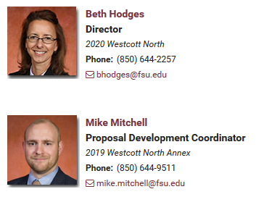
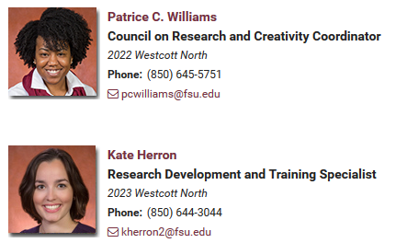
Questions or Assistance-- Contact OPD staff anytime:
Notes:
Change presenter info as needed

Slide 15
Thank you.

