Slide 1

CRC Grants Workshop
May 5th 2016
Humanities, Performing Arts, and Fine Arts “break-out” section
Daniel J Pullen, Department of Classics
Hannah Schwadron, Department of Dance

Slide 2
Funding in the Humanities at FSU
Internal
CRC (FYAP, COFRS, Planning, Small)
Provost travel grants, Dean’s funds, SRAD
External
research grants vs. fellowships
Federal agencies (NEH, NSF)
Foundations (ACLS, etc.)
discipline specific resources (e.g. Institute for Aegean Prehistory)

Slide 3
DJP funding over last 25 years: c. $603,429 external, $115,500 internal (+ $250,000 co-PI)
National Science Foundation, SHARP: Saronic Harbors Archaeological Research Project, 2008-2013 ($177,043)
University of Missouri Research Reactor/National Science Foundation Grant, 2013 ($9,520)
Loeb Classical Library Foundation Grant, SHARP: Saronic Harbors Archaeological Research Project, Year 2, 2008 ($30,000) Year 1, 2007 ($30,000)
Institute for Aegean Prehistory Grant, SHARP: Saronic Harbors Archaeological Research Project, 2013 ($5,000), 2012 ($8000), Year 4 ($55,000),Year 3, 2009 ($60,000), Year 2, 2008 ($60,000), Year 1 2007 ($60,000)
Arete Foundation & Niarchos Foundation (U Pennsylvania), 2007-2011 ($73,321)
Florida State University COFRS Award, SHARP: Saronic Harbors Archaeological Research Project, 2007 ($13,000)
Florida State University Faculty Travel Grant, 2002, 2004, 2007, 2008, 2009, 2010, 2012, 2013, 2014, 2015, 2016
Florida State University Research Foundation Arts & Humanities Program Enhancement Grant, "Landscapes and Complex Societies in the Mediterranean–Year Two" 2003 ($19,228), Year One: 2002 ($25,000)
Institute for Aegean Prehistory Grant, "Mycenaean Korphos Mapping Project," 2002 ($10,000)
Florida State University COFRS Award, "Mycenaean Korphos Mapping Project," 2002 ($8,000)
Florida State University Research Foundation Arts & Humanities Program Enhancement Grant (co-PI with Susan Baldino), The Museum Laboratory, 2001 ($32,000), 2002 ($31,000)
Institute for Aegean Prehistory (Co-PI with T. Gregory, Ohio State), for the Eastern Korinthia Archaeological Survey, 2000, 2001
Florida State University Council for Instruction Grant, 2000 ($7,530)
Schraeder Endowment Grant, Indiana University, 1999 ($1,117)
Florida State University Dean of the College of Arts and Sciences Research Grant, 1998 ($1,862)
Indiana University Foundation Grant, 1997 ($1,000)
US Department of Education ($149,057) and European Union (ECU 180,000) for establishment of consortium Study and Evaluation of Cultural Landscapes, 1996-1998 [joint with colleagues at Ohio State University, St. Cloud State University, College of Wooster, Ionian University, Université de Paris IV, Université de Franche Comte Besançon]
Florida State University Dean of the College of Arts and Sciences Research Grant, 1997 ($3,115)
University of Missouri Research Reactor/National Science Foundation Grant, 1996 ($3,667)
American Research Institute in Turkey/National Endowment for the Humanities Fellowship, 1995-96, ($10,000)
Institute for Aegean Prehistory grant, Early Bronze Age Sardis and the Aegean, 1994–95 ($9,761)
Florida State University COFRS Award, Early Bronze Age Sardis and the Aegean, 1994 ($8,000)
President’s Fund Travel Award, Florida State University, December 1993
Planning Grant for FSU Excavations at Athienou, Cyprus, Florida State University Council on Research and Creativity, 1992 ($4,778)
Classics Department Slide Collection Improvement Project, Florida State University Council for Instruction, 1991–1992 ($10,337)
Florida State University Foundation Small Grant, Summer 1991
First Year Assistant Professor Summer Salary Award, Florida State University, Summer 1990
President’s Fund Travel Award, Florida State University, December 1989

Slide 4
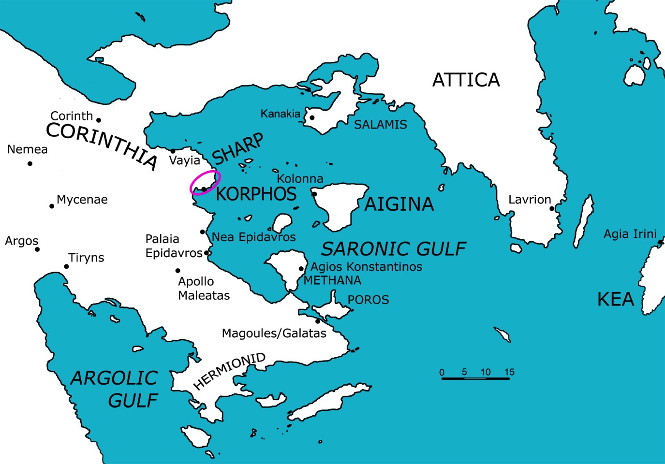
Saronic Harbors Archaeological Research Project (SHARP) 2007-2013
D.J. Pullen (Florida State University) and T.F. Tartaron (University of Pennsylvania), co-directors
Sponsored by the American School of Classical Studies at Athens with the kind permission of the Hellenic Ministry of Culture and the cooperation of the ΛZ’ Ephoreia of Prehistoric and Classical Antiquities, the 25th Ephoreia of Byzantine Antiquities, the Ephoreia of Underwater Antiquites (Enalion), and the Institute of Geology and Mineral Exploration
We gratefully acknowledge financial support from:
Institute for Aegean Prehistory
Loeb Classical Library Foundation
National Science Foundation
Stavros S. Niarchos Foundation
The Arete Foundation
The Florida State University
University of Pennsylvania

Slide 5
Institutions have variety of funding types, from various sources.
American School of Classical Studies at Athens
American Historical Association
Look at those that are not obvious: e.g., NSF for history of science, NIH for anything dealing with “medical humanities”

Slide 6
Sponsored Research (federal and state agencies)
vs.
Research Foundation (private foundations and agencies)

Slide 7
How to write a proposal:
www.acls.org > fellowships & grants > competitions & deadlines > ACLS Fellowships > download: “Writing Proposals for ACLS Fellowship Competitions” by Christina M. Gillis
NEH - call or email the Program Officer; often they will read a proposal in draft (provided it is submitted a couple of months in advance!)
Office of Faculty Recognition (Dr. Margaret “Peggy” Wright- Cleveland) is trying to help with all the non-grant fellowships [national, such as Guggenheim, ACLS, etc.] and awards

Slide 8
How to write a proposal:
Market yourself and your ideas
State right up front what you want, why, and why you are the one

Slide 9
Opening paragraph of successful application to the Institute for Aegean Prehistory:
SHARP: The Saronic Harbors Archaeological Research Project
Survey and Excavation of Korphos-Kalamianos, 2009 Season
Daniel J. Pullen (The Florida State University) and Thomas F. Tartaron (University of Pennsylvania) designed the three-year project, SHARP (Saronic Harbors Archaeological Research Project), to map, survey, and selectively excavate the Mycenaean remains at Korphos-Kalamianos. In 2007 and 2008, with the generous support of the Institute for Aegean Prehistory, we began to map the extant remains and to conduct an intensive survey of the site and its surrounding regions. The preliminary results reveal that we have a remarkably well-preserved Mycenaean harbor town set within a fortification wall. In 2009 we plan to excavate selected areas identified in 2007 and 2008, in addition to continuing the regional survey and on-site architectural documentation. We seek funding in this application for the 2009 season.

Slide 10
NEH how to prepare an application
www.neh.gov
Collaborative research grants:
www.neh.gov/grants/guidelines/collaborative.html

Slide 11
Narrative Sequence:
identify and explain the subject for research (indicate importance)
describe generally the state of current creative activity / scholarship
then focus on how the proposed research / creative activity differs from the current state ---or takes research / creativity into new territory
outline what you, the PI [“principal investigator”], have already accomplished on the topic and / or give background of the project;
describe what you will do to bring the project to completion during the grant period…expenditures are always made in the grant period
state how the project or production will be made available to the sector of the public for which it is intended and its likely impact

Slide 12
Honesty might not be the best policy:
“I’d really like to have the summer to work in my studio instead of teaching. I’ve found it very hard to get much done this academic year and I need more than local shows. A grant for the summer would allow me to get enough work done so I’d be able to try to find a regional venue for a solo show in ‘08. And travel would mean a lot to me right now. I could travel to gather inspiration for a new series of paintings.”
Professional approach, describes goals:
“In order to meet exhibition goals set for the coming year, travel should occur during Summer semester ‘08. By exploring regional venues and making professional contacts then, my work will be more widely shown. A second important objective for Summer ‘08 is to amass a photographic library of images. The identification and archiving of new imagery will be a vital resource for change in the next series of paintings.”

Slide 13
SHARE your proposal with your mentors, colleagues, friends, etc. Ask them to read your proposal and ask you questions. If a CRC member is in your department, ask her/him for advice and comments on internal applications. Ask a successful grant-getter in your field to look over your application.
Especially useful are people not directly in your field or discipline.
The more comments and feedback you get before you submit, the better the proposal will be, and the greater the chance of success.

Slide 14
Reviews: “nasty, brutish, and short” or helpful comments
Try, try, again. ASK for detailed comments of reviewers, opinion of staff. Is it worth reapplying?
NEH review results for SHARP
Panelist 3
Intellectual Significance: I cannot tell how significant this project actually is. It is not clear to me how the 'site' is determined and rendered significant through excavation of only architectural remains.
Pertinence of research: This is not clear to me, except to say that the complete harbor town plan will be recovered, and that its architectural style, or at least plan, refers to the Mycenaean core. It must be important to learn about towns that are economically significant for the success of the core, and that take on a 'foreign' style of architecture and building associated with the authority of the core.but the investigator does not frame the project convincingly in that way.
Qualifications of investigators: This is a large team, presumably competent.
Dissemination of results: looks okay, not well articulated, but there.
Potential for success, completion on time: this is an ambitious amount of work, but doable it would seem.
Problem: Looks like an expensive project to me.
Preliminary Rating: G
Additional comments after panel discussion: I am convinced after the discussion that my rating was too severe.
Final Rating: VG

Slide 15
Award Date: August 27, 2008
Award No. BCS-0810096
Proposal No. BCS-0810096
Dr. T. K. Wetherell
President
Florida State University
874 Traditions Way, 3rd Floor
TALLAHASSEE, FL 32306-4166
Dear Dr. Wetherell:
The National Science Foundation hereby awards a grant of $177,043 to Florida State University for support of the project described in the proposal referenced above as modified by revised budget dated April 17, 2008.
This project, entitled "SHARP: Saronic Harbors Archaeological Research Project," is under the direction of Daniel J. Pullen.
This award is effective September 1 , 2008 and expires August 31, 2010.
This grant is awarded pursuant to the authority of the National Science Foundation Act of 1950, as amended (42 U.S.C. 1861-75) and is subject to Research Terms and Conditions (RTC, dated July 2008) and the NSF RTC Agency-Specific Requirements (dated July 2008) are available at http://www.nsf.gov/awards/managing/rtc.jsp. This institution is a signatory to the Federal Demonstration Partnership (FDP) Phase IV Agreement which requires active institutional participation in new or ongoing FDP demonstrations and pilots.
The attached budget indicates the amounts, by categories, on which NSF has based its support.
Please view the project reporting requirements for this award at the following web address [ https://www.fastlane.nsf.gov/researchadmin/prsLoginHome.do?awdID=0810096 ].
The cognizant NSF program official for this grant is John E. Yellen, (703) 292-8759.
The cognizant NSF grants official contact is Barbara A. Brooks, (703) 292-4802. Sincerely,
Robert F. Joyce
Grants and Agreements Officer
CFDA No. 47.075

Slide 16
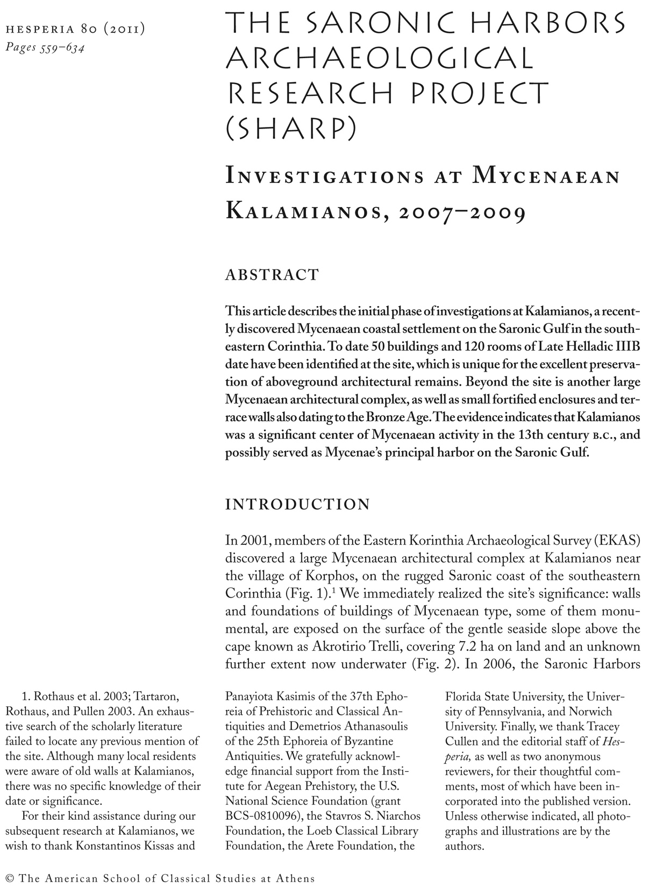
Acknowledgments of all funding agencies

