Slide 1
Opportunities and Issues for External Funding: A Social Science (SS) Perspective
Mark W. Horner, Ph.D.
Department of Geography
2016 First Year Assistant Professor Grants Workshop

Slide 2
FSU’s University Transportation Center
Center for Accessibility and Safety for an Aging Population (ASAP) created Fall 2013.
ASAP is a research partnership of Florida State University (FSU), Florida A&M University (FAMU) and the University of North Florida (UNF).
Received a $4.1 million University Transportation Centers program grant from the U.S. DOT.
Addresses the challenges of providing safe and accessible transportation to an aging population.
Interdisciplinary and includes faculty from Engineering, Psychology, Urban Regional Planning, Geography, Health Sciences, etc.
utc.fsu.edu

Slide 3
ASAP at FSU

Slide 4
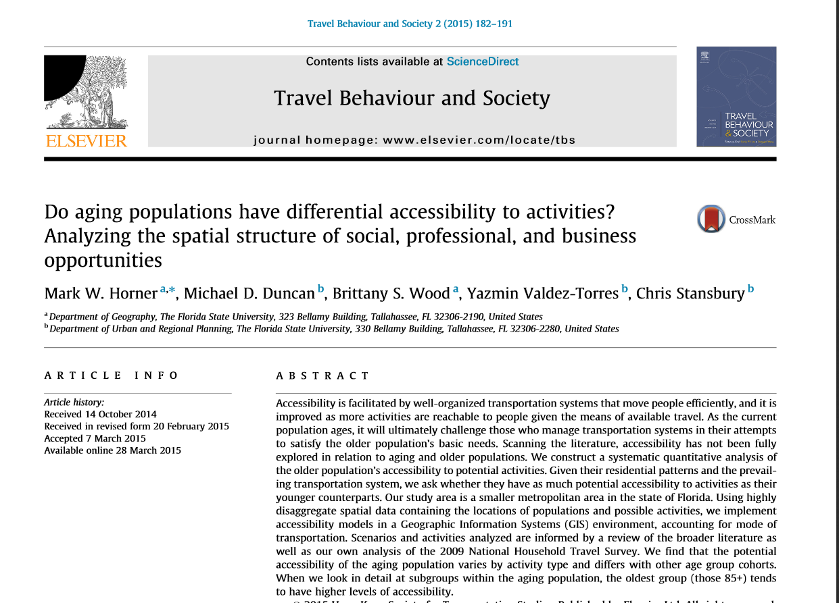
Study of accessibility differentials by population age for a diverse range of opportunity types

Slide 5
Why Write a Grant Proposal?
(Especially when the chances of a funded proposal can be slim.)
Risk vs. reward? Varies by discipline, field, topic…

Slide 6
Top 10 Reasons for Writing Grant Proposals
?????

Slide 7
Top 10 Reasons for Writing Grant Proposals
10. If you are funded, your parents will be impressed because they may think the money is sent to you.

Slide 8
Top 10 Reasons for Writing Grant Proposals
9. Grant activity is increasingly expected for successful promotion and tenure.
May be variation in expectations by SS discipline?

Slide 9
Top 10 Reasons for Writing Grant Proposals
8. Your department and the college will get “SRAD.”

Slide 10
Top 10 Reasons for Writing Grant Proposals
7. Budgets may have money to buy useful equipment , data, computers, etc.

Slide 11
Top 10 Reasons for Writing Grant Proposals
6. Can make it possible to recruit and support more graduate students under your direction.
Potential long term impacts on your field

Slide 12
Top 10 Reasons for Writing Grant Proposals
5. Can make it possible to hire a research associate/post-doc.

Slide 13
Top 10 Reasons for Writing Grant Proposals
4. Can make it possible to travel to conferences you could not attend otherwise, to disseminate your research findings.
Can work to build your professional network at an early career stage

Slide 14
Top 10 Reasons for Writing Grant Proposals
3. Can pay your summer salary
Great time for getting research done.
Allows you to focus on specific research activities

Slide 15
Top 10 Reasons for Writing Grant Proposals
2. You can make it a “two-fer.”
Grant proposal themselves can later become part of papers, even if not funded
Example: write the intro and you may have the start of a review paper as well as part of a grant proposal.

Slide 16
Top 10 Reasons for Writing Grant Proposals
1. If funded, you will be getting to execute the research YOU PROPOSED DOING!!!

Slide 17
Thinking Programmatically
Your goal as a new professor is to establish a program of research.
Multiple studies over multiple years with a defined trajectory contributing to a broader goal.
The grant proposal process, by and large, compels us all to think in these terms.
This is a very very positive thing!!!

Slide 18
Thinking Programmatically
A possible worst case scenario is that you don’t write a successful proposal but you will end up with better ideas for studies than you would have otherwise.

Slide 19
Some Advice
Points:
A proposal is a request to use other people’s money, to which none of us is entitled.
If you want to have a serious chance of success, you must put serious thought into making the case: “why I should be given other people’s money”.
Be persistent: good proposals do eventually get funded.

Slide 20
Some Advice
General Advice
Learn from those who have had recent success
You could read proposal from folks who were recently funded
Know dynamics of your particular program
In Geography, for example, NSF program managers attend professional meetings and allocate time specifically to take questions about the GSS program
Be complete in your budget planning
Ask for everything you need to do the work. But make sure you justify every item from a budget perspective.

Slide 21
Some Advice
Think Transformatively
Big emphasis at NSF, for example!!!
Be realistic whether an idea is ‘big’ enough such that it deserves funding
Write engagingly and be thorough
All reviewers are over-stretched these days. Don’t annoy them with writing issues!
Tell a coherent, interesting, story. This is a key to success. No proposal by chunks that reads as chunks…
Use a spell checker
Pay strict attention to formatting

Slide 22
Some Advice
Multi-PI proposals:
If the proposal is the work of several co-PIs, make sure it is clear who is to do what.
Keep the writing to the point. Absolutely avoid filler. If the proposal is written by several people, assign the job of editor to someone on your team.
The editor’s job is to give the proposal the sense that it was written by a single mind.
Repetition is fine, up to a point, so long as it has a useful purpose, such as making the reviewers’ job easier.

Slide 23
Summary
Proposals
with bad ideas invariably fail.
with good ideas, but that are badly written often fail.
that are well written and have good ideas will eventually succeed, so don’t give up!
Learn from others
Learn from those in your peer group who have had recent success.

Slide 24
Other discussion considerations?
How does funding vary?
Choices of possible sources?
NSF, NEH, NIH, DOE, USDOT, State and Local sources, etc.
Applied vs. Basic research?
Grants vs. Contracts?
Participating on teams? Contributions from SS?

Slide 25
Insights on NSF
Process
Proposal Reviews
Panels
Tips

Slide 26
Thanks
Discussion/Questions?
Acknowledge prior FYAP presentations by Wagner and Prosper that were incorporated into this presentation
mhorner@fsu.edu

