Slide 1

Writing an NSF Grant
Kim Hughes
Department of Biological Science
Ecology and Evolutionary Biology Graduate Program
Notes:
Thank the organizers …

Slide 3
Personal observations
Served on many panels
Written many proposals (some of them funded!)
Helped students write proposals
But still learn something new every time I write or read a proposal or serve on a panel
So ask questions, tell us if you have other ideas

Slide 4
Outline
Know your audience
Know what successful proposals in your field look like
Present the best case
Follow all the guidelines (which change all the time)
If your proposal is not funded …

Slide 5
1. Know your audience
I typically apply to one of two different divisions within the NSF Directorate of Biology
https://www.nsf.gov/staff/orglist.jsp

Slide 6
Divisions have multiple Programs
Evolutionary Processes Program (has own review panel)
Evolutionary Ecology Program
https://www.nsf.gov/funding/programs.jsp?org=DEB

Slide 7
Talk to Program Officers
Ask about fit between your ideas and the Program
What is the diversity of subdisciplines among likely reviewers?
  How familiar will they be with questions, methods, and terminology in your specialty?
  Best to assume broad audience, avoid subdiscipline-specific jargon!

Slide 8
2. Know what successful proposals look like
Ask colleagues for copies of previously-funded proposals
  As many as you can get
  As close to your field as possible (i.e., reviewed by the same NSF Panel)
Senior colleagues are usually happy to share
  Previous advisors, departmental colleagues, leaders in your field
  More junior colleagues might be more insecure

Slide 9
Ask colleagues to read your proposal
Best to ask colleagues who
  Work in your specialty
  Those who have recently been on your Panel
  Senior colleagues who have had lots of proposals funded, preferably by your Panel
Participate in/organize a Mock Panel
Take the advice of your volunteer reviewers!
Get on a panel

Slide 10
Give yourself enough time!
At least 6 months before deadline you should have
  Copies of successful proposal in hand
  Identified your Program and Panel
  Identified colleagues who will read the proposal
Your colleagues will likely need several weeks to read and evaluate your proposal, so make sure you give them plenty of time

Slide 11
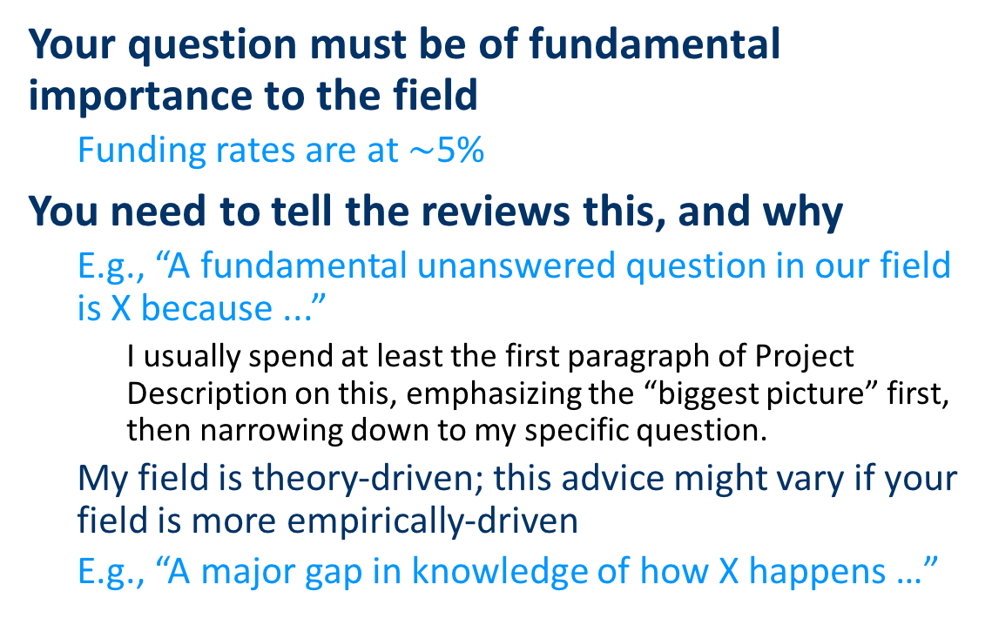
3. Present the best case
Your question must be of fundamental importance to the field
  Funding rates are at $\sim$5%
You need to tell the reviews this, and why
  E.g., “A fundamental unanswered question in our field is X because ...”
    I usually spend at least the first paragraph of Project Description on this, emphasizing the “biggest picture” first, then narrowing down to my specific question.
  My field is theory-driven; this advice might vary if your field is more empirically-driven
  E.g., “A major gap in knowledge of how X happens …”

Slide 12
Your ideas must be novel
New ideas
  A Quote from an NSF Research Program Manager
  “90% of the grant’s likelihood of success is based on how novel your questions are —ideally they are ones that have not been thought of or posed
Or new way forward on problem where field is stuck
  A new model
  A new analytical technique
  A new conceptualization
‪http://sas.rutgers.edu/documents/meetings-schedules-documents-and-minutes/junior-faculty-workshops/432-top-ten-tips-on-how-to-write-a-successful-nsf-proposal/file‪.‬

Slide 13
Grab reviewer’s attention immediately
In the introduction (first page) describe:
  Why is your question one of the most important in your field?
  If it’s so important, why has it not yet been answered?
  Why is your approach/system both novel and highly suitable to addressing this question?
  What specifically are you going to do, and what answers are you likely to produce (Aims/Hypotheses)?
If reviewers are not excited about the project after reading the first page, you’ve probably lost them for good.

Slide 14
Intellectual Merit and Broader Impacts are required and are the criteria for review
“Reviewers asked to evaluate two criteria:
Intellectual Merit: The Intellectual Merit criterion encompasses the potential to advance knowledge
Broader Impacts: The Broader Impacts criterion encompasses the potential to benefit society and contribute to the achievement of specific, desired societal outcomes.

Slide 15
Intellectual Merit and Broader Impacts
Criteria reviewers apply to both components:
To what extent is the project creative, original, or potentially transformative?
Is the plan for carrying out the project well-reasoned, well-organized, and based on a sound rationale?
How well qualified is the individual, team, or organization to conduct the project?
Are there adequate resources available to the PI (either at the home organization or through collaborations) to carry out the proposed activities?

Slide 16
Best practices--Stylistic
Reviewers are over-worked!
Use simple language and simple sentence structure
Use as much organizational structure as possible (Sections, subsections, bolded topic sentences)

Slide 17
Best practices--Scientific
Address your “big question” with a structured set of Aims/experiments (3-4)
  ideally outlined on the first page.
Have good preliminary data
  demonstrates likelihood of success; use CRC mechanism
Avoid Aims that are dependent on other Aims
Don’t be too ambitious-must be feasible
Justify sample sizes, include power analyses for statistical tests
Anticipate potential problems and describe how you will handle them
  Have a special subsection for each Aim
Include carefully selected references on the topic focusing – Synthesize don’t just describe
  Bad if you haven’t cited someone you should have and that person is a reviewer!

Slide 18
Tips and Tricks?

Slide 19
A few “tricks”
Summarize complex arguments or data:
  Use a bolded topic sentence to state what you want reviewers to take away from an entire section. E.g., for Preliminary data subheadings:
  The genetic basis of resistance to E. faecalis infection
  The genetic basis of resistance to E. faecalis infection differs in young and old individuals
  Response to chemical cues in male mosquitofish
  Males avoid chemical cues from other males

Slide 20
A few “tricks”
Structure each section of Proposal using ”tunnel down” model
  Within each section, move from most general to most specific information, E.g., in the Research Approach & Methods section, each Aim is hierarchically organized:
  Aim 1: Use specific, not general title: “Which and how many genes respond to selection on survival of infection?”
    Rationale …
    General Approach …
    Interpretation of alternative outcomes ...
    Experimental details ...
    Data analysis ...
    Potential problems and alternative approaches ...
Use these headings!

Slide 21
A few “tricks”
Summarize complex ideas/procedures with a figure or table

Slide 22
4. Follow the guidelines!

Slide 23
https://www.nsf.gov/pubs/policydocs/pappguide/nsf16001/gpg_index.jsp

Slide 24
Fastlane
Grants.gov
https://www.nsf.gov/pubs/policydocs/pappguide/nsf16001/gpg_index.jsp
https://www.nsf.gov/pubs/policydocs/grantsgovguide0116.pdf

Slide 25
Sections of a Proposal

Slide 26
Adhere to instructions exactly—you will not get a 2nd chance
“It is important that all proposals conform to the instructions provided in the GPG or NSF Grants.gov Application Guide. Conformance is required and will be strictly enforced unless an authorization to deviate from standard proposal preparation requirements has been approved. NSF will not accept or will return without review proposals that are not consistent with these instructions. See GPG Chapter IV.B for additional information.”
https://www.nsf.gov/pubs/policydocs/pappguide/nsf16001/gpg_2.jsp#IIA

Slide 27
Adhere to your Program Solicitation!
Does your program require a Preliminary Proposal?
How are collaborators/ subawards handled?
What components are required?
  Postdoc mentoring plan
  Data management plan
  Special components, e.g., REU, RET?
SPOs will help you, but it’s your responsibility

Slide 28
Look for checklist!
Invited Full Proposal Checklist For Compliance:
Prior to submission, please review your invited full proposal against this checklist to ensure that it is fully compliant with the guidelines provided in this solicitation:
Project Summary (maximum 1 page) includes as separate sections an Overview, the Intellectual Merit, and the Broader Impacts of the proposed activity.
Project Description (maximum 15 pages) includes as separate sections, the Intellectual Merit and Broader Impacts of the proposed research.
Biographical Sketches (maximum 2 pages, each) do not include information about advisors, advisees, and collaborators. Information about advisors, advisees, and collaborators must be provided in a separate single copy document of Collaborators & Other Affiliations,
REU, RET, and RAHSS activities, if planned, are included in the budget request.
The Data Management Plan, and (where applicable) Postdoctoral Mentoring Plan, have been uploaded into Supplementary Documents. Contact a cognizant Program Director if you have questions about these or other Supplementary Documents that you plan to upload.
Letters of Collaboration conform to the provided template and are loaded into Supplementary Documents. Generic letters of support are not allowed.
Collaborators & Other Affiliations Information list(s) has been included as a Single Copy Document.
It is recommended that a list of suggested reviewers be submitted as a Single Copy Document in FastLane, including the individuals' names, institutions, and areas of expertise, email addresses, and URLs if available.
Personnel List Spreadsheet is prepared according to the provided template and emailed to debtemplate@nsf.gov within 3 days of submission.
Ensure that your final submitted PDF conforms to the typeface size limits (10-11 pt depending on font), line spacing maximum (no more than six lines of text per vertical space of one inch) and margins (at least one inch on all sides of page) specified in the GPG. II

Slide 29
5. If your proposal is not funded
Welcome to the club!
Read reviews
Wait a few days
Read the reviews again
Come up with a strategy to address critiques next time
Contact your Program Officer
Discuss your strategy to address critiques with PO
You might learn something that isn’t apparent from reviews

Slide 30
Questions?

Slide 31
Activity

Slide 32
Broader Impacts
a) Integration of Research and Learning
b) Enhancing Diversity
c) Building Infrastructure
d) Dissemination
e) Societal Impact of the Technology or
Science

Slide 33
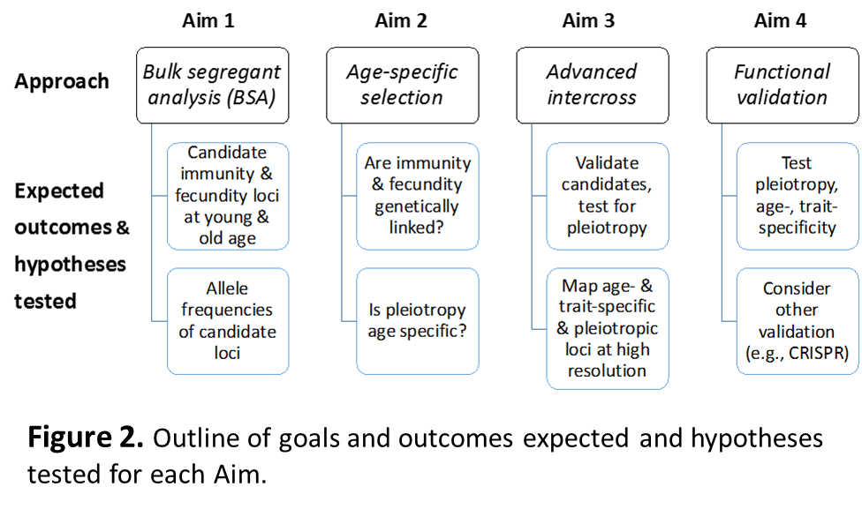
A few “tricks”
Summarize complex ideas/procedures with a figure or table

