Slide 1



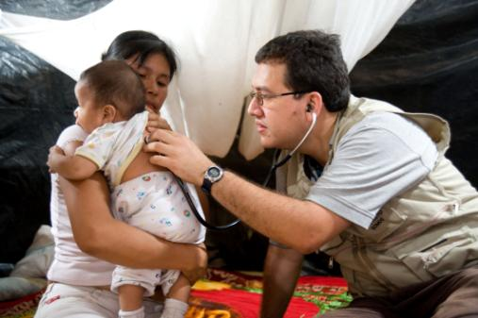
International Researchers: Where to Start
Christine Jessup, PhD
Program Officer
Division of International Training and Research
Presentation at 2016 NIH Regional Seminar
October 27, 2016

Slide 2


Office of the Director
National Institute
on Aging
National Institute
on Alcohol Abuse
and Alcoholism
National Institute
of Allergy and
Infectious Diseases
National Institute
of Arthritis and
Musculoskeletal
and Skin Diseases
National Cancer
Institute
National Institute
of Child Health
and Human
Development
National Institute on
Deafness and Other
Communication
Disorders
National Institute
of Dental and
Craniofacial
Research
National Institute
of Diabetes and
Digestive and
Kidney Diseases
National Institute
on Drug Abuse
National Institute
of Environmental
Health Sciences
National Eye
Institute
National Institute
of General
Medical Sciences
National Heart,
Lung, and Blood
Institute
National Human
Genome Research
Institute
National Institute
of Mental Health
National Institute
of Neurological
Disorders and
Stroke
National Institute
of Nursing Research
National Institute of
Biomedical Imaging
and Bioengineering
National Center
for Complementary
and Integrative
Health
Fogarty
International
Center
National Center
for Advancing
Translational
Science
National Library
of Medicine
National Institute on
Minority Health and
Health Disparities
Science for Global Health
Clinical Center
Center for
Information
Technology
Center for
Scientific Review

Slide 3
NIH Mission
NIH . . . Turning Discovery Into Health®
Seek fundamental knowledge about the nature and behavior of living systems and the application of that knowledge to enhance health, lengthen life, and reduce illness and disability.

Slide 4
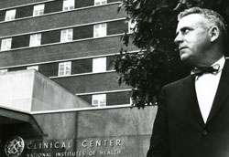
International Research
“Time and again it has been demonstrated that the goal of better health has the capacity to demolish geographic and political boundaries and to enter the hearts and minds of men, women, and children in the four corners of the earth. …And there is widespread belief that the nations of the world can and must share their knowledge and other resources so that people everywhere may have the blessing of better health, and through health, may move forward to new levels of peaceful productivity.”
~ John E. Fogarty, 1958

Slide 5

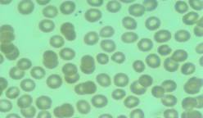



The NIH and International Research
Reasons why NIH supports international research:
  Application presents special opportunities for furthering research programs through the use of unusual talents, resources, populations, or environmental conditions not available in the U.S. or that augment existing U.S. resources.
  Specific relevance to the mission and objectives of the awarding IC and has the potential for significantly advancing the health sciences in the U.S.

Slide 6
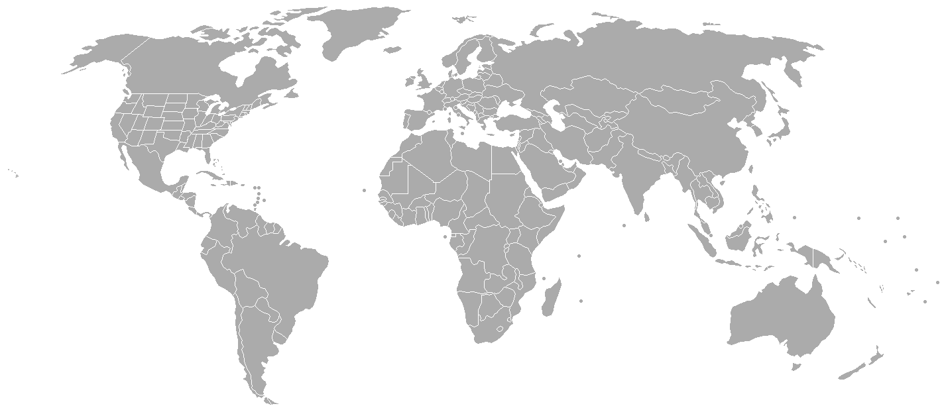
The NIH and Foreign Investments
Over 160
Countries
How NIH invests globally:
  Direct foreign grants
  Domestic grants with foreign components:
    Formal/Direct subawards
    **Indirect investments (Collaborations, No subawards)
In FY 2015, the NIH awarded 526 direct foreign grants and 6128 domestic grants with foreign components.
In FY 2016, the NIH awarded 549 direct foreign grants and 6303 domestic grants with foreign components.

Slide 7
Definition of Foreign Component
The performance of any significant scientific element or segment of a project outside of the United States, either by the grantee or by a researcher employed by a foreign organization, whether or not grant funds are expended.
Activities that would meet this definition include, but are not limited to:
The involvement of human subjects or animals
Extensive foreign travel by grantee project staff for the purpose of data collection, surveying, sampling, and similar activities
Any activity of the grantee that may have an impact on U.S. foreign policy through involvement in the affairs or environment of a foreign country
Examples of other grant-related activities that may be foreign components are:
Collaborations with investigators at a foreign site anticipated to result in co-authorship
User of facilities or instrumentation at a foreign site
Receipt of financial support or resources from a foreign entity
Foreign travel for consultation is not considered a foreign component.

Slide 8
Session Objectives
Upon completion of this session, attendees will gain knowledge of:
NIH extramural funding opportunities available to international investigators;
How to determine eligibility for NIH funding opportunities;
Policies and procedures unique to foreign awards; and
Resources available to international investigators.

Slide 9
Agenda
Pre-Award issues for international investigators
Post-Award issues for international investigators
Funding opportunities for international investigators

Slide 10
NIH Application Process
Find funding opportunity, download the instructions and READ CAREFULLY
            Prepare the application
            (a lot of team work!)
Submit to Grants.gov:
1. Check submission status in eRA Commons
2. Review the application image for errors.
        Mission Complete!
&
Make sure required registrations are in place (DUNS, SAM, NCAGE, eRA Commons, Grants.gov)

Slide 11
Funding Opportunity Announcements (FOAs)
NIH advertises availability of grant support through Funding Opportunity Announcements (FOAs)
Search for FOAs at: Grants.gov/FIND and in the NIH Guide for Grants and Contracts.
Submit applications in response to a specific FOA
Use link in FOA to access specific application forms required
Read the FOA carefully and read the Form Instructions carefully (be sure to follow any Notices that have been issued in the NIH Guide)
Make sure relevant NIH Institute or Center is listed as participating organization
Check eligibility carefully! (Section III in FOA)
      whether Foreign Institutions are eligible to apply
      whether collaboration with Foreign Components are allowed
  See annotated FOA at: https://grants.nih.gov/grants/Annotated_FOA.pdf

Slide 12
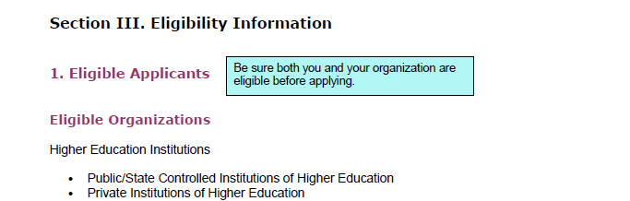
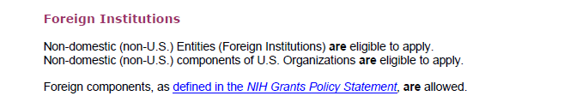
FOA: Eligibility
  See annotated FOA at: https://grants.nih.gov/grants/Annotated_FOA.pdf

Slide 13
FOA: Eligibility
  Principal Investigator (PI/PD)
    Education requirements
    Citizenship requirements
    Qualifications/expertise
  Applicant Organization
    E.g., non-profit status
    Ability to handle federal dollars
    Capacity to conduct research

Slide 14
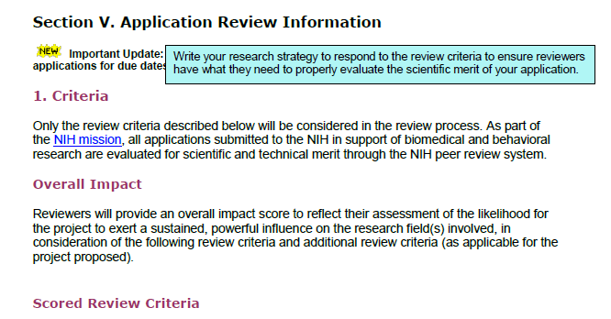
FOA: Review Criteria
Each FOA specifies all of the review criteria and considerations that will be used in the evaluation of applications submitted for that FOA.
Read these carefully!
Your application should respond to the review criteria listed in the FOA
  See annotated FOA at: https://grants.nih.gov/grants/Annotated_FOA.pdf

Slide 15
NIH Application Process
Find funding opportunity, download the instructions and READ CAREFULLY
            Prepare the application
            (a lot of team work!)
Submit to Grants.gov:
1. Check submission status in eRA Commons
2. Review the application image for errors.
        Mission Complete!
&
Make sure required registrations are in place (DUNS, SAM, NCAGE, eRA Commons, Grants.gov)

Slide 16
Who: Grant Proposal Team
Investigators (US and/or foreign responsible for the program plan/research)
Program managers (US and/or foreign responsible for logistics, supplemental proposal components)
Finance managers (responsible for mechanisms for moving project funds to the site)
Sponsored Programs Office (responsible for budget review and uploading application into Grants.gov)

Slide 17
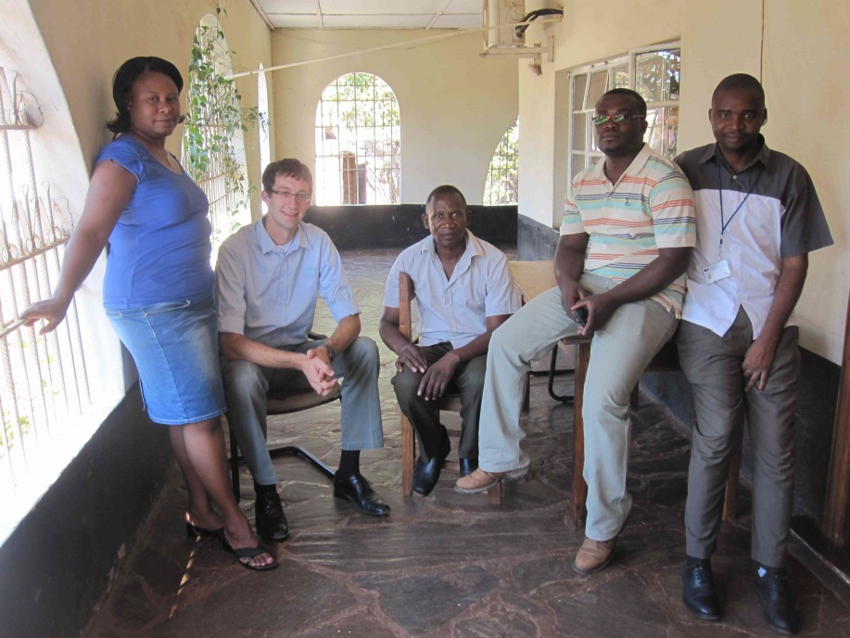
Who: Information from Foreign Investigators
NIH Biosketch
NIH Other Support
Foreign site salary base
& FTE
START EARLY with
good communication, inclusion, feedback.

Slide 18


What:
Proposal Stage Considerations
Foreign performance site information - NIH approved
Resources Section – description of facilities and infrastructure
Foreign institution’s organizational chart
Local FWA and OLAW/IACUC in place

Slide 19
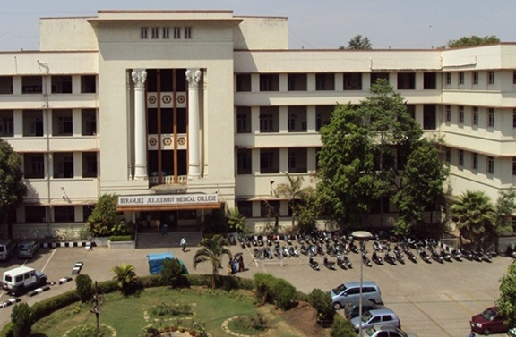
Where: Support from a Foreign Institution
Letters of support (subcontract dollar amounts)
MOU or collaborative agreement (commitment from Gov orgs: MOH; non-Gov orgs: NGOs; academic institutions: deans, local grants management office leaders, co-PIs)
Community advisory board
Good communication,
inclusion, feedback

Slide 20

Budget considerations
Foreign site salary norms
Procurement and availability of research supplies
Currency exchange rates
F&A = 8% for foreign institutions (parent or subcontracts)
Housing, transport, visas, immunization, travel insurance
Face-to-face team meetings
Costs associated with IRB review of human research protocols, or IACUC review of animal research protocols
If subawards are involved, prime grantee is responsible for subawardee compliance and for safeguarding U.S. funds

Slide 21
NIH Application Process
Find funding opportunity, download the instructions and READ CAREFULLY
            Prepare the application
            (a lot of team work!)
Submit to Grants.gov:
1. Check submission status in eRA Commons
2. Review the application image for errors.
        Mission Complete!
&
Make sure required registrations are in place (DUNS, SAM, NCAGE, eRA Commons, Grants.gov)

Slide 22
Registration Requirements
GET REGISTERED!
Start early: Registration is a multistep process that can take 8 weeks or more!
All registrations must be complete in order to submit application
Applicant Organizations
Dun and Bradstreet Universal Numbering System (DUNS) number
System for Award Management (SAM) active registration (requires annual renewal)
Foreign organizations must obtain an NCAGE in order to register in SAM.
eRA Commons - Applicants must have an active DUNS number and SAM registration in order to complete the eRA Commons registration.
Grants.gov – Applicants must have an active DUNS number and SAM registration in order to complete the Grants.gov registration.
PI and Signing Official (SO) need separate accounts in eRA Commons because each has different privileges.

Slide 23
Registration Requirements
GET REGISTERED!
Start early: Registration is a multistep process that can take 8 weeks or more!
All registrations must be complete in order to submit application
Program Directors/Principal Investigators (PD(s)/PI(s))
eRA Commons account (can take up to 2 weeks)
NEW! For Career Development Award (K) applications, primary mentors must have eRA Commons account (NOT-OD-16-082)

Slide 24
Registration Resources
Registering with Grants.gov
http://www.grants.gov/web/grants/applicants/organization-registration.html
http://grants.nih.gov/grants/ElectronicReceipt/preparing_grantsgov_reg.htm
Resources for International Applicants
Tips for International Applicants http://grants.nih.gov/grants/ElectronicReceipt/files/Tips_for_International_Applicants.pdf
Support Contacts for International Applicants http://grants.nih.gov/grants/ElectronicReceipt/files/international_support.pdf
Questions and Answers for International Applicants http://grants.nih.gov/grants/ElectronicReceipt/files/international_qa.pdf
Guidance for International Applicants Blocked from Registration Websites NOT-OD-11-090.
An NIH supported webinar on Electronic Submission of Grant Applications for Foreign Institutions can be found at http://grants.nih.gov/grants/webinar_docs/webinar_20120927.htm
FAQs Foreign Organizations http://grants.nih.gov/grants/electronicreceipt/faq_full.htm#special

Slide 25
NIH Application Process
Find funding opportunity, download the instructions and READ CAREFULLY
            Prepare the application
            (a lot of team work!)
Submit to Grants.gov:
1. Check submission status in eRA Commons
2. Review the application image for errors.
        Mission Complete!
&
Make sure required registrations are in place (DUNS, SAM, NCAGE, eRA Commons, Grants.gov)

Slide 26
Electronic Submission: How it Works
Applying for Grants at Grants.gov:
Step 1: Search for and identify a grant opportunity in the NIH Guide for Grants and Contracts or on Grants.gov.
Step 2: Download the grant application package.
Step 3: Complete the application. Be sure to save a copy of the application locally on your computer.
Step 4: The Authorized Organizational Representative (AOR) submits the application to Grants.gov either directly or through a Service Provider. All required registrations must be completed prior to submission.
Step 5: Grants.gov performs basic form validation and virus check on submitted application.

Slide 27
Electronic Submission: How it Works
Step 6: Track the status of the submitted application package at Grants.gov until you are notified via email that NIH has received it.
Step 7: eRA software performs NIH business rule validation on submitted application.
Step 8: NIH notifies Authorized Organization Representative (AOR)/Signing Official (SO) and the Principal Investigator (PI) by email to check the eRA Commons for results of NIH validations check.
Step 9: AOR/SO and PI find out if the grant application passed or failed the rule check. If it failed: all errors must be corrected and the entire corrected application must be submitted to Grants.gov.

Slide 28
Electronic Submission: How it Works
Step 10: AOR/SO and PI will have two weekdays after application assembly to review the application in the eRA Commons.
Step 11: The AOR has the authority to “Reject” the assembled application if it does not correctly reflect the submission, due to a Grants.gov or eRA Commons system issue (e.g., garbled or missing parts) or to address warnings.
PIs must work through the AOR/SO to “Reject” the application.
If no rejection occurs within 2 weekdays of application availability in eRA Commons, the submission process is complete and the application automatically moves forward to Receipt and Referral.
Step 12: Applicants can track the progress of their application in eRA Commons.
Applications are accepted by Grants.gov by 5:00pm local time of the applicant organization on the submission date.
Only the AOR is allowed to submit.

Slide 29
NIH Application Process
Find funding opportunity, download the instructions and READ CAREFULLY
            Prepare the application
            (a lot of team work!)
Submit to Grants.gov:
1. Check submission status in eRA Commons
2. Review the application image for errors.
        Mission Complete!
&
Make sure required registrations are in place (DUNS, SAM, NCAGE, eRA Commons, Grants.gov)

Slide 30

Peer Review
The peer review of applications from foreign institutions is the same as that for applications from U.S. institutions
In addition, the following are assessed as part of the review process and award decisions for applications from foreign institutions:
  Application presents special opportunities for furthering research programs through the use of unusual talents, resources, populations, or environmental conditions not available in the U.S. or that augment existing U.S. resources.
  Specific relevance to the mission and objectives of the awarding IC and has the potential for significantly advancing the health sciences in the U.S.

Slide 31





Peer Review
First Level of Review
Scientific Review Group
(Study Section)
  Second Level of Review
  NIH Institute/Center Council
NIH Center for Scientific Review
http://www.csr.nih.gov

Slide 32
Just-in-Time Documentation (JIT)
  Additional Clarification or documentation as needed, as each application is unique.
  Updated Other Support
  Federal-Wide Assurance (FWA)
  Updated Human Subjects’ Institutional Review Board (IRB) Approval-it is renewed annually
  Human Subjects’ Training Education Certification - completed by anyone involved in the design or conduct of NIH-funded HS research.
  Animal Assurance Number
  Updated Institutional Animal Care and Use Committee (IACUC) approval date–good for 3 yrs.

Slide 33
Who at NIH Can Answer Your Questions?
Before You Submit Your Application
A Program Officer at an NIH Institute or Center
Scientific Review Officer
After You Submit
Your Scientific Review Officer
After Your Review
Your Assigned Program Officer

Slide 34
Agenda
Pre-Award issues for international investigators
Post-Award issues for international investigators
Funding Opportunities for international investigators

Slide 35

Getting Started
Set up team communication
  Regular Skype calls
  Regular team face-to-face meetings
Define roles and responsibilities
  Procedures for directing and monitoring activities
  Procedures for payment and approval of expenditures
  Policies to be followed, such as travel reimbursement and salaries and fringe benefits

Slide 36
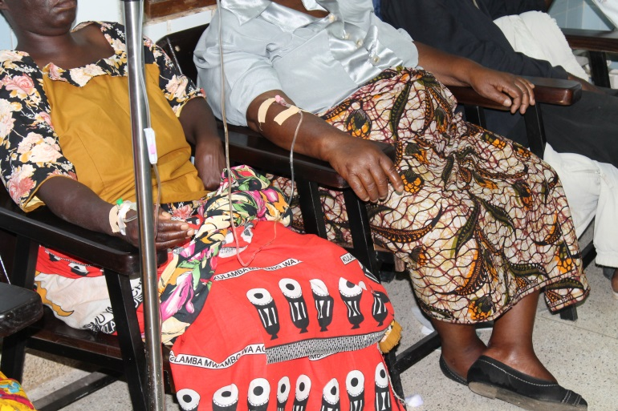
Human subjects/Vertebrate animals
Prime grantees are responsible for subaward compliance
Human subjects
  Foreign sites must have a Federal
  Wide Assurance.
  Foreign sites must have IRB approval
  annually.
  Foreign sites are subject to the education
  requirements.
Animal subjects
  Foreign sites must have an Animal Welfare Assurance.
  Foreign sites are not required to have IACUC approval.
  Foreign sites are encouraged to follow same standards.

Slide 37
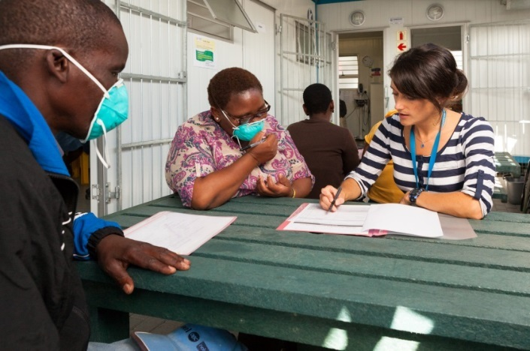
Human subjects/Vertebrate animals
REQUIRED:
1 local/in-country IRB: National Health Sciences Research Committee in Lilongwe, Malawi
1 U.S. Based IRB: UNC-CH IRB in Chapel Hill
Simultaneous submission process:
Start with sub-award site first: learn the local IRB meeting schedule; expect months of waiting, months b/w submission, feedback and approval. Find a connection on the board in country, if possible.
Primary institution second
Funds for human subjects/
IACUC related activities are
restricted until IRB approval

Slide 38
Project Implementation
Project tracking – expenditures
Compliance issues:
  ethics certifications
  IRB approval letters
  conflicts of interest
Sub-awardee reporting
Document, document, document!

Slide 39
Notice of Award (NoA)
Projects are programmatically approved for entire project period
Projects are funded in 12-month increments (budget periods)
Notice of Award
  Approved project period and budget period dates
  Amount of funds authorized
  Anticipated future-year commitments
  Applicable terms and conditions
  Any restriction on the use of funds
Read your NoA carefully! Especially any restrictions

Slide 40

Progress Reporting
Research Performance Progress Report (RPPR)
Describe progress, study results, the significance of the findings, and any significant changes
Provide additional information to NIH upon request
Each report should be a self-contained document
The RPPR is REQUIRED for all non-competing progress reports submitted on or after October 17, 2014 (NOT-OD-14-092)
  New information to be provided by grantees with the RPPR includes:
  Foreign component information
  Dollars spent in foreign country(ies) [via first-tier subawards]
  Organizational affiliation of personnel at foreign sites
NIH OER RPPR webpage: http://grants.nih.gov/grants/rppr/
FIC guidance: http://www.fic.nih.gov/Grants/Pages/progress-reports.aspx

Slide 41
Progress Reporting
Research Performance Progress Report (RPPR)
What slows down the award process?
  Lack of, or slow, response to inquiries
  Delays sending essential information (IRB, IACUC approvals, other support, etc.)
  Information sent without identification (e.g., grant number)
  Lack of institutional signatures/concurrence
  Budgets with inadequate justification
  Other Support for an individual that adds up to more than 100% or more than 12 person months per year
  Missing information for key personnel
  Calculations of F&A that do not make sense
  Lack of population data for clinical grants

Slide 42
Post-Award
Administrative Requirements
In general, the NIH grantees are allowed a certain degree of latitude to rebudget within and between budget categories to meet unanticipated needs and to make other types of post-award changes.
  Some changes may be made at grantee’s discretion.
  Some changes require NIH prior written approval.
Degrees of discretion permitted vary by type of grant, grantee, and coverage by special initiative.

Slide 43
Post-Award
Administrative Requirements
Actions likely to be considered a change in scope include, but are not limited to:
  Change in the specific aims
  Change in research from one disease area to another
  Change from the approved use of research subjects
  Substitution of one animal model for another
  A clinical hold by the FDA
  Application of a new technology
  Transferring the performance of substantive programmatic work to a new foreign component
  Change in key personnel
  Significant rebudgeting, whether or not the particular expenditure(s) require prior approval

Slide 44
Post-Award
Administrative Requirements
Process to Request Prior Approval
Prepare a letter from the PI and signed by the institutional business official.
  Include:
    Reason for the change
    Impact on the project activities
    Impact on the project timing
    Impact on the budget
    Supporting documentation
    Biosketches and other support if applicable
Send letter to the Grants and Program staff at NIH.
  Enact change only if written approval is received from the NIH

Slide 45
Post-Award
Administrative Requirements
Managing subawards
  Agreement must be in writing and periodically updated.
  Communication channels must be clear and consistent.
  Prime grantee is responsible for subawardee compliance and for safeguarding U.S. funds.
  Arrangements must be consistent with your institutional policy and procedures.

Slide 46
Final Progress Reports
Closeout of an award is the process by which NIH determines that all applicable administrative actions and all required work of an award have been completed by the grantee and NIH.
Grantees must submit the following closeout reports:
Final Federal Financial Report (except for Fellowships)
Final Progress Report (except for Fellowships for which the Termination Notice will continue to serve as the Final Progress Report)
Final Invention Statement and Certification (except for Training grants, Fellowships, and certain other programs—e.g., activity codes C06, R13, R25, S10)
All applicable closeout reports are due no later than 120 days after the project end date.
Failure to submit timely and accurate final reports may affect future funding to the organization and/or awards with the same PD/PI.

Slide 47
Resources
eRA Commons: https://commons.era.nih.gov/commons/
Electronic Research Administration: http://era.nih.gov/
Applying Electronically: http://grants.nih.gov/grants/ElectronicReceipt/
FAQs for Foreign Organizations: http://grants.nih.gov/grants/electronicreceipt/faq_full.htm#special
NIH About Grants: http://grants.nih.gov/grants/oer.htm
NIH Guide to Grants and Contracts: https://grants.nih.gov/funding/index.htm
SF424 (R&R) Application Instructions: https://grants.nih.gov/grants/how-to-apply-application-guide.htm
NIH Grants Policy Statement: http://grants.nih.gov/policy/nihgps/index.htm
Research Portfolio Online Reporting Tools (RePORT): https://report.nih.gov/

Slide 48
Agenda
Pre-Award issues for international investigators
Post-Award issues for international investigators
Funding Opportunities for international investigators

Slide 49


Slide 50
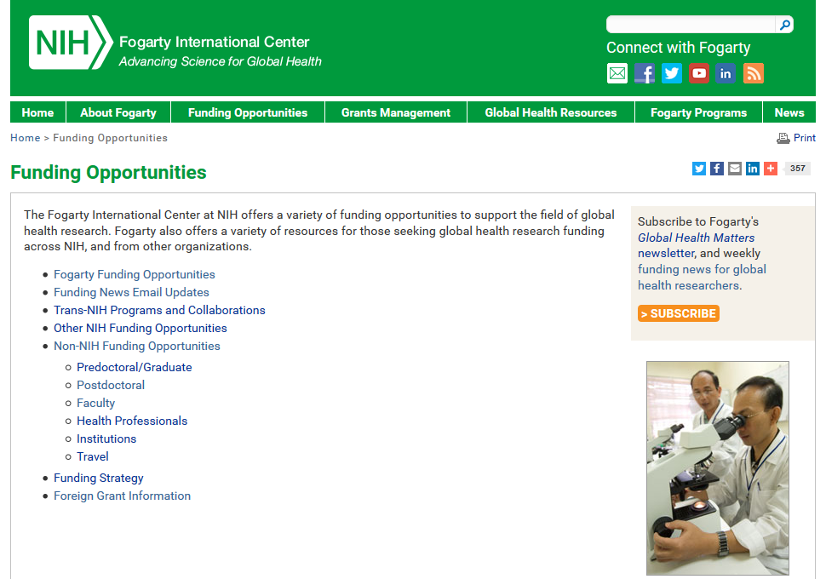
Global Health Funding Opportunities https://www.fic.nih.gov/Funding/Pages/default.aspx

Slide 51
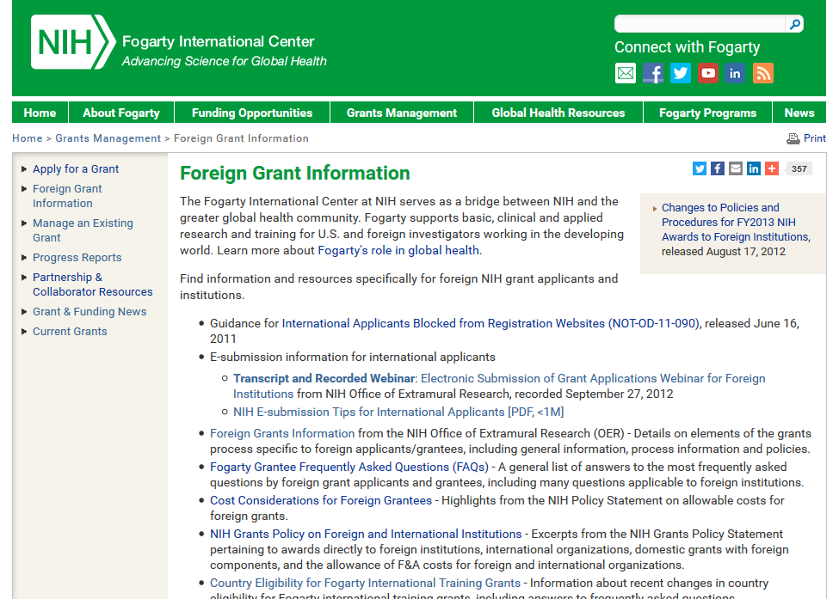
Foreign Grant Information https://www.fic.nih.gov/Grants/Pages/Foreign.aspx

Slide 52

Building a robust global health workforce
Research Training D43
IRSDA K01
Training & Career Awards
Global Health Fellows and Scholars
Emerging Global Leader K43
Pre-Bac
Graduate/ Medical Student
Postdoc
Career
Research Awards
R03
R01
R21
Developing leaders in the field requires:
well-trained individuals
protected time to conduct research in LMICs
strong mentorship from U.S. investigators with experience working in LMIC settings AND from LMIC investigators

Slide 53
Fogarty Career Development Programs
Fogarty offers two mentored global health research career development programs
Since 1999 – K01 for U.S. investigators
International Research Scientist Development Award (IRSDA; K01; PAR-17-002)
New program – K43 for Low- and Middle-Income Country (LMIC) investigators
Emerging Global Leader Award (K43; PAR-17-001)
K01
K43
NEW!

Slide 54
Fogarty Programs
Research | Research Environment
Brain Disorders in the Developing World: Research Across the Lifespan (Non-AIDS & AIDS) International Cooperative Biodiversity Groups (ICBG) Ecology and Evolution of Infectious Diseases Initiative (EEID) Chronic, Non-Communicable Diseases Global Environmental and Occupational Health (GEOHealth) | International Research Ethics Education and Curriculum Development (BIOETHICS) Global Health eCapacity HIV Research Infrastructure for LMICs
Research Training | Fellowships
Global Infectious Disease Research Training (GID) HIV Research Training Chronic, Non-Communicable Diseases | Global Health Program for Fellows and Scholars International Research Scientist Development Award (IRSDA) Emerging Global Leader Award
Fogarty Funding Opportunities - Dates and Deadlines
http://www.fic.nih.gov/Funding/Pages/Fogarty-Funding-Opps.aspx

Slide 55
Questions?

