Slide 1
Research integrity at the nih
october 27, 2016
NIH Regional Seminar - Chicago

Slide 2
Overview
What is research misconduct?
Steps after an allegation is received
Steps after a finding of research misconduct
Grantee responsibilities
2

Slide 3
HHS ORI oversees allegations of RM involving PHS-funded activities
Public Health Service includes these OpDivs:
NIH, CDC, FDA, HRSA, IHS, SAMHSA

Slide 4
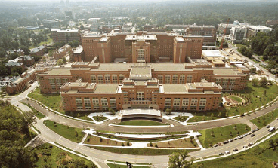
National Institutes of HealtH
Agency Research Integrity Liaison Officer
Agency Extramural RIO
Agency Intramural RIO
Extramural RIOs
26 Extramural IC RIOs

Slide 5
Overview
What is research misconduct?
Steps after an allegation is received
Steps after a finding of research misconduct
Grantee responsibilities
2

Slide 6
What constitutes research misconduct?
42 CFR §93.103
Fabrication
Falsification
Plagiarism
- In proposing, performing or reviewing research or in reporting research results
d. does not include honest error or differences of opinion.

Slide 7
Fabrication is making up data or results and recording or reporting them.

Slide 8
Falsification is manipulating research materials, equipment, or processes, or changing or omitting data or results such that the research is not accurately represented in the research record.

Slide 9
Plagiarism is the appropriation of another person’s ideas, processes, results, or words without giving appropriate credit.

Slide 10
Ori policy on plagiarism
Excludes:
The limited use of identical or nearly-identical (general) phrases
not substantially misleading or of great significance.
Disputes among collaborators (present or former)
issues of IP rights – ‘authorship disputes’
http://ori.hhs.gov/ori-policy-plagiarism

Slide 11
Overview
What is research misconduct?
Steps after an allegation is received
Steps after a finding of research misconduct
Grantee responsibilities
2

Slide 12
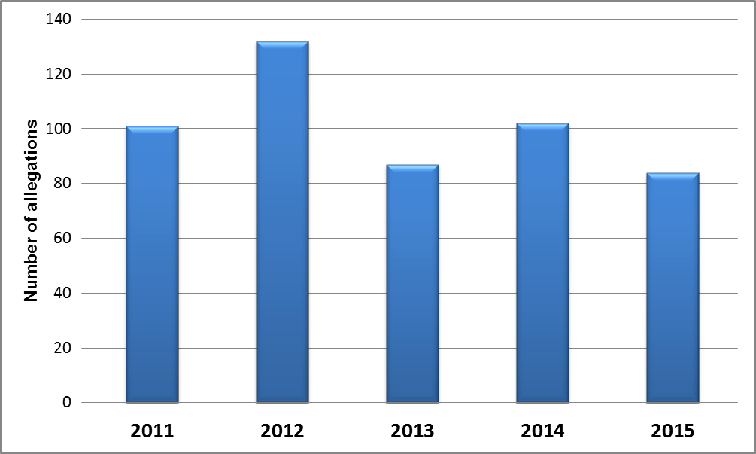
Research misconduct Allegations (OER-RI)

Slide 13
Handling Allegations – NIH Extramural
Allegation
NIH OER-RI
Resolution
Other?
RM?
Resolution
OHRP
OPERA
OMA
OLAW
ORI
Notes:
IC RIO sends allegation to OER-RI
NIH OER-Research Integrity does an initial review of allegation
Refers all allegations of RM to ORI
NIH Office of Policy for Extramural Research Administration (OPERA) – grants management policy and compliance
NIH Office of Management Assessment (OMA) – fraud, waste & abuse investigations
NIH Office of Laboratory Animal Welfare (OLAW)
Other Federal Agencies: OHRP, FDA

Slide 14
Who investigates?
Investigations are carried out by the university or institution
HHS ORI provides oversight for the investigation

Slide 15
Three steps
1. Assessment
2. Inquiry
3. Investigation
Notes:
Assessment
Carried out by the institution or HHS ORI
Occurs immediately after an allegation is received
Institute RIO or HHS ORI determines whether an inquiry is warranted
Inquiry
Carried out by the institution’s RIO
Inquiry Committee formed
Involves sequestration or research records (most crucial step; confidentiality important)
Institution must report to HHS ORI on the decision to investigate
(must initiate investigation in 30 days)
Investigation
Carried out by the institution
Must begin no more than 30 days after inquiry decision to investigate
Investigation Committee is formed
Respondent can comment on report
Institution reports findings and actions to HHS ORI
HHS ORI may or may not concur with an institutional finding of misconduct
Institutions may have different definitions of research misconduct

Slide 16
Requirements for ORI to makE a finding
Significant departure from accepted practices;
Committed intentionally, knowingly, or recklessly;
Proven by a preponderance of evidence
Plus, additional considerations
Notes:
Burden of proof
Preponderance of evidence – not beyond a reasonable doubt (criminal)
Must be able to identify individual responsible.

Slide 17
Overview
What is research misconduct?
Steps after an allegation is received
Steps after a finding of research misconduct
Grantee responsibilities
2

Slide 18
NIH eRA links to PHS Administrative Action Bulletin Board

Slide 19
NIH’s Role in Enforcing PHS Actions
PHS Administrative Actions
NIH’s Role in Implementation
Requirement for supervision
Certification from institution
Prohibition from participating in advisory role
Debarment
Retraction
Ensure conditions are met before releasing funds
Not select as peer reviewers
or council members
Decline applications for funding/making awards
Announce ORI finding in PubMed
Notes:
Findings of Research Misconduct published in the Federal Register and in the NIH Guide
Respondent may enter into a Voluntary Exclusion or Settlement Agreement that could involve:
Requirement for direct supervision
Requirement for employer to certify the integrity of respondent’s data for future submissions
Exclusion from serving in an advisory capacity to the PHS (includes review committees)
Debarment (ineligible to received government funding)
Request retraction of publications – Announce finding in PubMed

Slide 20
Announce in PubMed

Slide 21
Notice in the NIH Guide
Notes:
Notice and note is never removed

Slide 22
Overview
What is research misconduct?
Steps after an allegation is received
Steps after a finding of research misconduct
Grantee responsibilities
2

Slide 23
Grantee Responsibilities
Hold active assurance of compliance with ORI
Submit annual report to ORI – January each year
Provision for ‘Small Institutions’: 1-10 employees – “Small Organization Statement”
Small Institutions must IMMEDIATELY report all allegations of research misconduct involving PHS support to ORI
Notes:
Requires institution must report to the ORI all allegations of research misconduct involving PHS support IMMEDIATELY upon learning of such allegations or evidence of possible misconduct
Office of Research Integrity
Small Organization Statement for Handling Allegations of Research Misconduct
Involving Public Health Services Research and Related Activities
[institution] has incorporated into its policies and procedures the following approach for handling and reporting possible research misconduct and agrees to comply with other provisions of 42 C.F.R. Part 93:
1. Upon becoming aware of an allegation or other evidence of possible research misconduct, the designated misconduct policy and procedures official of [institution] will immediately contact the Office of Research Integrity (ORI) at (240) 453-8400, and [institution] will submit an annual report to ORI.
2. [institution] will work with ORI or other appropriate offices of the Department of Health and Human Services (HHS) to develop and implement a process consistent with the regulation at 42 C.F.R. Part 93 to fully explore the allegation or evidence of misconduct involving PHS support research or research activities. This may entail ORI/HHS taking primary responsibility for conducting the inquiry and/or investigation.
3. [institution] will cooperate fully with the ORI/HHS in conducting its oversight and review of possible research misconduct involving PHS supported research or research activities.
4. [institution] will inform its employees of their option to report any allegation or evidence of research misconduct directly to ORI rather than to [institution’s] designated misconduct policies and procedures official.
5. [institution] has _____ employees, ____ of whom are involved in PHS research or research activities as defined in 42 C.F.R. Part 93.
Name of Institution:
E-mail Address:
Mailing Address:
Phone:
Fax:
Institutional Official’s Name:
Institutional Official’s Title:
Institutional Official’s Signature:
Date Signed:

Slide 24
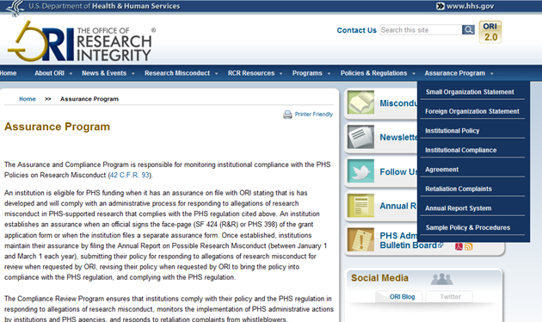
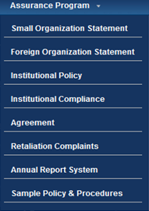
ORI Website: www.ori.hhs.gov/
Notes:
This consists of an image of the ORI website.
The magnified image to the right is an image of the pull down box under Assurance Program and shows numerous selections. A top arrow points to “Assurance Program” and a bottom arrow points to “Annual Report System”.

Slide 25
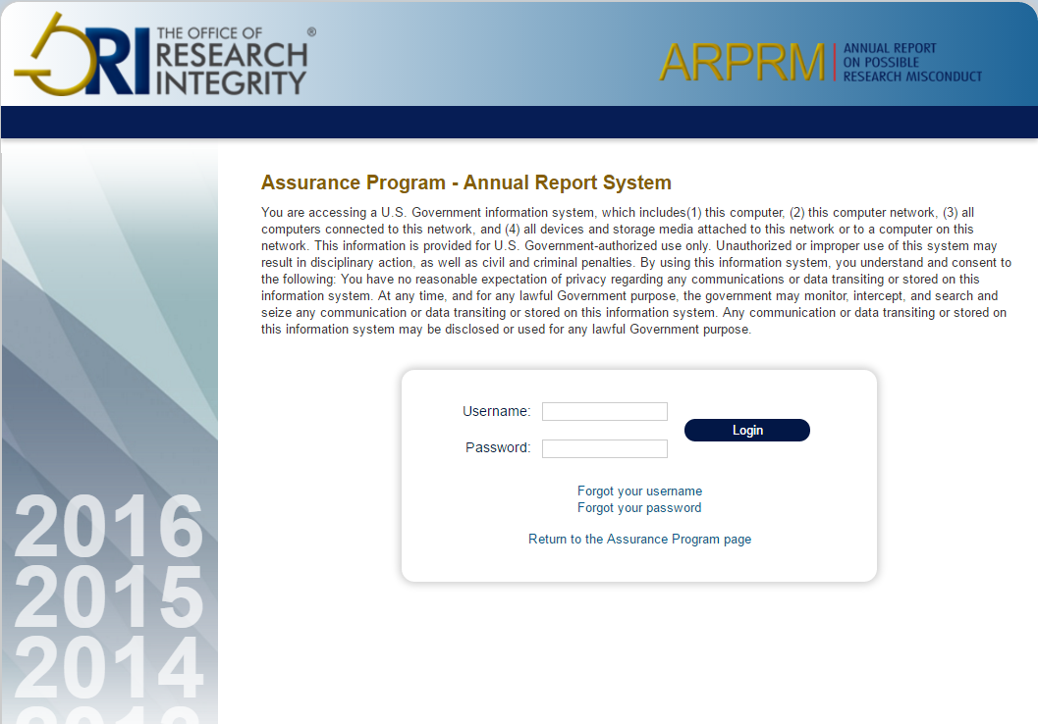
Annual Report System
Notes:
This slide captures the image of the Annual Report System selected from the ORI website.
The institution’s Assurance record is maintained with the following:1) Accurate contact information of the signing official; 2) The current year’s Annual Report on Possible Research Misconduct (Form PHS-6349). The electronic submission date starts each year on January 1 and the deadline is March 1; 3) Policy and Procedures for Responding to Allegations of Research Misconduct.

Slide 26
Grantee Responsibilities
Institutions must comply with requirements:
Have written policies & procedures for addressing allegations of research misconduct, and make this known to their staff
Appropriately respond to allegations
Foster environment promoting research integrity
Ensure confidentiality and protect whistle-blower
Cooperate with and make reports to ORI
Assist w/ enforcing HHS admin actions
Notes:
Public Health Service (PHS) Policies on Research Misconduct 42 CFR 93 apply to all NIH grantees!

Slide 27
Instruction in the
Responsible Conduct of Research
NOT-OD-10-019
Institutional training grants
Individual fellowships
Career development awards
Dissertation awards
Research education grants
Requirements:
At least 8 contact hours
Minimum of once every four years,
Need training at each career stage (T, F, K)
Notes:
NIH requires that all trainees, fellows, participants, and scholars receiving support through any NIH training, career development award (individual or institutional), research education grant, and dissertation research grant must receive instruction in responsible conduct of research.
Image courtesy of NIH NIAD

Slide 28
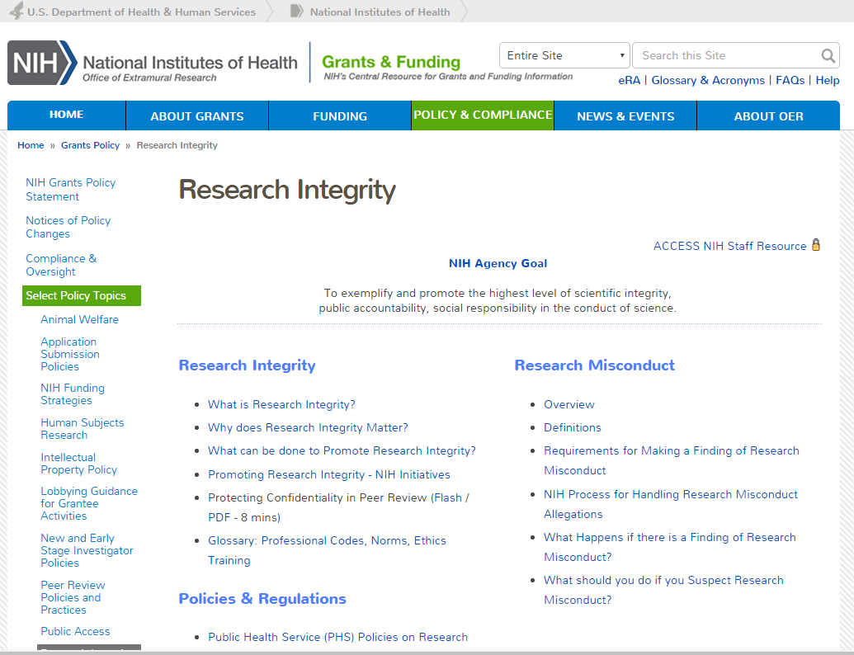
https://grants.nih.gov/policy/research_integrity/

