Slide 1

Takin’ Care of Business: SBIR/STTR Strategies for Success
NIH Regional Seminar
Chicago, Illinois
October 26-28, 2016
Robert Vinson
SBIR/STTR Program Manager
Office of Extramural Research, NIH

Slide 2
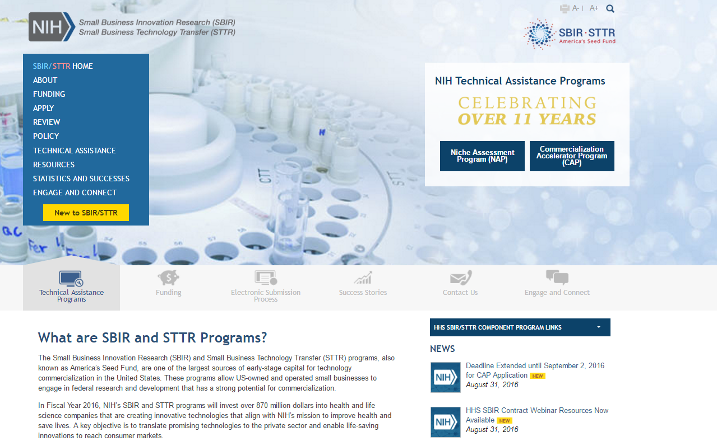
NIH SBIR/STTR Website
https://sbir.nih.gov

Slide 3
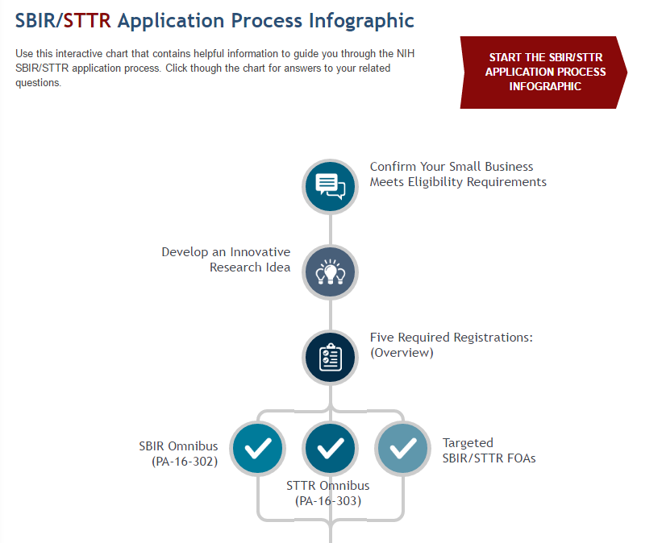
New to SBIR/STTR?
http://sbir.nih.gov/infographic

Slide 4
Congressionally Mandated Programs
SET ASIDE
SMALL BUSINESS INNOVATION
RESEARCH (SBIR) PROGRAM
Set-aside program for small business concerns to engage in federal R&D -- with potential for commercialization
SMALL BUSINESS TECHNOLOGY
TRANSFER (STTR) PROGRAM
Set-aside program to facilitate cooperative R&D between small business concerns and US
research institutions -- with potential for commercialization
3.0%
3.2%
(FY16)
(FY17)
.45%
.45%
(FY16)
(FY17)

Slide 5

SBIR/STTR Budgets by Agency
Agencies with SBIR and STTR Programs | Budget
Department of Defense (DOD) | $1.070B
Department of Health and Human Services (HHS), including the National Institutes of Health (NIH)* | $797.0M
Department of Energy (DOE), including Advanced Research Projects Agency – Energy (ARPA-E) | $206.1M
National Aeronautics and Space Administration (NASA) | $180.1M
National Science Foundation (NSF) | $176.0M
Agencies with SBIR Programs | Budget
U.S. Department of Agriculture (USDA) | $25.3M
Department of Homeland Security (DHS): Science and Technology Directorate (S&T) and Domestic Nuclear Detection Office (DNDO) | $17.7M
Department of Commerce: National Oceanic and Atmospheric Administration (NOAA) and National Institute of Standards and Technology (NIST)* | $8.4M
Department of Transportation (DOT) | $7.9M
Department of Education (ED) | $7.5M
Environmental Protection Agency (EPA) | $4.2M
~ $2.5B in FY2015
across all agencies
Grants
Contracts

Slide 6
Program Eligibility Criteria
Organized as for-profit US business
Small: 500 or fewer employees, including affiliates
Work must be done in the US (with few exceptions)
Individual Ownership:
Greater than 50% US-owned by individuals and independently operated OR
Greater than 50% owned and controlled by other business concern/s that is/are greater than 50% owned and controlled by one or more individuals OR
Be a concern which is more than 50% owned by multiple venture capital operating companies, hedge funds, private equity firms, or any combination of these (For FOAs after 1/28/2013 NIH; 7/10/14 CDC)
Determined at Time of Award

Slide 7



NIH SBIR/STTR
3-Phase Program
Phase I Feasibility Study
Budget Guide: $150K for SBIR and STTR
Project Period: 6 months (SBIR); 1 year (STTR)
Phase
I
Discovery
Phase II Full Research/R&D
$1M for SBIR and STTR, over two years
Phase
II
Development
Phase IIB Competing Renewal/R&D
Clinical R&D; Complex Instrumentation/to FDA
Many, but not all, IC’s participate
Varies~$1M per year; up to 3 years
Phase
IIB
Phase III Commercialization
NIH, generally, not the “customer”
Consider partnering and exit strategy early
Phase
III
Commercialization

Slide 8
SBIR and STTR Critical Differences
 | SBIR | STTR
Partnering Requirement | Permits partnering | Requires a non-profit research institution partner (e.g. university)
Work Requirement | Guidelines: May outsource 33% (Phase I) 50% (Phase II) | Minimum Work Requirements: 40% small business 30% research institution partner
Principal Investigator | Primary employment (>50%) must be with the small business | PI may be employed by either the research institution partner or small business
Award is always made to the small business

Slide 9
HHS Program Funding
2016 Budget | SBIR | STTR
NIH | $763M | $114M
CDC | $9.0M | N/A
ACL (NIDILRR) | $2.7M | N/A
FDA | $1.6M | N/A
ACF | $93.5K | N/A

Slide 10
National Institutes of Health
Office of Research
Infrastructure Programs
Office of the Director
http://www.nih.gov/icd
National Institute
on Aging
National Institute
on Alcohol Abuse
and Alcoholism
National Institute
of Allergy and
Infectious Diseases
National Institute of Arthritis and Musculoskeletal and Skin Diseases
National Cancer
Institute
National Institute
of Child Health
and Human
Development
National Institute on Deafness and Other Communication Disorders
National Institute of Dental and Craniofacial Research
National Institute of Diabetes and Digestive and Kidney Diseases
National Institute
on Drug Abuse
National Institute
of Environmental
Health Sciences
National Eye
Institute
National Institute of General Medical Sciences
National Heart,
Lung, and Blood
Institute
National Human
Genome Research
Institute
National Institute
of Mental Health
National Institute of Neurological Disorders and Stroke
National Institute
of Nursing Research
National Institute
on Minority Health and Health Disparities
National Center for Complementary and Integrative Health
Fogarty International Center
National Center
for Advancing
Translational Sciences
National Library
of Medicine
National Institute
of Biomedical
Imaging and
Bioengineering
NIH Clinical Center
Center for Information Technology
Center for Scientific Review
No funding authority

Slide 11
NIH SBIR/STTR Budget Allocations FY2016
3.00% SBIR $763M
0.45% STTR $114M
Total FY16 $877M

Slide 12




NIH SBIR/STTR
3-Phase Program
Discovery
Phase I
Development
Phase II
Competing Renewal Award
Phase IIB
Commercialization
Phase III
$3M for up to 3 years
Feasibility
Full R/D
Commercialization Readiness Pilot (CRP)
Phase I Phase II
Fast-Track
$3M for up to 3 years
Direct to Phase II
Only Some ICs Participate

Slide 13
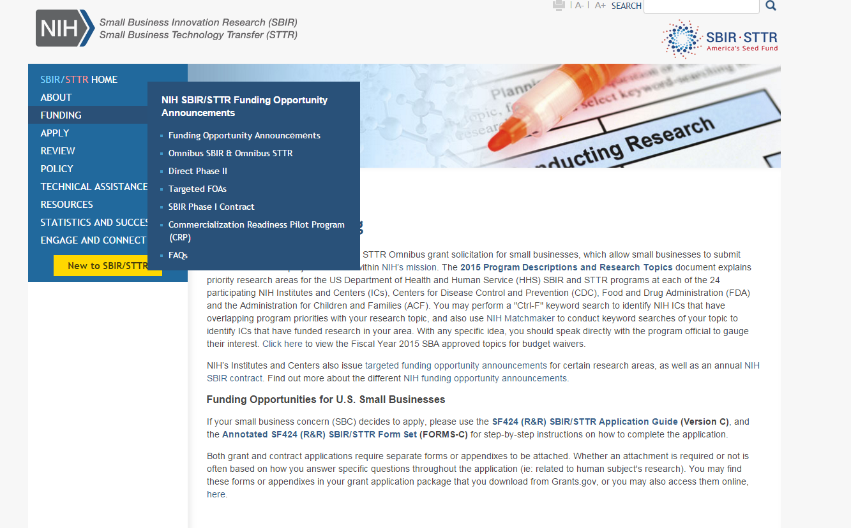
NIH SBIR/STTR FOAs
https://sbir.nih.gov/funding

Slide 14
Omnibus vs Targeted FOAs
 | Omnibus | Targeted
Due Dates | Standard Due Dates | Standard or Customized Due Dates
Review | SBIR/STTR panels at CSR | SBIR/STTR panels at CSR <OR> SBIR/STTR panel at IC
Application Instructions | Follow SF424 R&R SBIR/STTR Application Guide & Annotated Form Set | Follow SF424 R&R SBIR/STTR Application Guide & Annotated Form Set <AND> any additional instructions in FOA
Read FOA very carefully!

Slide 15
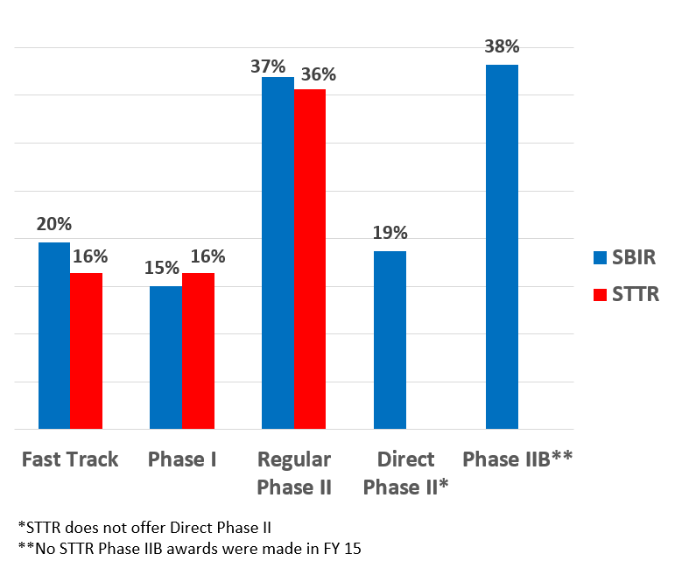
Grant Success Rate of SBIR/STTR 2015 by Phase

Slide 16

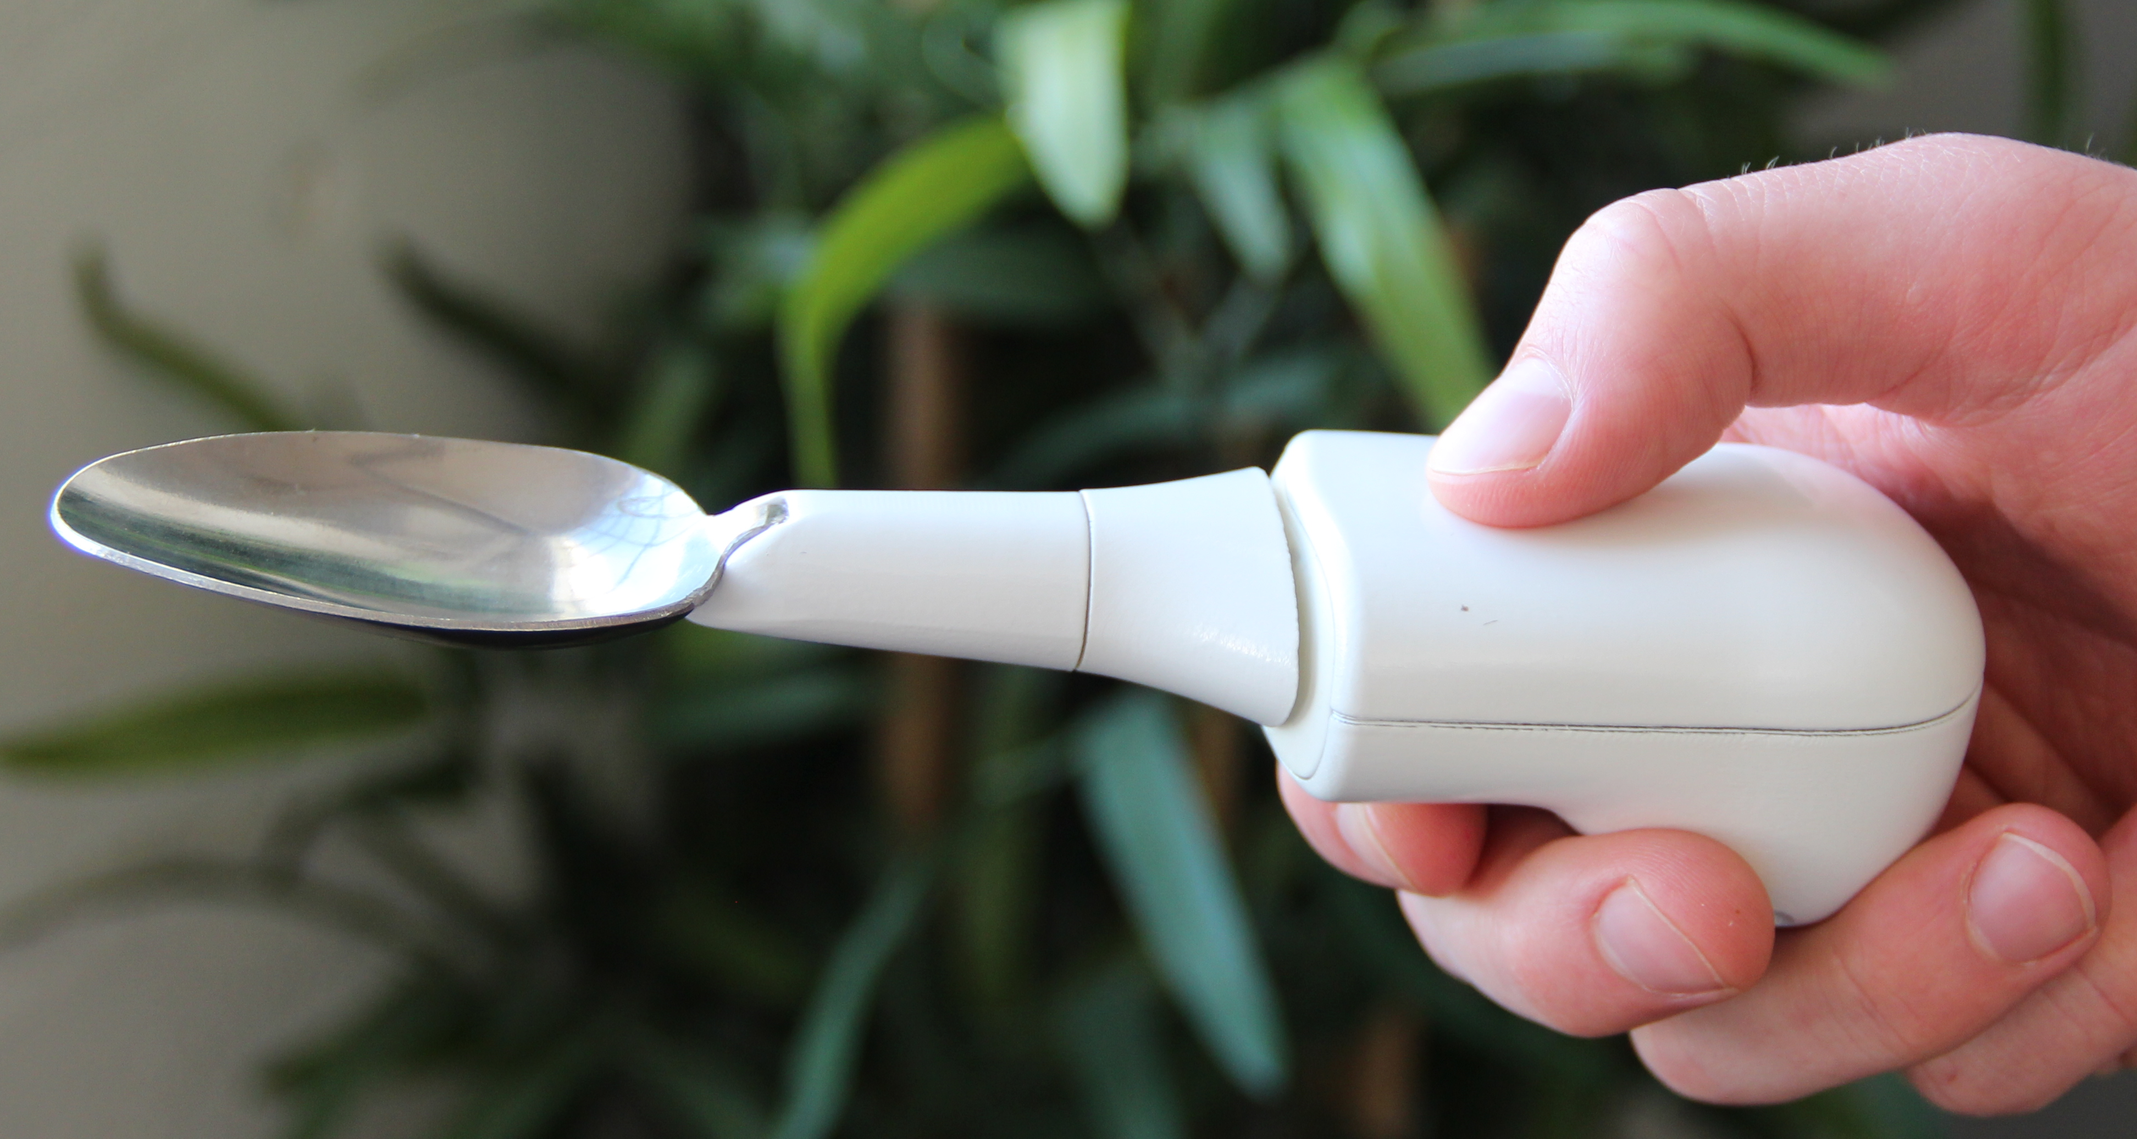

When is SBIR/STTR appropriate?
Lift Labs
Develops new technologies to provide proactive care for people with essential tremor and Parkinson's Disease
Acquired by Google in September 2014
Anupam Pathak, Ph.D.
Founder & CEO
NINDS SBIR Awardee
http://www.liftlabsdesign.com/

Slide 17

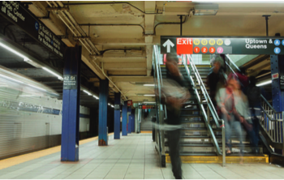
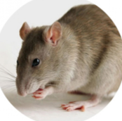

When is SBIR/STTR appropriate?
SenesTech
Limits rodent fertility in a non-lethal and environmentally-friendly way
Works with NYC Subway System, and Chicago Transit Authority
Loretta Mayer, Ph.D.
Founder & CSO
NIEHS SBIR Awardee
http://senestech.com/

Slide 18


When is SBIR/STTR appropriate?
Be Prepared to Resubmit!
“[SBIR] has been a long, trying, but worthwhile journey...from multiple submissions that were not discussed...to applications that scored below the funding levels...to concurrent applications (one Phase II and a Phase I) emerging from the rigorous peer review process with impact scores in the “Excellent" range.”
Laverne Morrow Carter, Ph.D.
Founder & President, REESSI
NIMHD SBIR Awardee
http://www.reessi.com

Slide 19


When is SBIR/STTR appropriate?
“As a native Spanish-speaking curriculum designer with a background in literary and performing arts, I work as a principal investigator on a number of NIH-funded projects. The SBIR and STTR programs allow me to translate evidence-based practices into web-based multimedia programs that offer skill-building tools for improving health and educational outcomes among Latino audiences.”
Jessie Marquez
Instructional Designer at
IRIS Educational Media
http://www.irised.com/

Slide 20

Electronic Submission
SBIR/STTR grant applications and SBIR contract proposals must be submitted electronically.
Registrations are required!!!
DUNS Number (Company)
System for Award Management (SAM)
Grants.gov (Company)
eRA Commons (Company and all PD/PIs)
SBA Company Registry at SBIR.gov
Helpful NIH Grants Registration Infographic
For contracts, submit proposals with electronic Contract Proposal Submission (eCPS) website

Slide 21
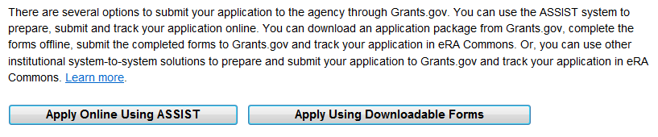


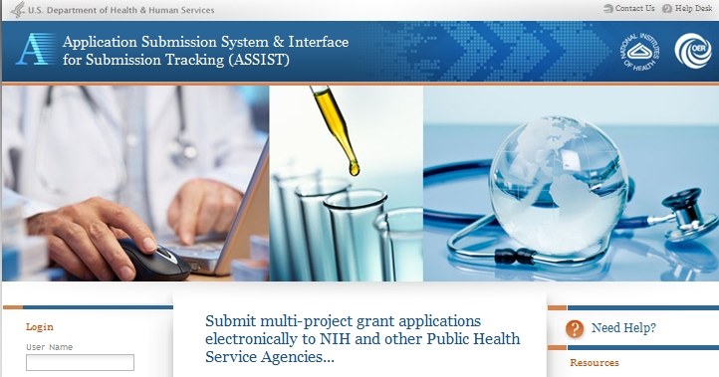
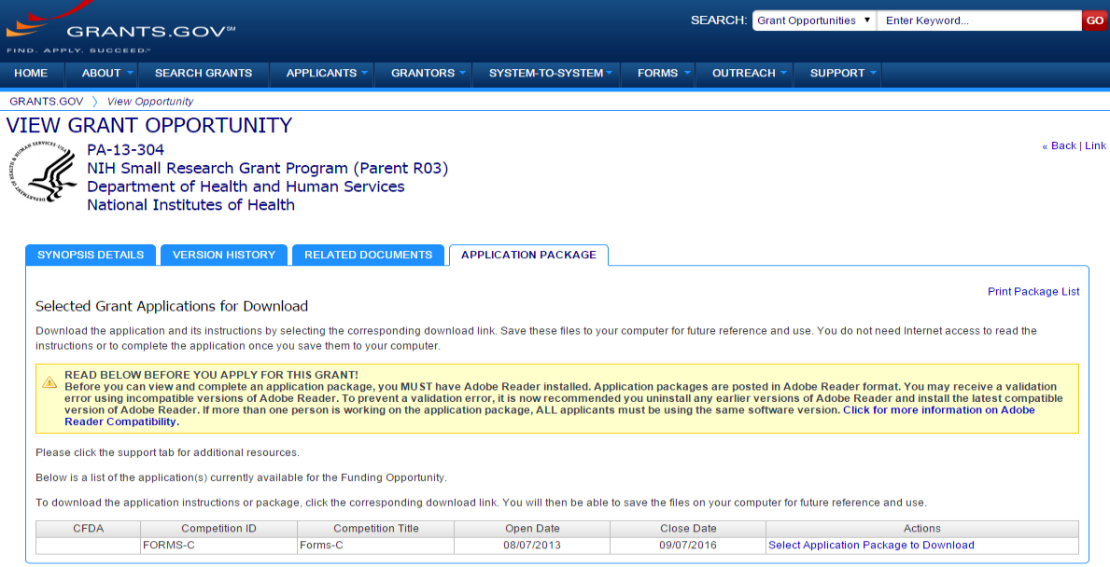
Submit via ASSIST or Forms
Excerpt from single-project FOA in NIH Guide…

Slide 22
Timeline: New Applications
Scientific
Review
Council
Review
Award
Date
Due Date
(earliest)
Sept 5th
Jan 5th
April 5th
Oct/Nov
Feb/Mar
June/July
Jan/Feb
May/June
Aug
March
July
Sept or Dec
Notes:
22
22

Slide 23





NIH Application & Review Process
Applicant initiates
research idea
Small Business
Concern confirms
Eligibility
Submits SBIR/STTR
grant application to
NIH electronically
NIH Center for
Scientific Review
assigns to IC and IRG
1-2 Months
3 Months
IC staff prepare
funding plan for
IC Director
Advisory Council or
Board recommend
Approval
Scientific Review
Group evaluates
scientific merit
2-4 Months
IC allocates
funds
Grantee conducts
research

Slide 24

Most Important Piece of Advice
Try to talk to a HHS Program Officer about a month in advance of deadline for application specific advice!
Contact information: HHS Agency Contact webpage
Questions about who to contact? Email sbir@od.nih.gov

Slide 25
WOSB and SDB Definitions
What is a Women-Owned Small Business (WOSB)?
A firm must be at least 51% owned and controlled by one or more women, and primarily managed by one or more women (who must be US citizens)
The firm must be “small” in its primary industry in accordance with SBA’s size standards for that industry
SBCs self certify on the SF 424 (R&R) Form
What is a Socially and Economically Disadvantaged Business (SDB)?
The firm must be 51% or more owned and control by one or more disadvantaged persons
The disadvantaged person or persons must be socially disadvantaged and economically disadvantaged
The firm must be small, according to SBA’s size standards
You must self-certify by registering your business in the System for Award Management

Slide 26
Solicitations and Due Dates
NIH, CDC, FDA, & ACF SBIR/STTR Grant Solicitation “Parent” FOAs: SBIR: PA-16-302 STTR: PA-16-303
Release: June 3, 2016
Standard Due Dates: September 5th, January 5th, April 5th
SBIR Contract Solicitation (NIH, CDC) – Program Solicitation PHS 2017-1 (SBIRs Only)
NIH Guide Notice NOT-OD-16-123
Release: August 1, 2016 Close: October 21, 2016 (5pm EDT)
NIH Guide for Grants and Contracts
Release: Weekly receipt dates specified in each FOA

Slide 27
Budget Hard Caps
New SBIR/STTR award budget HARD caps in place
Pre-approved topics list can be found on funding page: https://sbir.nih.gov/funding
Award Guidelines
Program | Phase I | Phase II
SBIR | $150,000 | $1,000,000
STTR | $150,000 | $1,000,000
Award Hard Caps – cannot exceed
Program | Phase I | Phase II
SBIR | $225,000 | $1,500,000
STTR | $225,000 | $1,500,000

Slide 28
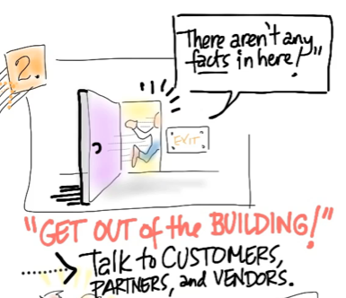
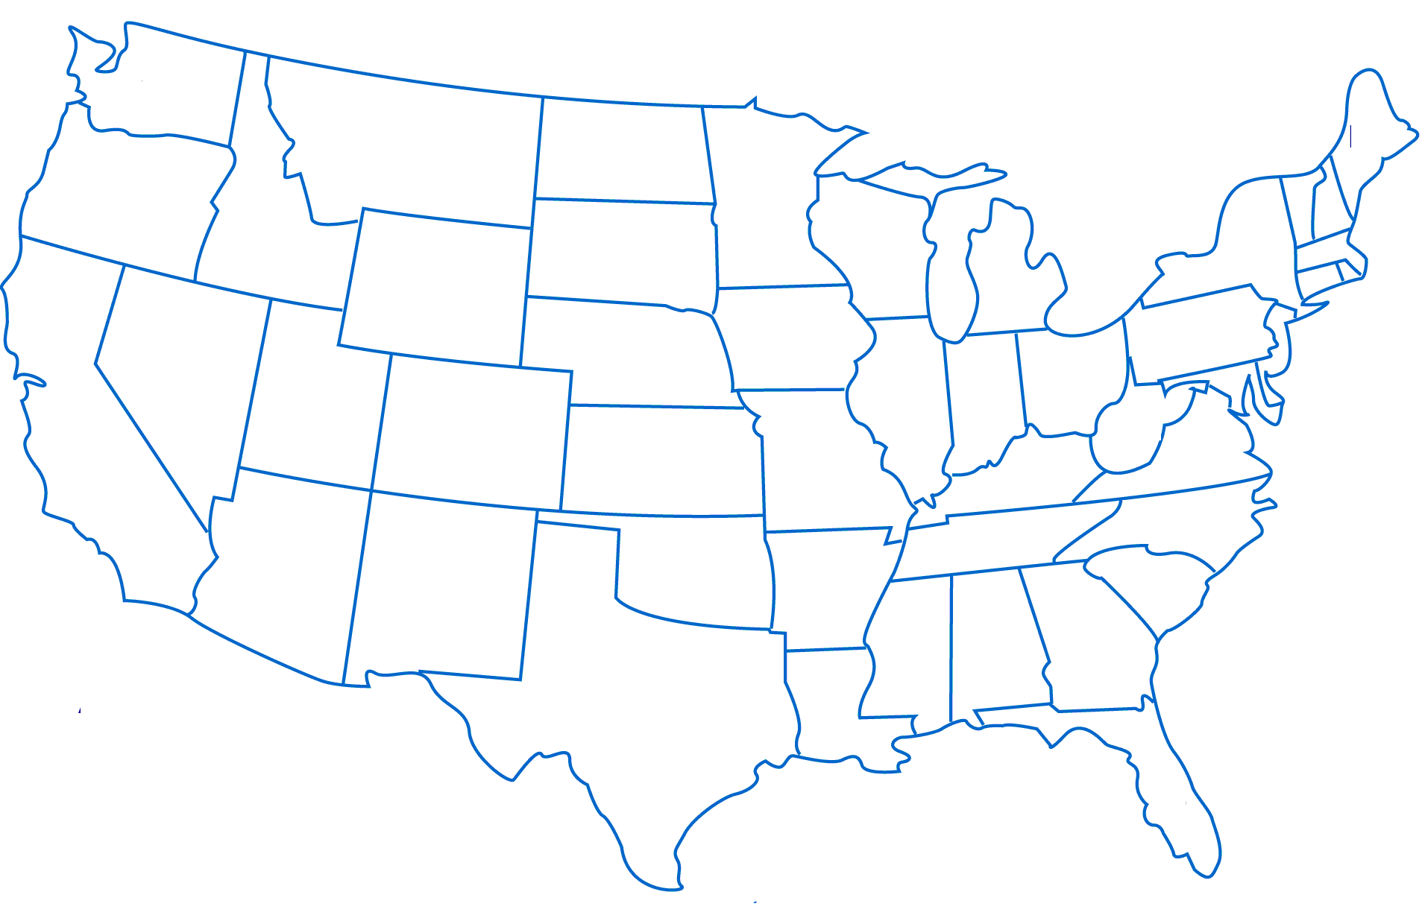





Multi-IC Technology Development Programs (open to eligible Awardees from participating ICs)
12 Participating ICs + CDC
I-CorpsTM at NIH
An intensive Entrepreneurial Immersion course for scientists
Facilitating Partnerships
Investor
Forum

Slide 29
NIH SBIR/STTR
Fast-Track
Discovery
Phase I
Development
Phase II
Competing Renewal Award
Phase IIB
Commercialization
Phase III
$3M for up to 3 years
Feasibility
Full R/D
Additional R/D
Phase I Phase II
Simultaneous submission and review of Phase I and II
Phase I is awarded
Milestones/aims of Phase I are assessed by program staff BEFORE Phase II is awarded
Fast-Track
Direct to Phase II

Slide 30
NIH SBIR/STTR
Direct to Phase II
Discovery
Phase I
Development
Phase II
Competing Renewal Award
Phase IIB
Commercialization
Phase III
$3M for up to 3 years
Feasibility
Full R/D
Additional R/D
Phase I Phase II
SBIR only
Bypass Phase I grant
Must have completed Phase-I-type R&D (i.e. feasibility) to move directly into a Phase-II
SEPARATE FOAs: https://sbir.nih.gov/funding#phase2
Not all ICs Participate
Fast-Track
Direct to Phase II

Slide 31


NIH Technical Assistance Programs
Niche Assessment Program-Foresight S&T
(Phase I Awardees)
Commercialization Accelerator Program - Larta, Inc.
(Phase II Awardees)
Identifies other uses of technology
Determines competitive advantages
Develops market entry strategy
“Menu” of technical assistance/training programs in:
Strategic/business planning
FDA requirements
Technology valuation
Manufacturing issues
Patent and licensing issues
Helps build strategic alliances
Facilitates investor partnerships
Individualized mentoring/consulting

Slide 32
Phase IIB Competing
Renewal Award
Discovery
Phase I
Development
Phase II
Competing Renewal
Phase IIB
Commercialization
Phase III
$3M for up to 3 years
SBIR/STTR Phase II awardee
Technologies that require extraordinary time/effort to develop, and often require FDA regulatory approval
Awards up to $1M/year for up to 3 years
IC must accept Competing Renewal applications (NIA, NIAAA, NIAID, NICHD, NIDA, NIDCD, NIDDK, NEI, NIGMS NHLBI, NIMH, NINDS, NCATS, ORIP, NCI, NHLBI, NINDS)
Contact NIH Program Staff to discuss!

Slide 33
Commercialization
Readiness Pilot (CRP)
Discovery
Phase I
Development
Phase II
Competing Renewal Award
Phase IIB
Commercialization
Phase III
$3M for up to 3 years
Commercialization Readiness Pilot (CRP)
$3M up to 3 years
Webinar materials available at sbir.nih.gov
Contact NIH Program Staff to discuss!
PAR16-026: Technical Assistance
PAR16-027: Technical Assistance and Late Stage Development

Slide 34
Commercialization Readiness Pilot Program (CRP)
CRP may fund work that is not typically supported through SBIR/STTR Phase II or Phase IIB awards, including:
Preparation of documents for a Food and Drug Administration (FDA) submission
Development of an intellectual property strategy
Investigational New Drug (IND)-enabling studies
Clinical studies
Manufacturing costs
Regulatory assistance
Subcontracted work to other institutions, including contract research organizations (CRO)
A combination of services
HHS CRP Informational Webinar (December 2, 2015)
View slides, audio, transcript: http://bit.ly/SBIR_CRP

Slide 35
More Information
Get Connected!
Subscribe to the SBIR/STTR Listserv:
Email LISTSERV@LIST.NIH.GOV with the following text in the message body: subscribe SBIR-STTR your name
NIH Guide for Grants and Contracts (weekly notification)
Follow us on Twitter: @NIHsbir
Read our NIH SBIR/STTR Notable Successes
Connect with Us
Email: sbir@od.nih.gov

Slide 36


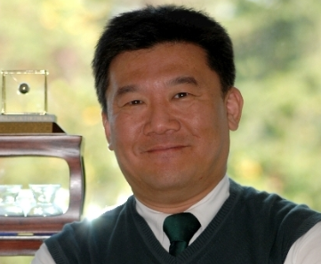


NIH SBIR/STTR Program Office
Matthew Portnoy, PhD
NIH SBIR/STTR Program Coordinator
Phone: 301- 435-2688
Email: mportnoy@mail.nih.gov
Robert Vinson
SBIR/STTR Program Manager
Phone: 301-435-2713
Email: vinsonr@mail.nih.gov
JP Kim, JD, MBA
SBIR/STTR Program Manager
Phone: 301-435-0189
Email: jpkim@nih.gov
Betty Royster
SBIR/STTR Communications Specialist
Phone: 301-402-1632
Email: betty.royster@nih.gov
Julie Beaver
SBIR/STTR Statistician
Phone: 301-496-8807
Email: julie.beaver@nih.gov

Slide 37

Register Now!
Register Now! http://bit.ly/OrlandoSBIR

