Slide 1
Research Involving Human Subjects
NIH Regional Seminar
Jaime O. Hernandez, J.D., M.Be.
Public Health Advisor
Division of Education and Development
Office for Human Research Protections (OHRP), HHS
Petrice Brown-Longenecker, Ph.D.
NIH Human Research Protections Officer
Office of Extramural Research, NIH
Meredith Temple-O’Connor, Ph.D.
Senior Scientific Advisor to the
NIH Deputy Director for Extramural Research
Office of Extramural Research, NIH

Slide 2
Session Overview
Human Subjects Regulations and application of the Common Rule
NIH policies for grant applications proposing human subjects research
NIH policies on inclusion of women, minorities and children in NIH-funded research

Slide 3
Learning Objectives
Understand the ethical rationale for the federal regulations on human research protections
Apply the basics of the Common Rule
Recognize the requirements for human subjects in NIH grant applications
Understand the post award requirements for research involving human subjects
Know the requirements for addressing inclusion of women, minorities, and children in NIH grant applications
Understand what studies inclusion policy applies to
Understand post award requirements for monitoring inclusion in clinical research

Slide 4

Who is OHRP?
Office for Human Research Protections
Mission
Provide leadership in protecting the rights, welfare, and wellbeing of human subjects in research conducted or supported by HHS

Slide 5
HHS Organizational Structure
HHS
NIH, FDA, and other HHS
Agencies
Office of Asst Sec for Health
(Includes OHRP)
Notes:
To understand how OHRP fulfills its mission, it is helpful to understand where it fits in the federal organizational structure.
OHRP is located within the Office of the Assistant Secretary for Health in the Department of Health and Human Services. HHS has eleven agencies, including NIH, the FDA, the CDC, and several others. Because of this relationship, OHRP’s authority spans—and is limited to—research sponsored or conducted by these HHS agencies.

Slide 6

Hhs Regulations on Human Research protections

Slide 7
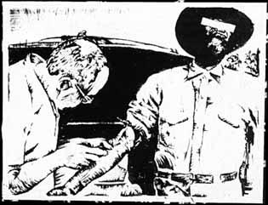
Historical Cases Led to Regulations
For example:
Tuskegee Syphilis Study (1933-72)
Led to:
    1974: National Research Act
    1979: Belmont Report
    1991: Protection of Human Subjects regulations, 45 CFR 46
Notes:
Alt Text: the image shows a person having his blood taken

Slide 8
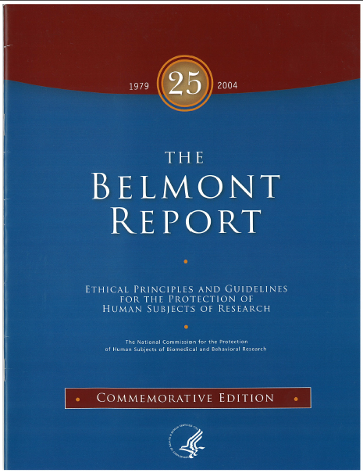
The Belmont Report
Main Principles
Respect for Persons
  Promoting autonomy
Beneficence
  Maximize benefits; minimize harms
Justice
  Ensure equitable distribution of burden and benefits
Notes:
Alt Text: the image shows a copy of the Belmont Report

Slide 9
HHS Regulations on Human Research Protections 45 CFR Part 46
Subpart A – The Common Rule
Subpart B – Pregnant women and fetuses
Subpart C - Prisoners
Subpart D – Children
Subpart E – IRB Registration

Slide 10
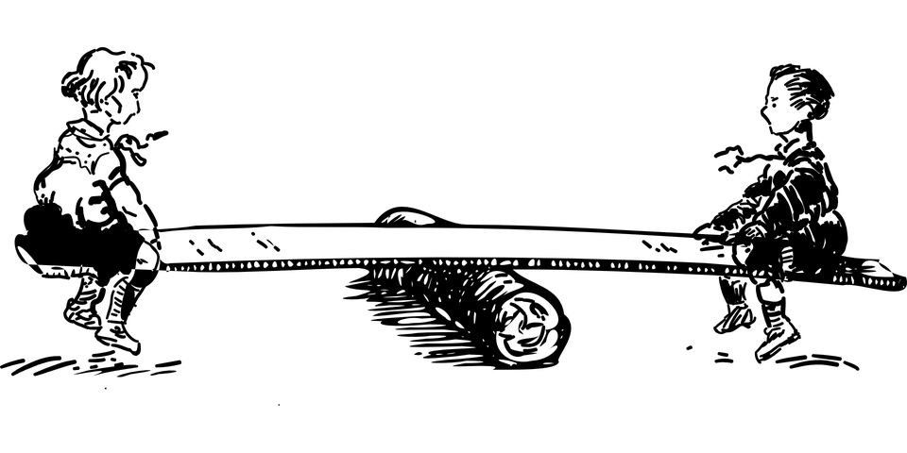
The Challenge
Societal benefit of science through human subjects research
Respecting research subjects as individuals, not treating them as a means to an end

Slide 11
HHS and FDA Regulations
Differences in Scope:
  HHS regulations apply to HHS-funded research
    This includes all NIH-funded research
  FDA regulations apply to clinical investigations involving FDA-regulated products: drugs, devices, and biologics
Which regulations apply? Two key questions:
  Who funds your research?
  Does your research involve drugs, devices, or biologics regulated by FDA or marketed in the U.S?
Notes:
Although the FDA is an HHS agency, it has separate regulations for the research it regulates. This is necessary because of FDA’s specific mission regarding the safety of drugs, medical devices and biologics.
When considering which regulations apply to your proposed research, think about:
-which agency funds your research
-whether your research involves drugs, devices, or biologics regulated by the FDA or marketed in the US
Today we’ll be focusing specifically on the HHS regulations. If you’re research falls under the FDA regulations, you’ll want to make sure to seek out the appropriate training. If you’re not sure whether your research is FDA regulated, your IRB should be able to help you figure it out.

Slide 12
HHS vs. FDA Regulations cont’d
Basic requirements for IRBs and informed consent are congruent
Harmonization efforts – joint guidance
Detailed differences at FDA Website

Slide 13
Applying the hhs regulations

Slide 14
When do the Regulations Apply?
Non-exempt, human-subject research conducted or supported by HHS
Ask these questions in THIS ORDER:
Does activity involve Research?
Does research involve Human Subjects?
Is human subjects research Exempt?
See Human Subject Regulations Decision Charts.
Notes:
14
Kevin L. Nellis, MS, MT(ASCP)
February 8, 2008
14
Jurisdiction

Slide 15
Is it Research?
“Research refers to a systematic investigation, including research development, testing, and evaluation, designed to develop or contribute to generalizable knowledge” (emphasis added)
  45 CFR 46.102(d)

Slide 16
A team of physicians see a patient with an unusual constellation of symptoms. They run a variety of diagnostic tests and procedures. Results of the test do not yield a known diagnosis.
They write a case summary of their observations and submit it to a medical journal for publication.
Is this research?
Example 1: Is it Research?
Yes
No
I don’t know
Notes:
Let’s go through a few scenarios to see if we’ve got it down.
Key points:
--whether or not it’s published doesn’t determine if it’s research
--not systematic, not generalizable

Slide 17
Does it involve Human Subjects?
Human subject – a living individual about whom an investigator obtains:
  data through intervention or interaction with the individual, or
  identifiable private information*
  * Identity of the subject is or may readily be ascertained by the investigator or associated with the information
Notes:
17

Slide 18
An investigator receives survey data on the use of opioid pain medications from an outside source to use in a new study. The data were obtained for a previous and unrelated research study, not the current research. The investigator receives no individually identifiable information with the data.
Is this human subjects research?
Example 2: Does it Involve Human Subjects?
Yes
No
I don’t know
Notes:
Key points:
--no interaction, no information about individuals

Slide 19
Is the Research Exempt?
45 CFR 46.101(b)(1-6)
1. Normal educational practices in established educational settings
2. Educational tests, surveys, interviews, or observation of public behavior— unless identified and sensitive*
3. Research on elected or appointed public officials or candidates for public office
4. Research using existing data, if publicly available or recorded without identifiers
5. Evaluation of public benefit service programs
6. Taste and food quality evaluation and consumer acceptance studies
Exemptions do not apply to research with prisoners.
*Does not apply to children except for educational tests and some observations.
Notes:
Exemptions are specific circumstances under which the research activity is not required to comply with the Common Rule regulations. Six exemptions were created as part of the regulations, but today we will focus on the three most commonly used.
These are Exemptions 1,2, and 4. As you will see when we go through them, these exemptions are particularly relevant for a social and behavioral research.
Note that some of these exemptions do not apply to certain types of research with children, and NONE of them apply to research with prisoners.
[if needed—what age is “child”?]
This is defined by state law.

Slide 20
Example 3: Is it Exempt?
A researcher asks dieticians from several institutions to complete an online survey asking their opinions on a nutritional advertising campaign. The survey includes the dieticians’ email addresses for potential follow-up.
Is this exempt human subjects research?
Yes
No
I don’t know
Notes:
This study would most likely fall under Exemption 2.
Even though identifiable information (email address) is being gathered, the data collected most likely doesn’t include sensitive information. In this case, the data are presumably not sensitive. Note that under different conditions, perhaps asking them about their clinics’ medicare billing practices, a study designed in the same way would likely not fall under Exemption 2 (because it would contain identifiable AND sensitive information).

Slide 21
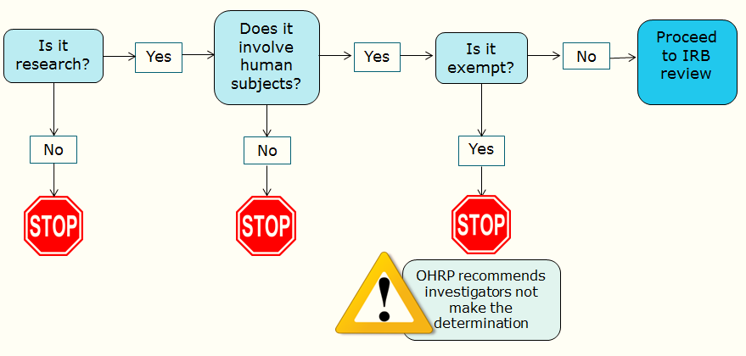
Do the Regulations Apply?

Slide 22

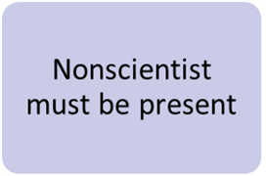
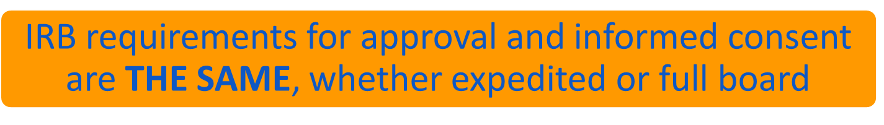
IRB Review
Initial Review of Research
(non-exempt, human subject research)
Full-Board
No more than minimal risk AND only procedures listed
Reviewed by IRB chair or an experienced reviewer
Research that does not qualify for expedited review
Majority of IRB members must be present
Notes:
NONscientist must be present at every meeting, while the other required participants such as the scientist and the unaffiliated member must be in the IRB roster, they are not required to participate in every meeting. But the non-scientist is. This will become relevant later in regards to one of the practical tips to write a successful IRB submission
Expedited does not mean easier, or submit less, or shorter of a protocol. It means only faster (assuming the protocol is approvable in its submitted form).

Slide 23
Contact OHRP
Web Site: http://www.hhs.gov/ohrp
Phone: 866-447-4777 or 240-453-6900
Inquiries (policies and regulations): OHRP@hhs.gov
Inquiries (education activities): OHRP-Edu@hhs.gov
Join our ListServ: http://www.hhs.gov/ohrp/newsroom/index.html

Slide 24
NIH Policies & grant application instructions for human subjects research
Petrice Brown-Longenecker, phd
NIH Extramural Human Research Protection Officers
NIH Office of Extramural Programs (OEP), OER
National Institute of Allergy and Infectious Disease
October 26, 2016
Petrice.Brown@nih.gov
Notes:
The course title is your second opportunity to engage your audience. Use a title, and sub-title if needed, to pique their interest. Avoid common, overused titles – like ones that start with:
Introduction to . . .
Fundamentals of . . .
Foundations of . . .
Principles of . . .

Slide 25

It’s kind of a big deal

Slide 26
Learning Objectives
Understand the ethical rationale for the federal regulations on human research protections
Apply the basics of the Common Rule
Recognize the requirements for human subjects in NIH grant applications
Understand the post award requirements for research involving human subjects
Know the requirements for addressing inclusion of women, minorities, and children in NIH grant applications
Understand what studies inclusion policy applies to
Understand post award requirements for monitoring inclusion in clinical research

Slide 27
Regulatory Requirements for Sponsoring Agency (NIH)
Agencies evaluate applications/proposals involving human subjects for risks, adequacy of protections, benefits and importance of knowledge to be gained
  NIH delegates to Peer Review
Do not make an award unless regulatory requirements are met
  Administrative procedures to ensure compliance
27
27
Notes:
27
27
The Department or Agency head will evaluate all applications and proposals involving human subjects submitted to the Department or Agency through such officers and employees of the Department or Agency and such experts and consultants as the Department or Agency head determines to be appropriate. This evaluation will take into consideration the risks to the subjects, the adequacy of protection against these risks, the potential benefits of the research to the subjects and others, and the importance of the knowledge gained or to be gained.
(b) On the basis of this evaluation, the Department or Agency head may approve or disapprove the application or proposal, or enter into negotiations to develop an approvable one.
Federal funds administered by a Department or Agency may not be expended for research involving human subjects unless the requirements of this policy have been satisfied.

Slide 28
Just-in-Time
(all HS research)
Submit:
FWA
IRB certification
HS education
Annual IRB review/
approval
Write and Submit NIH Application
Peer Review
Award is made
HS monitoring
HS Unacceptable
(bar to funding)
Resolution through OEP
SRG Concern
(few applications)
Written response to resolve concerns

Slide 29
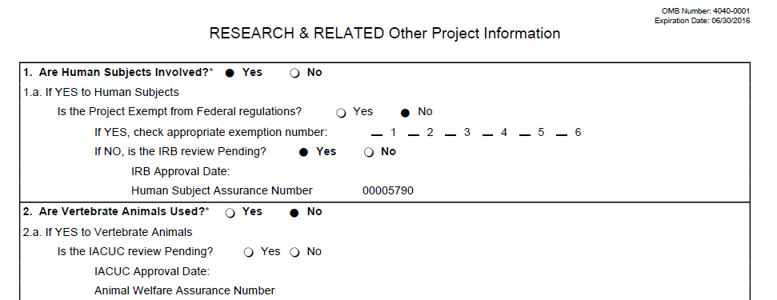
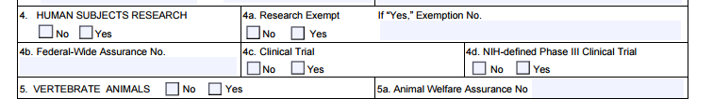
What is evaluated?
SF424
You must provide a
Protection of Human Subjects section.
PHS 398 R&R

Slide 30

Human Subjects Section In NIH Application (Non-exempt HSR)
1. Risks
  Human subjects involvement and characteristics; vulnerable populations
  Sources of materials – what, how, access to identifiers
  Potential Risks – physical, psychological, social, legal
2. Adequacy of Protection Against Risks
  Recruitment; consent
  Procedures to minimize risks
  Additional protections for vulnerable subjects

Slide 31

Human Subjects Section In NIH Application (Non-exempt HSR)
3. Potential Benefits of Research to Human Subjects and Others
  May not be direct benefit to subjects
  Discuss risks in relation to anticipated benefits
  Should not include monetary compensation
4. Importance of Knowledge to be Gained
  Discuss in relation to risks

Slide 32
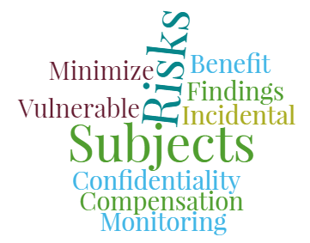
Characteristics of A Good HS Section
Commensurate with the level of risk

Slide 33
Additional NIH Requirements
For Clinical Trials:
  Data and Safety Monitoring Plan or Board
  Registration in ClinicalTrials.gov
For NIH-Defined Clinical Research
  Inclusion of Women, Minorities, and Children
33
33

Slide 34
2º use of Identifiable
Human Samples/Data
HS Section Should:
Describe source; who has access to identifiers
Address consent
Main risk is disclosure
Describe steps to protect the identity of subjects
Will any results be provided to subjects; if so, what are considerations for doing this?

Slide 35
“No” Human Subjects Involved
Data or specimen not collected specifically for this study and no access to identifiers
  Check “No” on application
Must justify your designation of “No” human subjects
  Explain in Research Strategy OR
  Can add separate HS section
Key Points
  Not collected for your proposed research
    Discuss source (repository, purchased commercially)
  None of investigators have access to ID (or code key)
    Investigator = anyone involved in conduct of the research beyond providing samples/data

Slide 36
Tricky Situations
Investigator was involved in original data collection or has association w/ source
Excess samples
Vague Terminology: de-identified, anonymized
Collecting samples w/o identifiers
Cell lines
Never assume. Make sure it’s in the application

Slide 37
Options for using coded data/samples
If possible, break the link for the purposes of proposed study
  Honest broker to assemble data/samples without linkable code
Can provider not have a role beyond providing?

Slide 38
Preparing the Human Subjects Section
Use Instructions for Preparing HS section
Select one of 6 scenarios:
  A. No Human Subjects
  B. Non-Exempt Human Subjects Research
  C. Exempt Human Subjects Research
  D. Delayed-Onset of Human Subjects Research
  E. Clinical Trial
  F. NIH-defined Phase III Clinical Trial
38
38

Slide 39
Preparing the Human Subjects Section
Reviewers can’t assume.
Not being clear can delay your award.
Use Instructions for Preparing HS section
Select one of 6 scenarios:
  A. No Human Subjects
  B. Non-Exempt Human Subjects Research
  C. Exempt Human Subjects Research
  D. Delayed-Onset of Human Subjects Research
  E. Clinical Trial
  F. NIH-defined Phase III Clinical Trial
If using human materials describe source; can upload a Protection of Human Subjects section.
May need to discuss whether specimens or data were collected specifically for study and whether anyone can access subject identifiers.
39
39

Slide 40
Preparing the Human Subjects Section
You will need to include:
Protection of Human Subjects section commensurate with risk
Inclusion information and Enrollment forms
If a Clinical Trial:
A Data and Safety Monitoring Plan
If an NIH-defined Phase III Clinical Trial:
A Data and Safety Monitoring Board
Use Instructions for Preparing HS section
Select one of 6 scenarios:
  A. No Human Subjects
  B. Non-Exempt Human Subjects Research
  C. Exempt Human Subjects Research
  D. Delayed-Onset of Human Subjects Research
  E. Clinical Trial
  F. NIH-defined Phase III Clinical Trial
40
40

Slide 41
Preparing the Human Subjects Section
Delayed Onset: Human subjects research anticipated but specific plans can’t be described in the application (pilot studies to be selected; HS dependent on findings in animal model)
Human Subjects Section – explain why delayed onset
If funded, awardee must provide FWA, IRB approval, human subjects and inclusion sections to NIH before involving human subjects
Use Instructions for Preparing HS section
Select one of 6 scenarios:
  A. No Human Subjects
  B. Non-Exempt Human Subjects Research
  C. Exempt Human Subjects Research
  D. Delayed-Onset of Human Subjects Research
  E. Clinical Trial
  F. NIH-defined Phase III Clinical Trial
Reviewers can’t assume. Not being clear can delay your award.
41
41

Slide 42
Preparing the Human Subjects Section
Justify selection of exemption(s)
NOT verbatim of regulatory definition!
Sources of research materials
Inclusion monitoring is required, unless the entire study is considered Exemption 4
Use Instructions for Preparing HS section
Select one of 6 scenarios:
  A. No Human Subjects
  B. Non-Exempt Human Subjects Research
  C. Exempt Human Subjects Research
  D. Delayed-Onset of Human Subjects Research
  E. Clinical Trial
  F. NIH-defined Phase III Clinical Trial
Reviewers can’t assume. Not being clear can delay your award.
42
42

Slide 43
NIH Clinical Trials (CT) Policies
NIH CT requirements: http://grants.nih.gov/grants/policy/hs/data_safety.htm
  Data and safety monitoring (DSM) plan
  DSM Board for Phase III and some others
IC specific policies
AE/UP reporting
  IRB, OHRP, funding agency, institution, FDA
CT.gov reporting
FDA requirements may apply

Slide 44
Data and Safety Monitoring Plan
Data and Safety Monitoring Plan includes:
  Commensurate with risks
  Overall framework for data and safety monitoring
  Responsible party for monitoring
  Procedures for reporting Adverse Events/Unanticipated Problems
Data and Safety Monitoring Board (DSMB) required for:
  Multi-site trials with > than minimum risk and generally for Phase III trials
Funding IC approval before enrollment begins
44
44

Slide 45
ClinicalTrials.gov
Current requirements for trials regulated by FDA:
  Trial registration
  Results
Effective January 18, 2017, all NIH-funded clinical trials will be expected to register at ClinicalTrials.gov and report findings.
  All phases
  All interventions (FDA regulated, behavioral, other)
  All mechanisms (grant, coop. agreement, contract)

Slide 46


Peer Review of
Human Subjects Section
Each reviewer will assess human subjects involvement & protections
  Actual or potential unacceptable risks, or inadequate protections, or insufficient information
Peer review group will determine overall rating of “acceptable” or “unacceptable”
Summary Statement:
    PROTECTION OF HUMAN SUBJECTS: UNACCEPTABLE (Code 44)
    Code 44 is a bar to award
46
Notes:
46
Alternate text: The picture depicts a stack of dollars and a stack of gold coins with a red “X” through them.

Slide 47
Common HS Concerns Identified in Peer Review
Something’s missing
  Human Subjects Section inadequate/incomplete
  Missing/inadequate DSMP/B
2. Inadequate discussion
  Source of specimens/data inadequately described
  Physical/psychological risks not adequately addressed
  Informed consent issues
  Confidentiality of data
  Incidental findings not addressed
Notes:
In order from most to least common in FY2002

Slide 48

Just-in-Time Requirements
After peer review, grants likely to be funded:
  Institution’s OHRP Federal-wide Assurance Number (FWA)
  Certify IRB approval
    Can rely on other IRB
  Certify Key Personnel have taken HS education
    https://phrp.nihtraining.com/users/login.php
  Resolve unacceptable Human Subjects concern
    Written response to IC
    NIH Office of Extramural Research concurrence
48
Notes:
Alternate text: The graphic on this page is a clock.

Slide 49
After the Award…
Now What?
Human Research Protections include:
  Annual IRB approval
  UP/AE Reports – within 3 days or as required
  Prior NIH Approval for changes in human subjects research that increase risk
    Add HS activities to non-HS award or add Clinical Trial
    New enrollment of pregnant women, children or prisoners
    Addition that is greater than minimal risk or new info that study procedure/intervention is higher risk
    Discuss plans with PO before starting!!
Notes:
Alternate text: The graphics at the top of this slide are dollar bills with a $ and smiley face and feet.

Slide 50
Updates for Clinical trials
Effective January 18, 2017 all NIH-funded clinical trials will be expected to register at ClinicalTrials.gov and report findings.
Effective January 1, 2107 all NIH-funded investigators who are involved in the conduct, oversight, or management of clinical trials should be trained in Good Clinical Practice (GCP).
Starting with application receipt dates on or after September 27, 2017, NIH will require that all applications involving one or more clinical trials be submitted through a Funding Opportunity Announcement (FOA) specifically designed for clinical trials.

Slide 51
Coming Soon…
Single IRB Review
Starting with May 25, 2017 receipt dates, NIH will require all domestic sites in multi-site studies to use a single IRB of record
Same overall study
Options:
  Form new single IRB
  Use existing IRBs
  Use independent IRB

Slide 52

Certificates of Confidentiality (CoC)
CoC
Purpose:
  Protects investigators/institutions from forced disclosure of identifiable research information (subpoena)
  Encourage participation
For IRB approved studies that collect personal identifiers and sensitive info
DHHS Agencies that issue: CDC, IHS, SAMHSA, HRSA, FDA, and NIH
Federal funding not required but research must be health related (NIH and FDA issue bulk of CoCs for non-funded research)
https://humansubjects.nih.gov/coc/index
Notes:
Alternate text: This graphic illustrates a shield.

Slide 53
Resources for NIH HS Policies
NIH OER Human Subjects Website:
https://humansubjects.nih.gov
Infographics, Flow charts, Policy Updates
SF 424 & Electronic Submission Page
http://grants.nih.gov/grants/funding/424/index.htm
NIH Revised Definition of Clinical Trial:
http://grants.nih.gov/grants/guide/notice-files/NOT-OD-15-015.html
NIH Data and Safety Monitoring
http://grants.nih.gov/grants/policy/hs/data_safety.htm
53
Notes:
53

Slide 54
NIH POLICIES AND GRANT APPLICATION INSTRUCTIONS FOR INCLUSION OF WOMEN, MINORITIES, AND CHILDREN IN CLINICAL RESEARCH
Meredith D. Temple-O’Connor, Ph.D.
Senior Scientific Advisor to the NIH Deputy Director for Extramural Research
Office of Extramural Research (OER)
National Institutes of Health
inclusion@od.nih.gov

Slide 55
Learning Objectives
Understand the ethical rationale for the federal regulations on human research protections
Apply the basics of the Common Rule
Recognize the requirements for human subjects in NIH grant applications
Understand the post award requirements for research involving human subjects
Know the requirements for addressing inclusion of women, minorities, and children in NIH grant applications
Understand what studies inclusion policy applies to
Understand post award requirements for monitoring inclusion in clinical research

Slide 56
NIH Inclusion Policies
Inclusion of Women and Minorities
  Must be included in NIH-defined clinical research unless exclusion is justified for scientific reasons
  Justify the proposed sample in the context of who is at risk for the disease/condition and the scientific goals of the specific study
  Plans for outreach and recruitment
  Provide Inclusion Enrollment Report form(s) with proposed sex/gender, race, and ethnicity of the sample
56
Notes:
56

Slide 57
NIH Inclusion Policies (con’t)
Inclusion of Children
  Children must be included in clinical research unless there are scientific or ethical reasons not to do so
  “Children” are currently defined by the NIH as individuals <18 years
    Note: Age of a child for inclusion purposes changed to <18 years starting with January 25, 2016 application receipt dates
  Applicants should justify the proposed age range of the participants, with specific attention to justifying the inclusion/exclusion of individuals under 18
57

Slide 58

Defining the Universe
Inclusion of women and minorities in all NIH funded or supported clinical research is mandated by law and policy; inclusion of children mandated by policy
What is subject to the statute/policies?
  All studies (intramural, extramural, contracts) that meet the NIH definition of clinical research
    NIH definition of clinical research: (1) Patient-Oriented Research: Research conducted with human subjects (or on material of human origin such as tissues, specimens, and cognitive phenomena) for which an investigator (or colleague) directly interacts with human subjects. Excluded from this definition are in vitro studies that utilize human tissues that cannot be linked to a living individual (e.g., IRB Exemption 4). Patient-oriented research includes (a) mechanisms of human disease, (b) therapeutic interventions, (c) clinical studies, or (d) development of new technologies; (2) Epidemiologic and Behavioral Studies; and (3) Outcomes Research and Health Services Research
  Additional requirements for NIH-defined Phase III clinical trials related to unbiased design and assessment of potential group differences
Bottom line:
  If you answer yes to human subjects and not E4, you should address inclusion because there are very few studies that will not be considered NIH-defined clinical research.

Slide 59

But what does it mean to include?
Purpose Statement: NIH supported clinical research should address/include the population(s) at risk for the disease or condition under study. The purpose of NIH Inclusion Policies is to ensure that the distribution of study participants by sex/gender, race, ethnicity, and age reflects the population needed to accomplish the scientific goals of the study, rather than enumeration of research participants. All NIH-funded studies that meet the NIH definition for clinical research are subject to NIH Inclusion Policies, regardless of funding mechanism*. (*Funding mechanism includes any activity code associated with extramural grants, R&D contracts, and cooperative agreements as well as intramural projects and R&D contracts)
Bottom line: Does the study have the right participants for the proposed science?

Slide 60
What’s required for inclusion in a competing application?
Remember the “universe” to determine whether inclusion applies to your application
Plans for inclusion of women and minorities
  Includes addressing plans for valid analysis if conducting an NIH-defined Phase III clinical trial
Plans for the inclusion of children
Inclusion enrollment report
  Planned or Cumulative (actual) depending on the study design
NOTE: Follow the scenarios described in Human Subjects’ protection section to further understand what’s expected for different scenarios

Slide 61
Inclusion Enrollment Report Forms
Inclusion Enrollment Report Forms
  Now a structured data form
  Is the study delayed onset?
  Is it planned enrollment or cumulative?
  Does it involve existing datasets or prospective enrollment?
  Is it a trial? Phase III trial?
  Need to consider race and ethnicity separately
Separate report forms for participants located in the US and outside of the US (even if part of the same study)
61

Slide 62


Peer Review of Inclusion
Each reviewer will assess the inclusion plans
  Plans for inclusion
  Justification in the context of the science
Peer review group will determine overall rating of “acceptable” or “unacceptable”
Summary Statement:
    INCLUSION OF WOMEN, MINORITIES, AND/OR CHILDREN: UNACCEPTABLE (U CODE)
    Unacceptable (U) code is a bar to award
62
Notes:
62
Alternate text: The picture depicts a stack of dollars and a stack of gold coins with a red “X” through them.

Slide 63
Common Inclusion Concerns Identified in Peer Review
Inadequate information describing the sex/gender, race, ethnicity, and/or age(s) of the sample
Inadequate justification for proposed sample
  Sex/gender, race, ethnicity, and/or age(s) breakdown not appropriate for the scientific goals of the study or not adequately justified
Unrealistic sampling
  Appropriate from scientific perspective but not realistic
    Collaborations and outreach plans may help
Notes:
In order from most to least common in FY2002

Slide 64

Just-in-Time Requirements
After peer review, for grants likely to be funded:
  Work with Institute/Center staff to resolve unacceptable inclusion concerns
    Written response to IC
  Provide inclusion enrollment report(s) if missing or need update as a result of peer review and/or programmatic adjustments
    This now happens directly in the Inclusion Management System through Commons
    Remember: If you make changes to inclusion data records through Commons, you need to route to your SO (signing official) to send to NIH
64
Notes:
Alternate text: The graphic on this page is a clock with a smiley face and feet.

Slide 65
After the Award…
Now What?
Provide cumulative inclusion enrollment (e.g., actual enrollment) information at least annually or as frequently as specified by the funding Institute/Center
  Provided in Inclusion Management System through RPPR or through Commons Status screen
  For NIH-defined Phase III Clinical Trial– report any analysis or findings related to outcomes by sex/gender, race, and ethnicity if available
  Note progress (or challenges) in recruitment as needed in RPPR
  2015 Updated Policy – Prior NIH Approval for changes in human subjects research that increase risk or delayed onset studies (Scenario D)
  Changes the project from no to yes for human subjects involvement or from no to yes for clinical trial
  Study not previously designed is ready to start
  Discuss plans with NIH PO before starting
  Ensure that inclusion plans and/or inclusion enrollment are provided (prior to start or at RPPR—check with funding Institute/Center for specific procedures)
65
Notes:
Alternate text: The graphics at the top of this slide are dollar bills with a $ and smiley face and feet.

Slide 66

Inclusion Resources for Investigators
Training and Guidance
  FAQs
  How To Videos and User Guides for working in the Inclusion Management System
    https://nih-extramural-intranet.od.nih.gov/d/IMS_Principal_Investigators
  Podcasts
  Narrated slide decks
Guide notices and other policy related documents
Public website
  http://grants.nih.gov/grants/funding/women_min/women_min.htm
Notes:
Alternate text: This figure depicts a graphic of a “screen bean” person with a light bulb over their head and their hand raised by the light bulb.

Slide 67


Contact OHRP:
Inquiries (policies and regulations): OHRP@hhs.gov
Inquiries (education activities): OHRP-Edu@hhs.gov
Contact NIH Human Subjects Team: OEP-HS@mail.nih.gov
Contact NIH Inclusion Policy Office: Inclusion@od.nih.gov

