Slide 1
The NIH Peer Review Process
NIH Regional Seminars 2016
Sally A. Amero, Ph.D. Weijia Ni, Ph.D., Chief
NIH Review Policy Officer Risk, Prevention and Health Behavior IRG
Extramural Research Integrity Liaison Officer Center for Scientific Review
Office of Extramural Research National Institutes of Health
National Institutes of Health

Slide 2

NIH Peer Review
Cornerstone of the NIH extramural mission
Standard of excellence worldwide
Partnership between NIH and the scientific community
Each year:
  ~ 80,000 applications
  ~ 25,000 reviewers
2

Slide 3
NIH Peer Review Process
Receipt and Referral
Initial Peer Review
National Advisory Councils
Submit your
application
Funding
decision

Slide 4
Division of Receipt and Referral (DRR)
Key decisions
  Policy compliance (format, timeliness, etc.)
  Assignment to Institute(s) for funding consideration
  Assignment to study section for initial peer review
Managed by Referral Officers
Funding Institute(s)
Scientific Review Group
Initial Review Groups (CSR or ICs)
Scientific Focus & Mission Relevance
Program Officials (POs)
Scientific Review Officers (SROs)
DRR
Council
IC
Director
Application

Slide 5
National Institutes of Health
Office of the Director
National Institute
on Aging
National Institute
on Alcohol Abuse
and Alcoholism
National Institute
of Allergy and
Infectious Diseases
National Institute
of Arthritis and
Musculoskeletal
and Skin Diseases
National Cancer
Institute
Eunice Kennedy
Shriver National Institute
of Child Health and
Human Development
National Institute on
Deafness and Other
Communication
Disorders
National Institute
of Dental and
Craniofacial
Research
National Institute
of Diabetes and
Digestive and
Kidney Diseases
National Institute
on Drug Abuse
National Institute
of Environmental
Health Sciences
National Eye
Institute
National Institute
of General
Medical Sciences
National Heart,
Lung, and Blood
Institute
National Human
Genome Research
Institute
National Institute
of Mental Health
National Institute
of Neurological
Disorders and
Stroke
National Institute
of Nursing Research
National Institute of
Biomedical Imaging
and Bioengineering
National Center
for Complementary
and Alternative
Medicine
John E. Fogarty
International
Center
National Center
for Research
Resources
National Library
of Medicine
National Institute on
Minority Health and
Health Disparities
Clinical Center
Center for
Information
Technology
Center for
Scientific Review

Slide 6

Submitting a Cover Letter
The cover letter conveys important information:
Application title
FOA # and title
Areas of expertise needed to evaluate the application
Any special situations (such as a late application)
Statement if proposed studies will generate large-scale genomic data

Slide 7

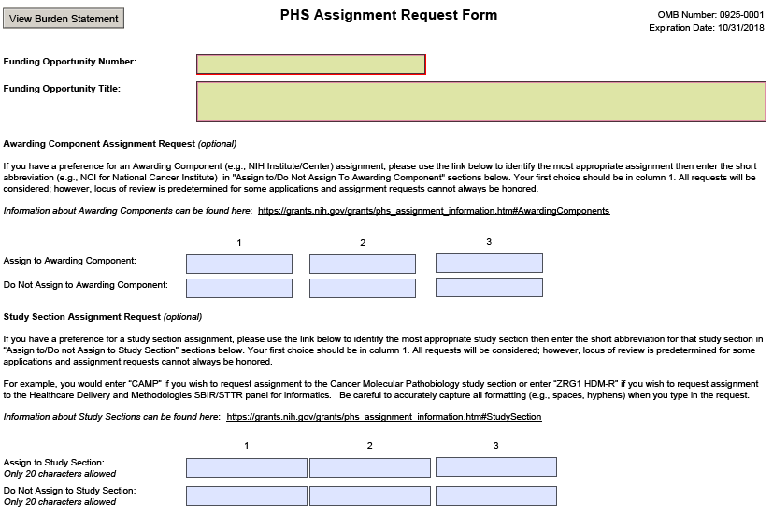

Slide 8
Requesting a Study Section
IC or CSR review is stated in the Funding Opportunity Announcement (FOA).
Information about study sections:
  Center for Scientific Review study sections: http://public.csr.nih.gov/StudySections/Pages/default.aspx
  Rosters are available on NIH websites https://public.era.nih.gov/pubroster/
  http://www.csr.nih.gov/Committees/rosterindex.asp
  eRA Like (A Thesaurus-based Search Tool)
    http://era.nih.gov/services_for_applicants/like_this/likethis.cfm
Not all study section/IC requests can be honored.

Slide 9


Post-Submission Materials
Submitted after the application, but before the review meeting
    Must result from an unforeseen administrative event
    Conform to format policy and page limits
    Submit to the SRO 30 days before the review
    Demonstrate concurrence of Authorized Organization Representative
  See NOT-OD-16-130
Follow a special process for videos
      Only type of non-traditional materials accepted
      See NOT-OD-12-141

Slide 10
Level 1: Initial Peer Review
Key decisions
  Scientific and technical merit of the work proposed
  Overall impact
  Appropriate justification for human subjects, inclusion, and vertebrate animals
Managed by Scientific Review Officers (SROs)
Funding Institute(s)
Scientific Review Group
Initial Review Groups (CSR or ICs)
Scientific Focus & Mission Relevance
Program Officials (POs)
Scientific Review Officers (SROs)
DRR
Council
IC
Director
Application

Slide 11
Level 1: Initial Peer Review
Reviewers
      How are they chosen
      Expectations for reviewers
Review Policy
    Review criteria
    Scoring system
What happens at the review meeting?
After the meeting

Slide 12

Reviewers
General Qualifications:
    Expertise
    Stature in field
    Mature judgment
    Impartiality
    Ability to work well in a group
    Managed conflicts of interest
    Balanced representation
    Availability

Slide 13

Managing Conflict of Interest
Types of Conflict of Interest (COI)
    Financial - Professional associates
    Employment - Study Section membership
    Personal - Other interests
Appearance of COI
Depending on the COI, the reviewer with a COI must be:
    Excluded from serving on the Study Section, or
    Recused from discussion and scoring of application.

Slide 14

Review Service
NIH-funded investigators are
expected to serve as reviewers
when asked.
NIH grantee institutions and
contract recipients are expected to
encourage their investigators to
serve.
See NOT-OD-15-035

Slide 15

Reviewer Assignments
For each application:
      ≥ Three qualified reviewers are assigned for in-depth assessment = “assigned” reviewers
    The SRO recruits reviewers and assigns applications
      Expertise of the reviewer
      Suggestions from the PI on expertise – not names!
      Suggestions from Program staff and Study Section members
      Managing conflicts of interest
      Balancing workload
Assignments are confidential!

Slide 16

Before the Meeting
Reviewers
    Examine assignments (~ six weeks in advance)
    Often participate in an SRO orientation teleconference
    Sign Conflict of Interest and Confidentiality certifications
    Read applications, prepare written critiques
    Enter preliminary scores and critiques into secure website
    Read and consider critiques and preliminary scores from other Study Section members

Slide 17

Maintaining Integrity in Peer Review
  All materials, discussions, and documents are confidential – deleted or destroyed after review.
  All questions must be referred to the SRO.
  Reviewers: Do not contact applicants directly!
  Applicants: Do not contact reviewers directly!
Research Misconduct
    Fabrication, falsification, or plagiarism.
    Reviewers: Report allegations directly
    to the SRO in confidence.

Slide 18
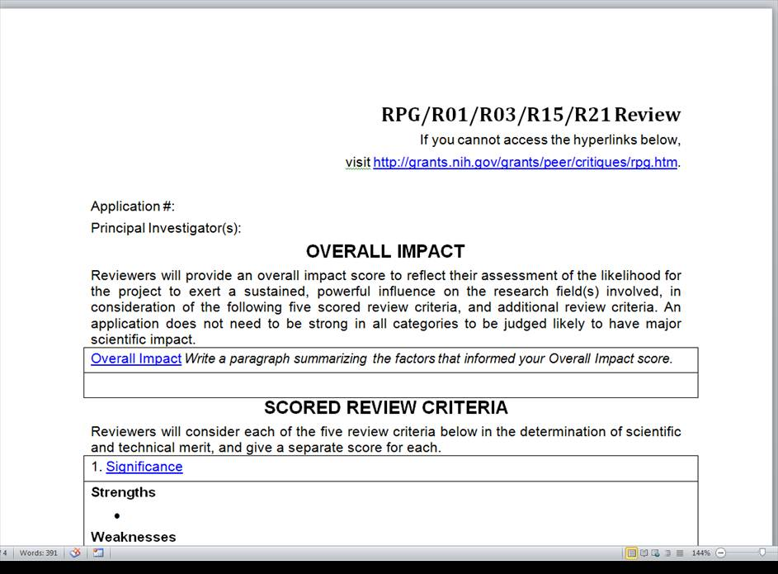
Written Critiques
Links to
definitions
of review
criteria

Slide 19

Review Criteria: Overall Impact
Overall consideration for all NIH applications
Defined differently for different types of applications
    Research grant applications: Likelihood for the project to
      exert a sustained, powerful influence on the research
      field(s) involved
See “Review Criteria at a Glance” http://grants.nih.gov/grants/peer/reviewer_guidelines.htm

Slide 20
Types of Review Criteria
Category* | Criteria (Research) | Criterion Scores? | Affect Overall Impact Score?
Scored Review Criteria | Significance Investigators Innovation Approach Environment | Yes | Yes
Additional Review Criteria | Human Subjects** Vertebrate Animals** Inclusion** Biohazards | No | Yes
Additional Review Considerations | Foreign Institutions Select Agents Resource Sharing Authentication of Key Resources | No | No
*Found in every Funding Opportunity Announcement
** If Unacceptable, award cannot be issued until resolved

Slide 21
Rigor and Transparency
Four components (*Can affect the scores):
  Scientific premise for the proposed work*
  Scientific rigor of the work proposed*
  Consideration of relevant biological variables, such as sex, age, weight, and underlying health conditions*
  Authentication of key biological/chemical resources
Implemented for most:
  Research grant applications
  Mentored Career Development Award applications
See Rigor and Reproducibility: http://grants.nih.gov/reproducibility/index.htm

Slide 22
Rigor and Transparency: Research
Element of Rigor and Transparency | Section of Application | Criterion Score | Additional Review Consideration | Contribute to Overall Impact Score?
Scientific Premise | Research Strategy | Significance | NA | Yes
Scientific Rigor | Research Strategy | Approach | NA | Yes
Consideration of Relevant Biological Variables | Research Strategy | Approach | NA | Yes
Authentication of Key Biological/ Chemical Resources | New Attachment | NA | Yes | No

Slide 23
NIH Scoring System
Reviewers give numerical scores
  1 (exceptional) to 9 (poor)
  Used for criterion scores and final impact score
Impact | Score | Descriptor
High Impact | 1 | Exceptional
 | 2 | Outstanding
 | 3 | Excellent
Moderate Impact | 4 | Very Good
 | 5 | Good
 | 6 | Satisfactory
Low Impact | 7 | Fair
 | 8 | Marginal
 | 9 | Poor

Slide 24
At the Review Meeting
    Any member in conflict with an application leaves the room
    Reviewer 1 introduces the application and presents critique, including all score-able issues (core criteria, human subjects and animal protection, etc.). Reviewers 2 and 3 highlight additional issues and areas that significantly impact scores
    All members join the discussion; Summary by Chair
    Assigned reviewers provide final scores, setting range
    All members provide final scores privately. If voting out of range, rationales are given
    Non-score-able issues discussed: budget, data sharing plan, foreign applications, etc.

Slide 25
Final Impact Scores
Entire panel of eligible members votes
    Eligible means no COI, no abstention
    Not just assigned reviewers
Voted by private ballot at the meeting
Calculated by averaging all reviewers’ scores and multiplying by 10
Range from 10 through 90
Percentiled for some mechanisms
10 – Highest Impact
90 – Lowest Impact

Slide 26
Streamlining Applications
Allows discussion of more meritorious applications
    Less meritorious applications are tabled
    Designated “Not Discussed” (ND)
ND requires full concurrence of the entire study section
Summary statements contain:
    Reviewer critiques
    Criterion scores
Scored
ND

Slide 27
After the Review
eRA Commons (http://era.nih.gov/commons/index.cfm)
    Final Impact Score within 3 days
    Summary statement available within 4 – 8 weeks to:
      Funding Institute Program Officer
      PD/PI
      Other NIH Officials
      Advisory Council members

Slide 28
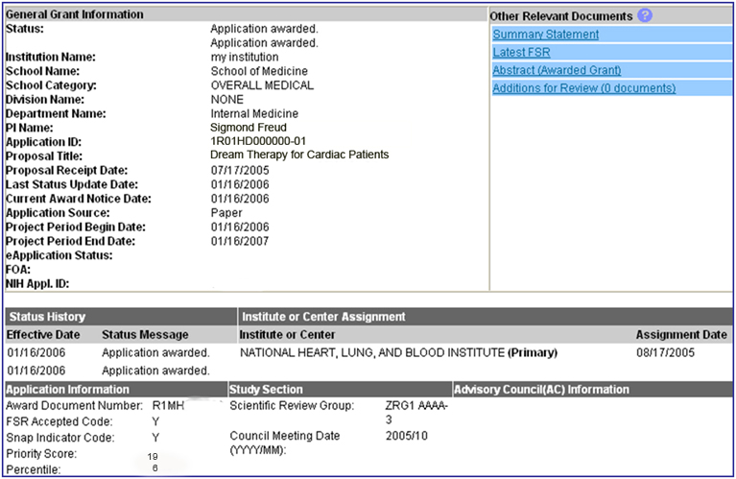
Check Application Status in the NIH Commons

Slide 29
Summary Statement
First page
  NIH Program Official (upper left corner)
  Final Impact Score or other designation
  Percentile (if applicable)
  Codes (human subjects, vertebrate animals, inclusion)
    44 = bar to funding
    35 = default for training grant applications
    30 = involves human subjects or vertebrate animals but the SRG had no concerns
    10 = no human subjects or vertebrate animals
  Budget request
A favorable score does not guarantee funding!

Slide 30

Summary Statement - continued
Subsequent Pages
          Resumé and Summary of Discussion (if discussed)
          Description (provided by applicant)
          Criterion scores from assigned reviewers
          Reviewer critiques – essentially unedited
          Administrative Notes
          Meeting roster

Slide 31

After the Review Meeting
  Your point of contact is the assigned NIH
  Program Official. You may need to:
      Submit Just-in-Time (JIT) information
      Resolve 44 codes
    Consider your options:
          Submit a new application
          Revise and resubmit your application
          Appeal the review outcome (NOT-OD-11-064)

Slide 32
Level 2 of NIH Peer Review: Councils
Key Decisions:
    Funding recommendations
    Program priority
Funding Institute(s)
Scientific Review Group
Initial Review Groups (CSR or ICs)
Scientific Focus & Mission Relevance
Program Officials (POs)
Scientific Review Officers (SROs)
DRR
Council
IC
Director
Application

Slide 33

National Advisory Councils
  Broad and diverse membership
            Basic/research scientists
            Clinician scientists
            “Public” members
  Awards cannot be made without Council approval
  Council procedures vary across IC’s
  Council is chaired by Institute Director, advised by IC extramural research staff

Slide 34

National Advisory Councils
Advise IC Director about
      Research priority areas
      Diverse policy issues
      Concept clearance for future initiatives
      Funding priorities
Recommend applications for funding
      Expedited awards
      En bloc concurrence
Consider unresolved appeals and grievances related to initial peer review

Slide 35

Funding Decisions: IC Director
The IC Director makes the final funding decisions
Based on:
    Mission of the NIH Institute or Center
    Program priorities, Congressional mandates
    Outcome (score/percentile) of initial peer review
    Additional outside expertise, if needed
    Recommendation of IC Program Staff
    Recommendation of the IC Advisory Council
    Available Funds

Slide 36
Additional Information
Office of Extramural Research Peer Review Process
http://grants.nih.gov/grants/peer_review_process.htm
Peer Review Policies & Practices
http://grants.nih.gov/grants/peer/peer.htm
Center for Scientific Review
http://public.csr.nih.gov/Pages/default.aspx
NIH Guide to Grants and Contracts
http://grants.nih.gov/grants/guide/index.html

