Slide 1







Preparing, Submitting & Tracking
Multi-project Applications Using
A
S
T
S
I
S
Sheri Cummins
cumminss@mail.nih.gov
October 2016

Slide 2

What is ASSIST?
ASSIST is NIH's
online system for the
preparation, submission & tracking
of grant applications through
Grants.gov to NIH

Slide 3

Electronic Submission Required
NIH requires electronic submission for all multi-project applications
Electronic submission options
  ASSIST
  Institutional system-to-system (S2S) solutions
    Check with your office of sponsored research to see if this is an option for you
Electronic submission is required.
Using ASSIST is optional.

Slide 4

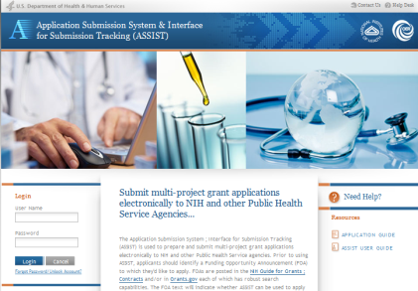




Submission Options

Slide 5

Before jumping into ASSIST, let’s take some time to get acclimated…

Slide 6

Application Format
All electronic multi-project applications include:
  A single Overall component
  Some number of additional components
  Automatically prepared data summaries

Slide 7







Multi-Project Application: Overall Component
Overall Component
Examples:
P01, P20, P50
PD/PIs: Cher D. Money, Ben A. Round
Organization: A
Project Title: Research Center to Cure the Diseases of the World
Component Type: Admin Core
Component Type: Core
Component Type: Project
Single Overall component
Provides an overview of the entire application
Admin Core-001
Core-001
Project-001
Project Title: Administrative Core
Project Lead: Jed I. Knight
Organization: A
Project Title: Research Core 1
Project Lead: Ben A. Round
Organization: A
Project Title: Fabulous Research Focus 1
Project Lead: Cher D. Money
Organization: A
Subaward Budget
Project-002
Organization: D
Project Title: Fabulous Research Focus 2
Project Lead: Quin T. Sential
Organization: B
Core-002
Project Title: Research Core 2
Project Lead: Abel Tu Lead
Organization: B
Project-003
Project Title: Fabulous Research Focus 3
Project Lead: Ima Doer
Organization: C

Slide 8
Multi-Project Application: Component Types
Overall Component
PD/PIs: Cher D. Money, Ben A. Round
Organization: A
Project Title: Research Center to Cure the Diseases of the World
Component Type: Admin Core
Component Type: Core
Component Type: Project
Admin Core-001
Core-001
Project-001
Project Title: Administrative Core
Project Lead: Jed I. Knight
Organization: A
Project Title: Research Core
Project Lead: Ben A. Round
Organization: A
Project Title: Fabulous Research Focus 1
Project Lead: Cher D. Money
Organization: A
Some number of additional component types
Component types vary by opportunity
Funding opportunity announcements indicate the types of components expected in a responsive application
Subaward Budget
Project-002
Organization: D
Project Title: Fabulous Research Focus 2
Project Lead: Quin T. Sential
Organization: B
Core-002
Project Title: Research Core 2
Project Lead: Abel Tu Lead
Organization: B
Project-003
Project Title: Fabulous Research Focus 3
Project Lead: Ima Doer
Organization: C

Slide 9
Multi-Project Application: Components
Overall Component
PD/PIs: Cher D. Money, Ben A. Round
Organization: A
Project Title: Research Center to Cure the Diseases of the World
Component Type: Admin Core
Component Type: Core
Component Type: Project
Admin Core-001
Core-001
Project-001
Some number of components within a component type
Announcements indicate the required minimum and/or maximum number of components expected
Project Title: Administrative Core
Project Lead: Jed I. Knight
Organization: A
Project Title: Research Core
Project Lead: Ben A. Round
Organization: A
Project Title: Fabulous Research Focus 1
Project Lead: Cher D. Money
Organization: A
Subaward Budget
Project-002
Organization: D
Project Title: Fabulous Research Focus 2
Project Lead: Quin T. Sential
Organization: B
Core-002
Project Title: Research Core 2
Project Lead: Abel Tu Lead
Organization: B
Project-003
Project Title: Fabulous Research Focus 3
Project Lead: Ima Doer
Organization: C

Slide 10
Multi-project Application Forms
Overall Component
PD/PIs: Cher D. Money, Ben A. Round
Organization: A
Project Title: Research Center to Cure the Diseases of the World
Required Forms
SF424 (R&R)
Project/Performance Sites
R&R Other Project Info
R&R Senior/Key Persons
PHS 398 Cover Page Supplement
PHS 398 Research Plan
Component Type: Admin Core
Component Type: Core
Component Type: Project
Admin Core-001
Core-001
Project-001
Project Title: Administrative Core
Project Lead: Jed I. Knight
Organization: A
Project Title: Research Core
Project Lead: Ben A. Round
Organization: A
Project Title: Fabulous Research Focus 1
Project Lead: Cher D. Money
Organization: A
“Optional” Forms
Required Forms
PHS Additional Indirect Costs
PHS Assignment Request Form
SF424 (R&R)
Project/Performance Sites
R&R Other Project Info
R&R Senior/Key Persons
PHS 398 Cover Page Supplement
PHS 398 Research Plan
R&R Budget
Subaward Budget
Project-002
Subaward Budget
Organization: D
Project Title: Fabulous Research Focus 2
Project Lead: Quin T. Sential
Organization: B
Organization: B
Core-002
Project Title: Research Core 2
Project Lead: Abel Tu Lead
Organization: B
“Optional” Forms
Project-003
R&R Subaward Budget
PHS Inclusion Enrollment Report
Project Title: Fabulous Research Focus 3
Project Lead: Ima Doer
Organization: C

Slide 11

Multi-project Application Assembly
Understand how your application image will be assembled by NIH for funding consideration
  The Overall component is presented first
    Including system-generated data summaries
  Additional component types are presented in alphabetical order (e.g., Cores before Projects)
    Components of the same type are grouped together
    Components are identified by type and sequential number (e.g., Core-001, Core-002)
Check out this resource: http://grants.nih.gov/grants/ElectronicReceipt/files/Electronic_Multi-project_Application_Image_Assembly.pdf

Slide 12








Overview of Process
Find
Opportunity
Enter
application
data
Initiate
application
Submit
Find
Plan
Initiate
Build Team
Enter Data
Finalize
Submit
Track
Make a submission
plan
Finalize
application and prepare for submission
Define team
and provide application access
Track status and view final application image

Slide 13
Find Opportunity
Find
Plan
Initiate
Build Team
Enter Data
Finalize
Submit
Track

Slide 14

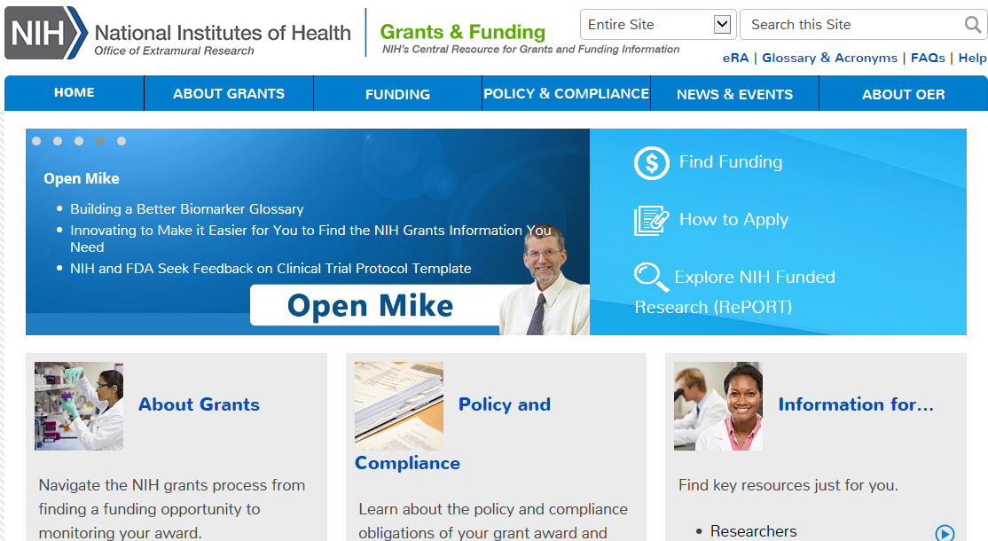
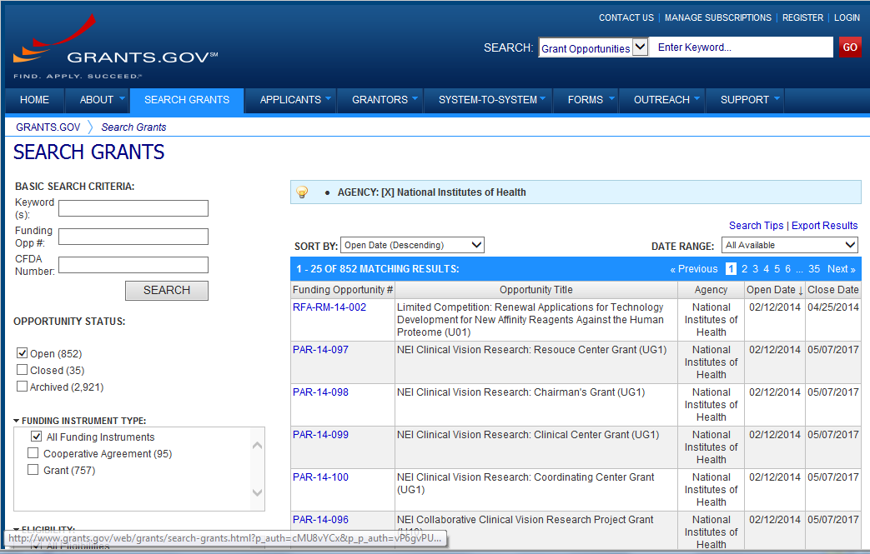
Find Multi-project FOAs in…
Find Funding -
NIH Guide for Grants & Contracts
Grants.gov Search Grants

Slide 15
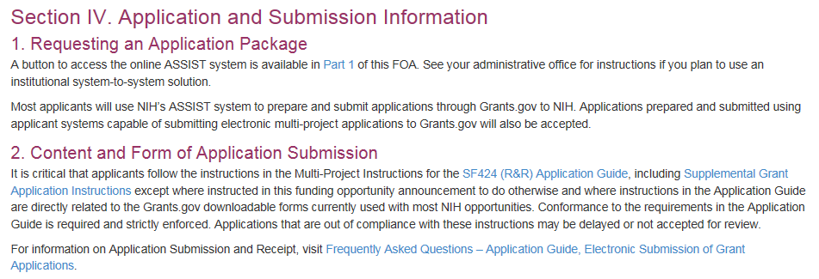
Multi-project FOAs
Section IV. Application and Submission Information of NIH FOAs includes important guidance for preparing your application in ASSIST
SF424 (R&R) Application Guide provides general instructions for completing application forms

Slide 16
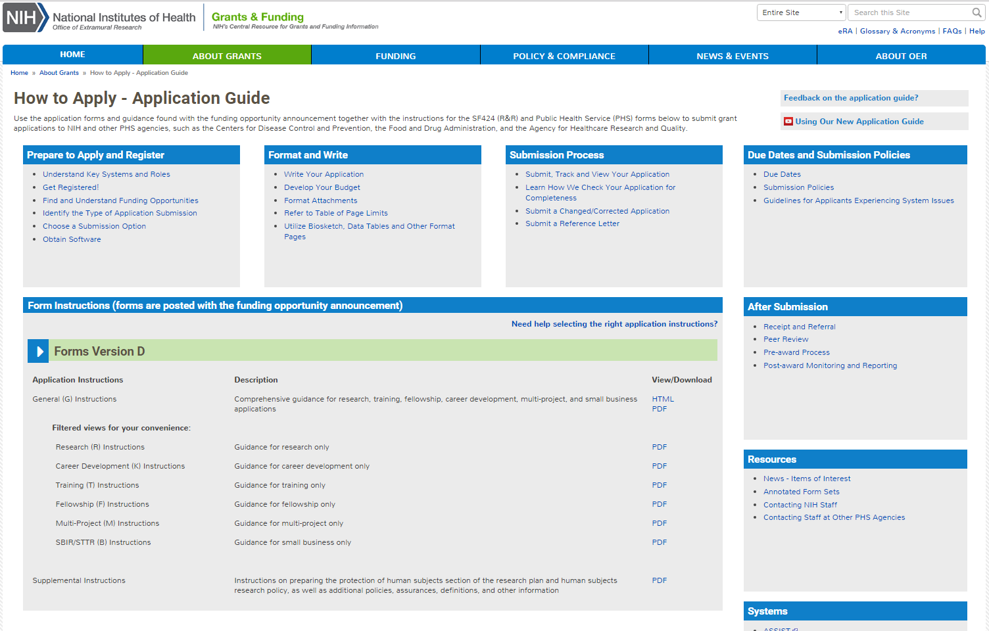
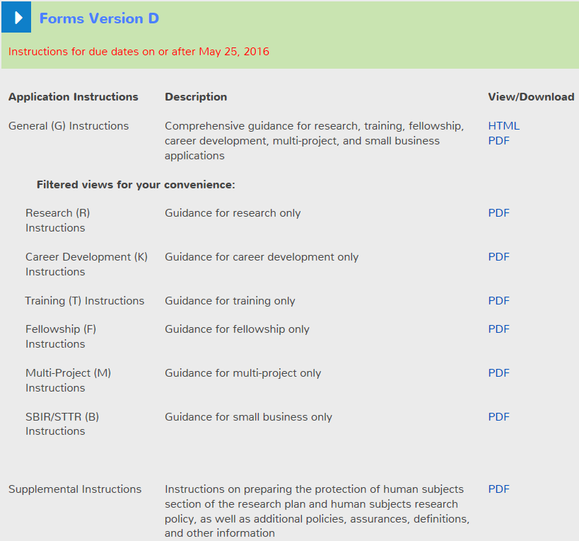
Application Guide
General Instructions
Multi-project filtered view of General Instructions
Supplemental Instructions

Slide 17
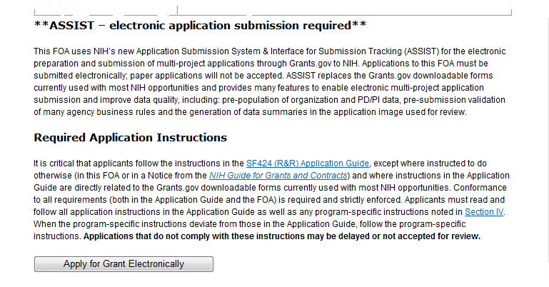

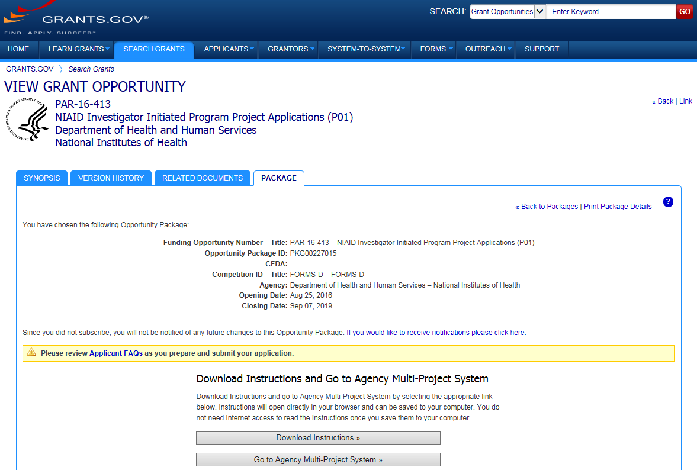
FOAs Link You to ASSIST
NIH Guide for Grants & Contracts
Grants.gov

Slide 18
Make a
Submission Plan
Find
Plan
Initiate
Build Team
Enter Data
Finalize
Submit
Track

Slide 19
Make a Submission Plan
Ensure all registrations are in place
  All standard registration requirements apply (DUNS, SAM, Grants.gov, eRA Commons)
    http://grants.nih.gov/grants/how-to-apply-application-guide/prepare-to-apply-and-register/registration.htm
    Decide how to distribute work
  Gather the Commons IDs for everyone who will be working on your application in ASSIST
Carefully read the funding opportunity announcement
  Note the allowable types of required/optional components and any special instructions
  Define the layout of your application (e.g., define components and who will lead each)

Slide 20
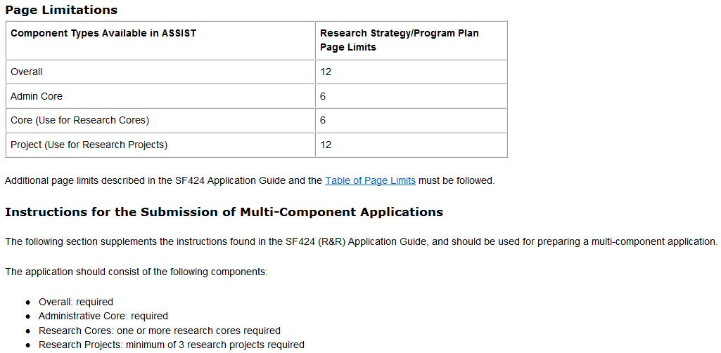
FOA Text Instructions
Sample excerpt from FOA (section IV)
Component Types
Research Strategy page limit per component
Number of components for responsive application

Slide 21
Define the Layout of Your Application
Think about the components you plan to include
  PD/PI(s) for entire application
  Organization lead for each component
  Project lead for each component
  Project Title for application/components
  Start/End dates for application/components

Slide 22
Sample Application Layout
Overall Component
PD/PIs: Cher D. Money, Ben A. Round
Organization: A
Project Title: Research Center to Cure the Diseases of the World
Component Type: Admin Core
Component Type: Core
Component Type: Project
Admin Core-001
Core-001
Project-001
Project Title: Administrative Core
Project Lead: Jed I. Knight
Organization: A
Project Title: Research Core 1
Project Lead: Ben A. Round
Organization: A
Project Title: Fabulous Research Focus 1
Project Lead: Cher D. Money
Organization: A
Subaward Budget
Project-002
Organization: D
Project Title: Fabulous Research Focus 2
Project Lead: Quin T. Sential
Organization: B
Core-002
Project Title: Research Core 2
Project Lead: Abel Tu Lead
Organization: B
Project-003
Project Title: Fabulous Research Focus 3
Project Lead: Ima Doer
Organization: C

Slide 23

Initiate Your Application
Find
Plan
Initiate
Build Team
Enter Data
Finalize
Submit
Track

Slide 24


Create an Application Shell
Create an application shell by initiating the application and adding the components
  Components can be rearranged, added, deleted or abandoned at any time
    Applicants can rearrange components of the same type (e.g., have the third project entered in ASSIST appear first in the assembled application image)
    Applicants cannot control the order in which the component types appear (e.g., Cores will always be before Projects)

Slide 25

Log In to ASSIST
https://public.era.nih.gov/assist
Use your
eRA Commons credentials to access ASSIST

Slide 26
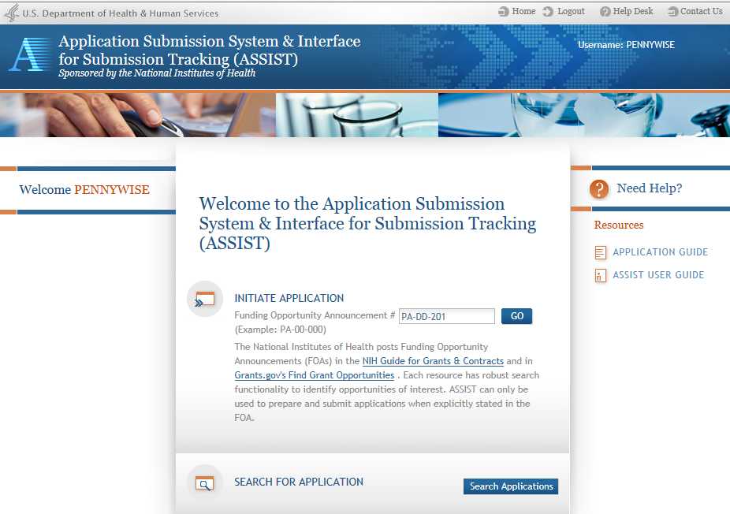
Initiate Application

Slide 27
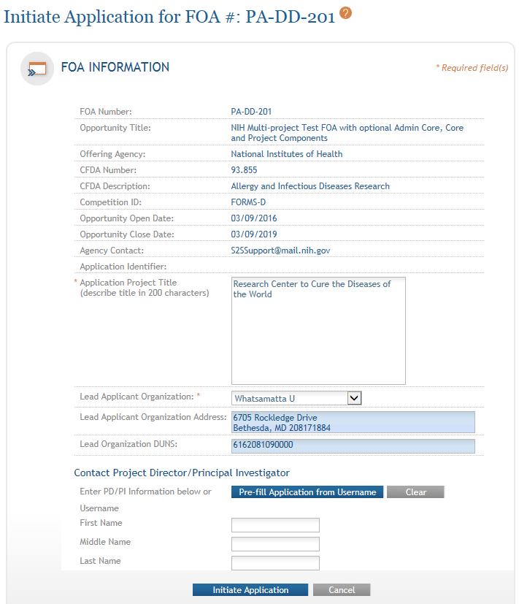
Initiate Screen
FOA information pulled from Grants.gov
Enter Project Title
Drop-down list of organizations affiliated with your eRA Commons account
Data pre-populated from organization selection

Slide 28
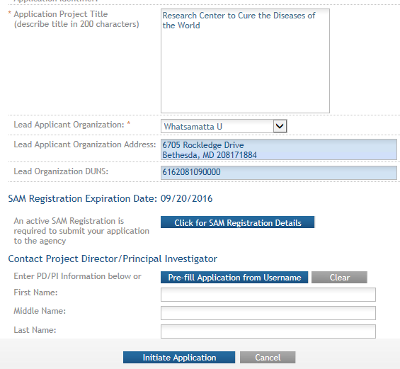
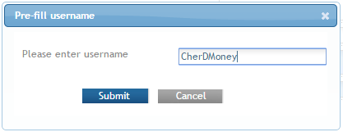
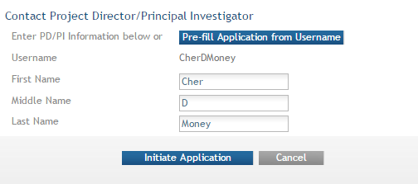
Initiate: Pre-population
Visibility to SAM registration expiration date & details
Can manually enter PD/PI information or provide
eRA Commons username to auto-populate

Slide 29
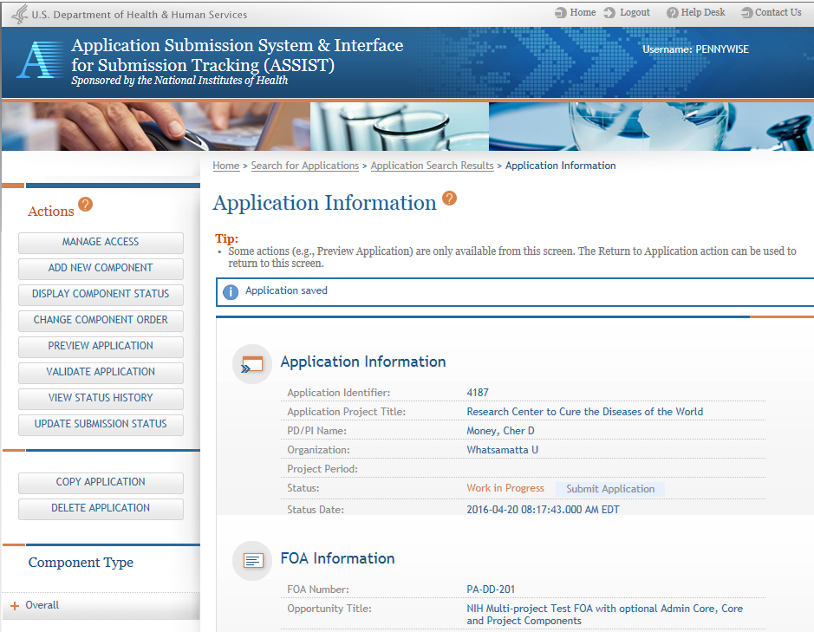
Using ASSIST
Access on-line help
Screen tips
ASSIST messages
Available actions vary based on application context and access

Slide 30
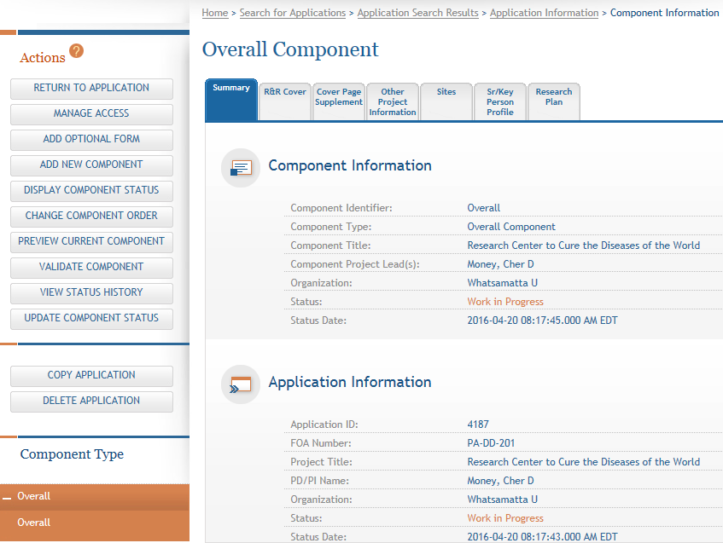
Overall Component
Form navigation for the selected component.
The Overall Component is added to the component navigation.

Slide 31
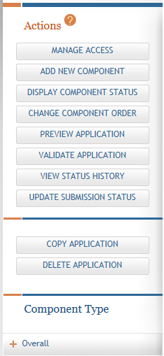
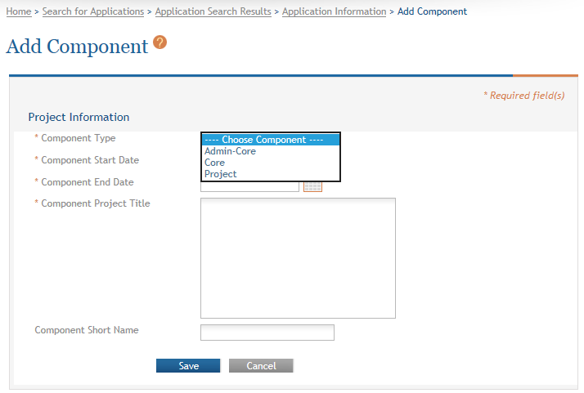
Adding Additional Components
Add New Component.
Allowable component types defined in the FOA are presented.
Provide name for easy reference during application preparation. Does not appear in image.

Slide 32
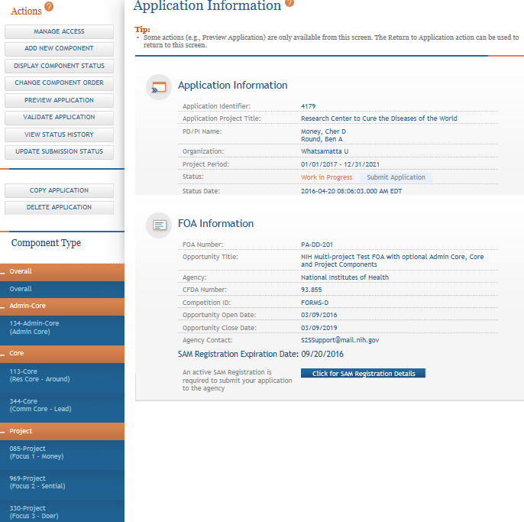
Adding Components
Continue adding components to build out the application shell.

Slide 33
Define Your Team and Provide Application Access
Find
Plan
Initiate
Build Team
Enter Data
Finalize
Submit
Track

Slide 34

Automatic Application Access
ASSIST automatically provides access to applications for some users:
Based on eRA Commons roles
  All SOs and AOs at the applicant institution have irrevocable edit access for the entire application
  All SOs and AOs at an organization leading a component
  have irrevocable edit access for their component once their DUNS number is provided
Based on role on the application
  The application initiator has edit access for the entire application
  All PD/PIs listed in the Overall component have edit
  access for the entire application once their eRA Commons
  IDs are provided
  The component Project Leads have edit access for their
  components once their eRA Commons IDs are provided

Slide 35

Managing Access
Application access can be given to additional users with Commons IDs
  Within or outside applicant organization
Application access can be controlled across these variables:
  Entire application vs. specific components
  View vs. Edit
  Budget vs. Non-budget data

Slide 36

Signing Officials (SOs)
SOs at the applicant institution can
  Manage application access for other users
  Manage application status all the way to Ready for Submission status
  Delegate Access Maintainer
  and Status Maintainer authority
  to other users within their
  institution
  Access the Submit action

Slide 37
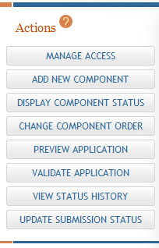
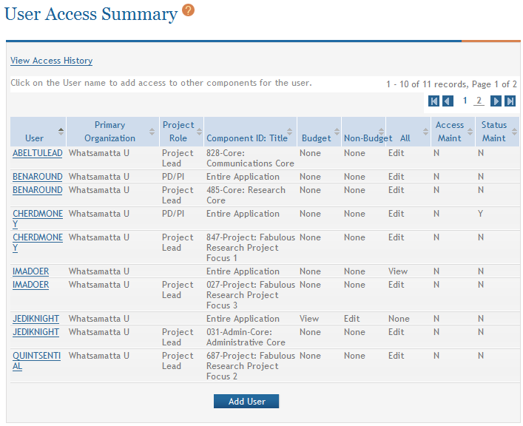
Managing Access
The Manage Access action can be used to provide access to additional users or modify access for existing users.
Modify access for existing user.
Give access to additional users.

Slide 38
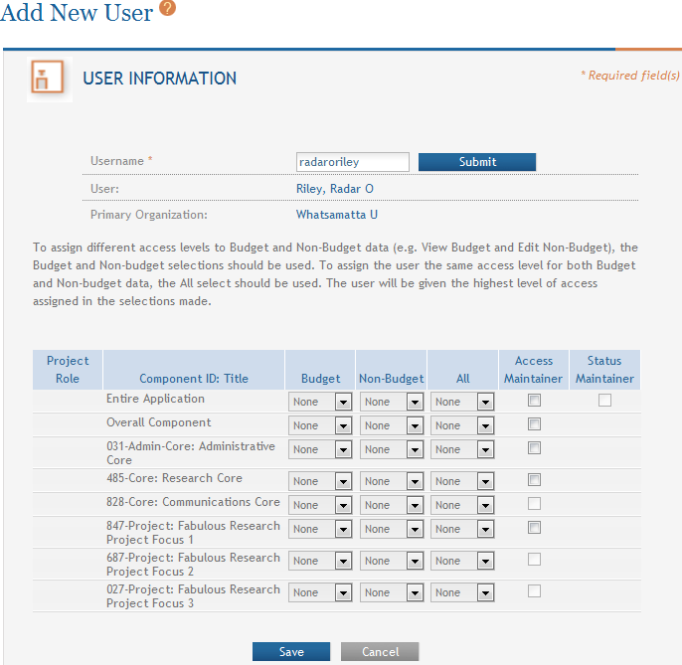
Add User
Provide Commons ID.
User can be designated to manage access for the application or components.
User can be designated to change application status.
Change View/Edit/None access for the application or components.

Slide 39
Enter Application Data
Find
Plan
Initiate
Build Team
Enter Data
Finalize
Submit
Track

Slide 40
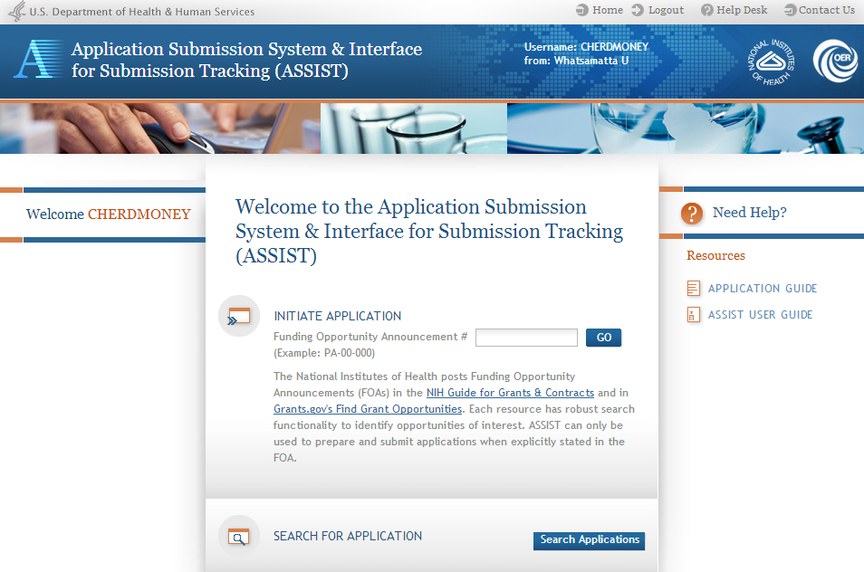
Searching for In-progress Applications
Use Search Applications to access your in progress application.

Slide 41
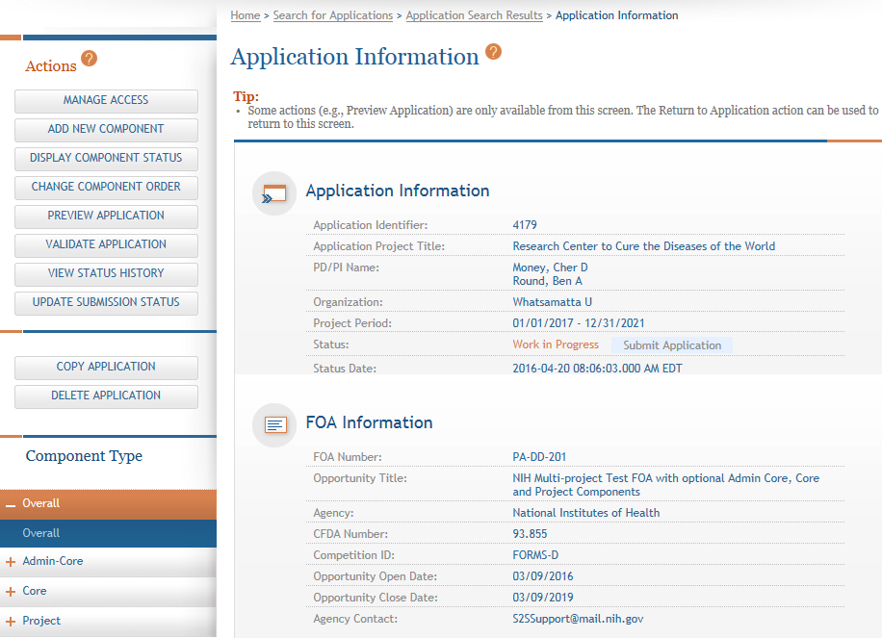
Navigating to a Specific Component
Use the component navigation to identify the component you want to work on.

Slide 42
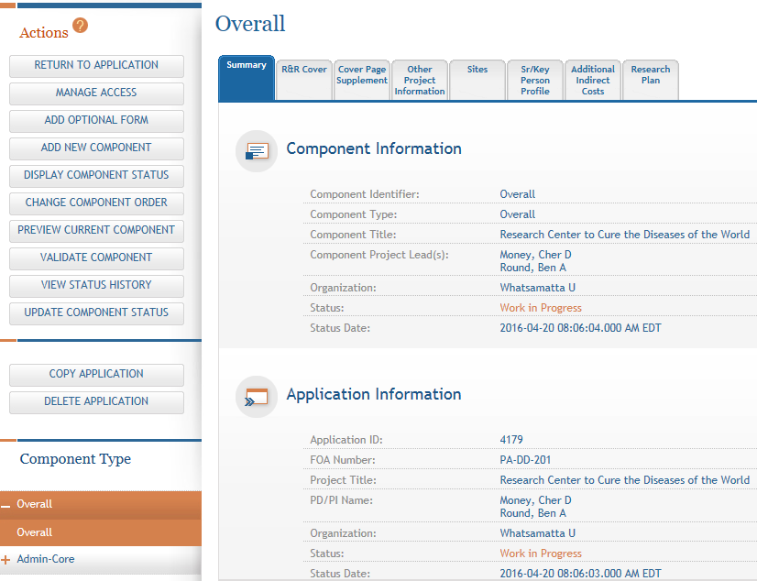
Summary Page
Every component has a Summary page.
Some actions are only available from the Summary page.

Slide 43
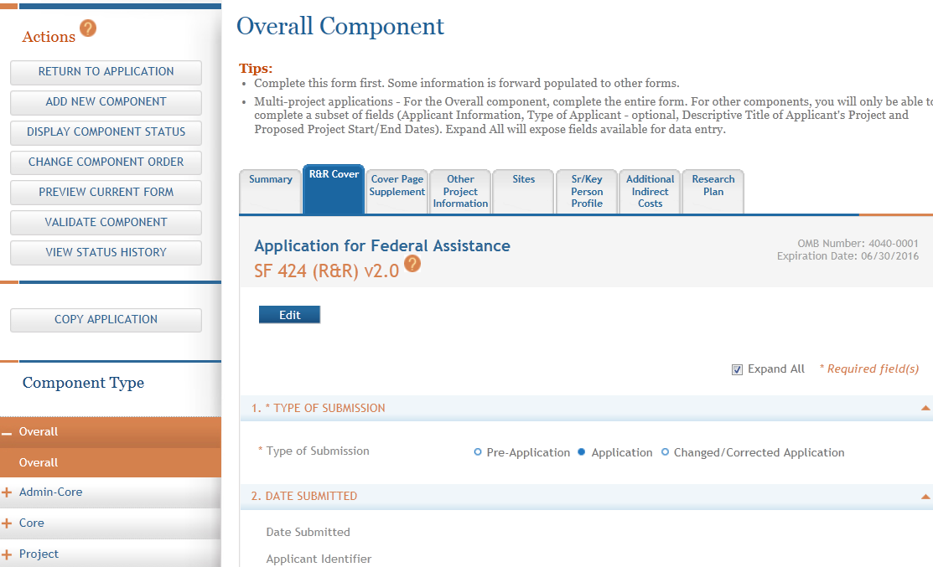
Entering Application Data
Click each tab to access form data entry screens.
Clicking Edit blocks other users from editing form.

Slide 44
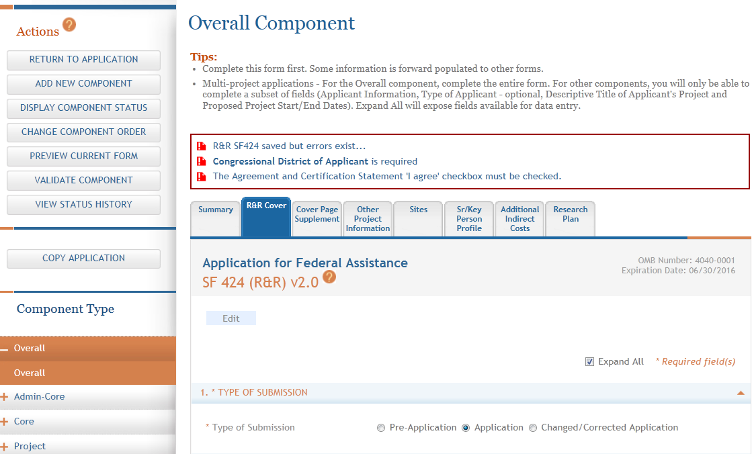
Data Entry Validation
ASSIST validates entered data and provides errors at the top of the screen when you Save.

Slide 45
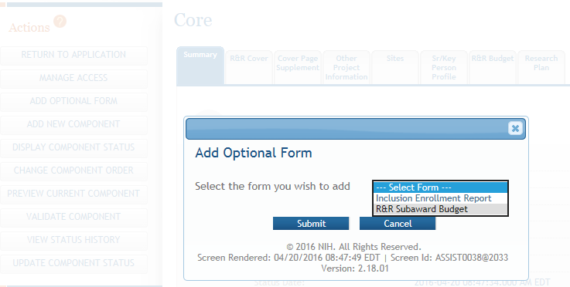
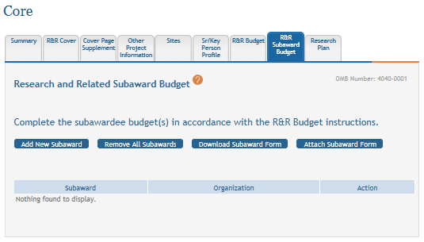
Adding Optional Forms
Add Optional Form.
Select form and click Submit.
Form added to navigation.

Slide 46
Data Entry: General
Overall
  Describe the entire application
  Always completed with applicant organization information
All Other Components
  Reflect the activity in the specific component
  Completed from the perspective of organization leading the component

Slide 47
Avoid Common Errors
ASSIST screen tips
  Found at the top of many data entry screens
How to Apply - Application Guide
  http://grants.nih.gov/grants/how-to-apply-application-guide.htm
Annotated form sets
  http://grants.nih.gov/grants/how-to-apply-application-guide/resources/annotated-form-sets.htm

Slide 48
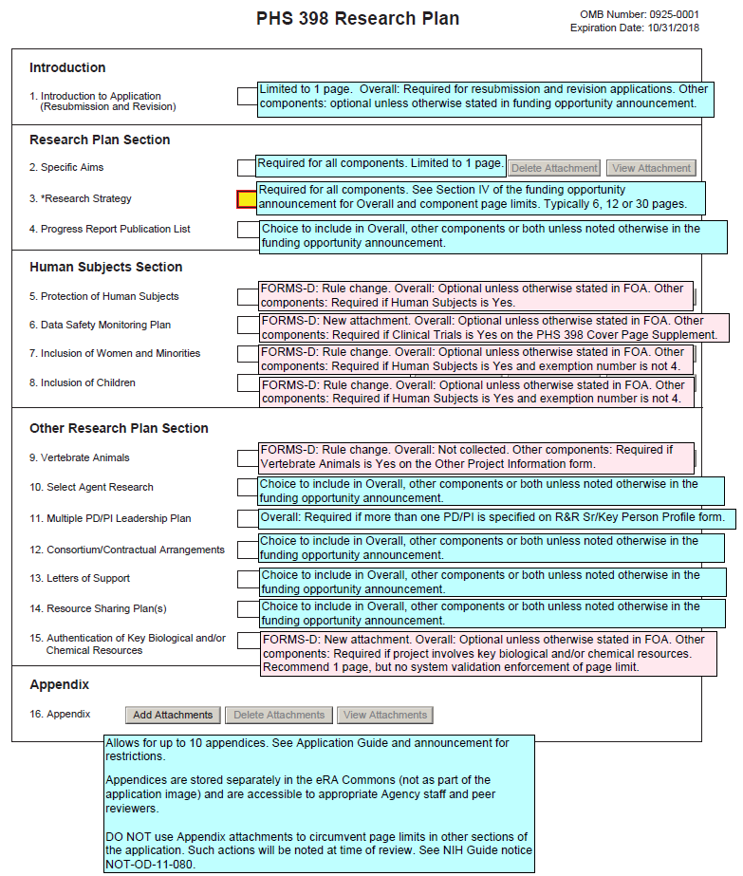
Annotated Form Set
Great resource to help you navigate system enforced form requirements.

Slide 49
Component Actions
As component data is entered several actions are available:
  Change Component Order
  Validate Component
  Preview Current Component
  Update Component Status
    Work In Progress – only status that allows editing
    Complete – component data entry is complete
    Final – component has been reviewed by applicant organization and incorporated into the application

Slide 50
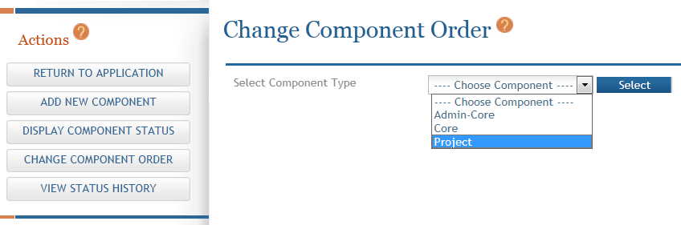
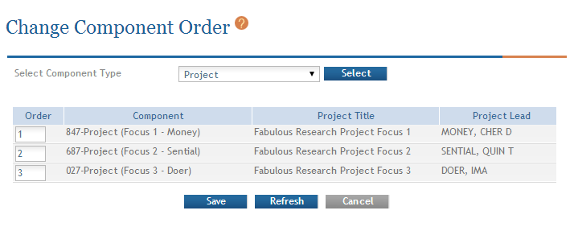
Change Component Order
Select Component Type to reorder.
Provide desired sequence.

Slide 51
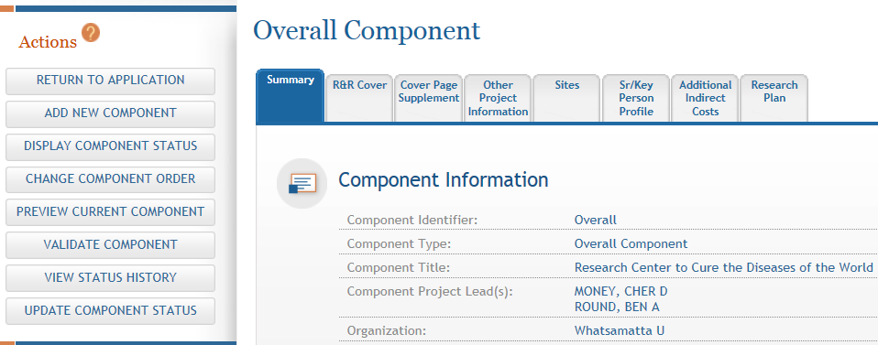
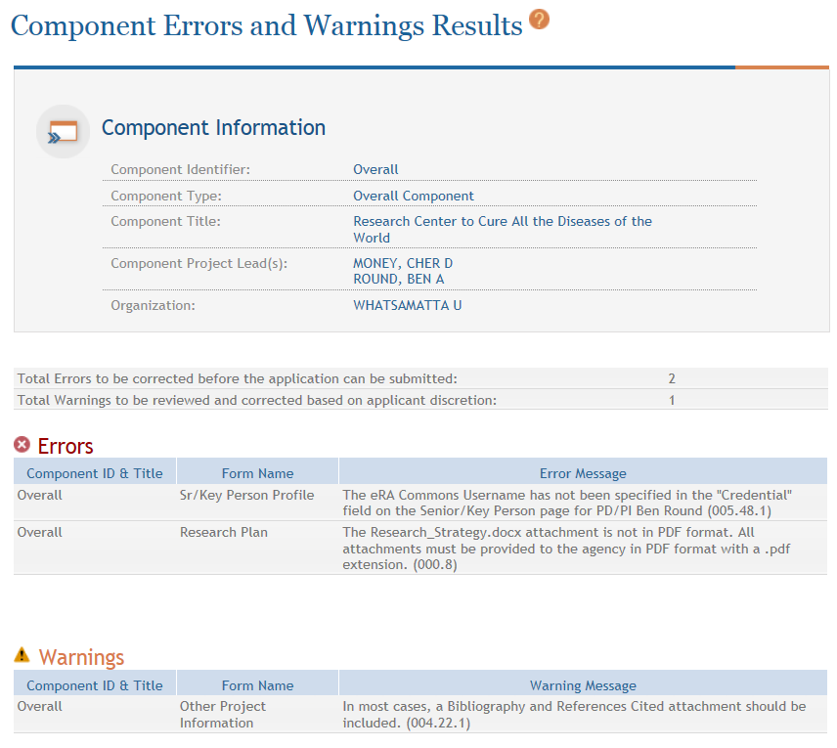
Validating a Component
Errors and Warnings are displayed.

Slide 52


Errors & Warnings
Errors stop application submission and processing and must be corrected before the due date
  Can’t submit until error-free
Warnings do not stop application submission or processing and are corrected at the discretion of the applicant before the due date

Slide 53
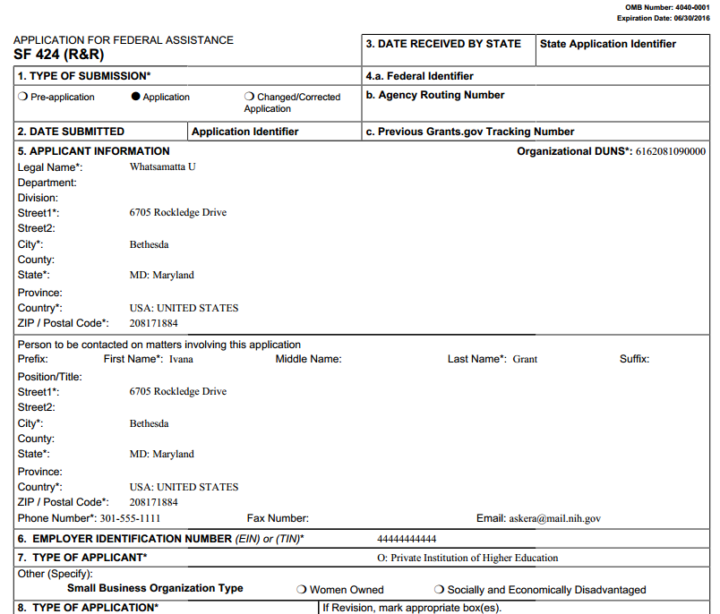
Previewing a Component
Component preview does not include bookmarks, Table of Contents, data summaries or biosketches.

Slide 54
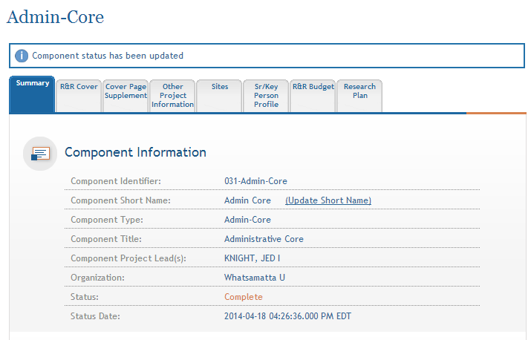
Updating Component Status to Complete
Select status and enter comment for Status History.
Once a component is marked ‘Complete’ no additional edits can be made unless someone with appropriate authority (i.e. AO, SO, Status Maintainer, or Initiator) returns the status to ‘Work in Progress’.
Status on Summary page is updated.

Slide 55

Finalize Application & Prepare for Submission
Find
Plan
Initiate
Build Team
Enter Data
Finalize
Submit
Track

Slide 56
Finalizing Components
As components are marked ‘Complete’, the applicant organization can preview them and incorporate those that are ready into the final application by updating the component status to ‘Final’
  Applicant organization AOs, SOs, users with Status Maintainer authority and application initiators have option to mark a component ‘Final’ directly from ‘Work in Progress’
All components must be marked ‘Final’ before an application can be prepared for submission

Slide 57
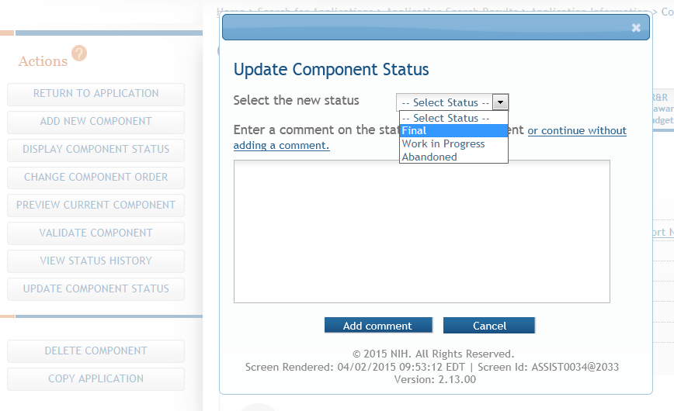
Setting Component Status to Final
Update the component status to Final once you are satisfied that the component is ready to be included in the final application.

Slide 58
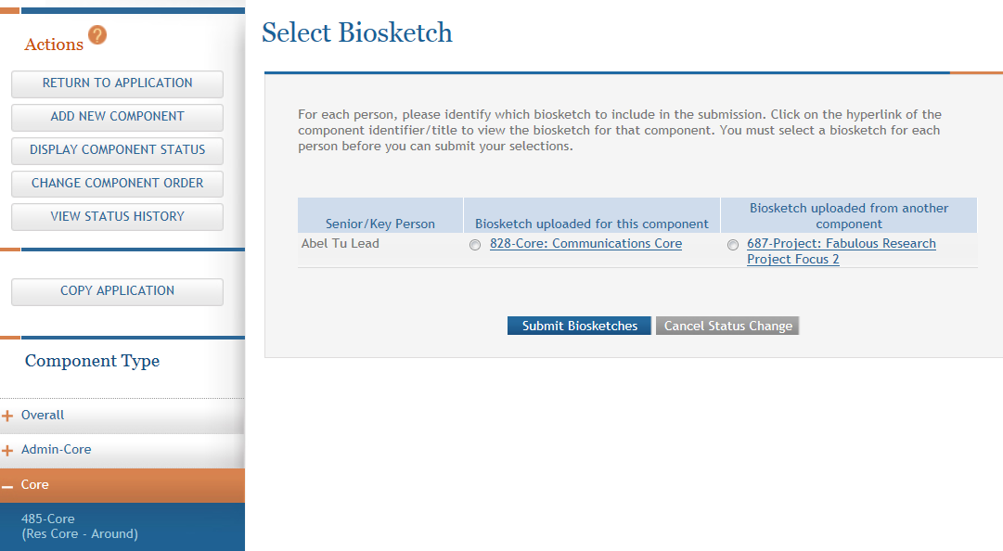
Reconciling Biosketches
ASSIST will check to ensure that only one biosketch is included for every Senior/Key person in the application.
If a biosketch is already included for any Sr/Key, you will have the option to view each biosketch and select the one you wish to keep.

Slide 59
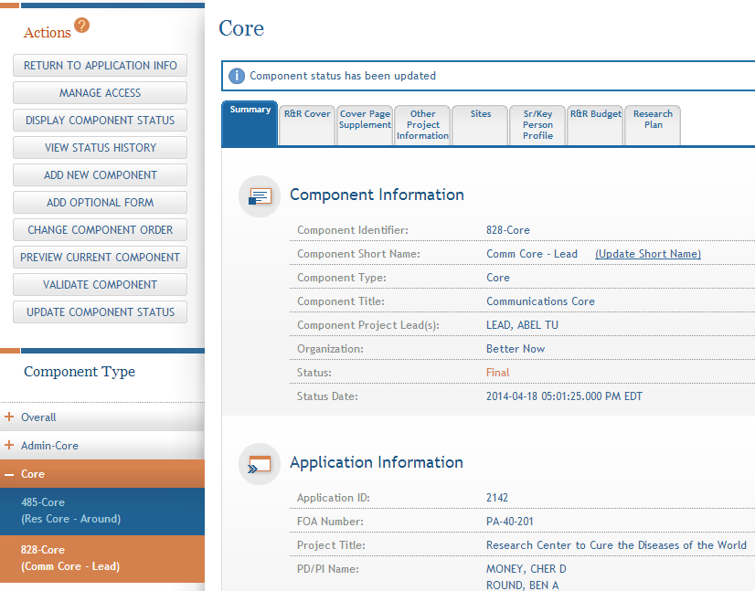
Finalizing Components
  After all biosketch issues are reconciled, the component status is set to Final.

Slide 60
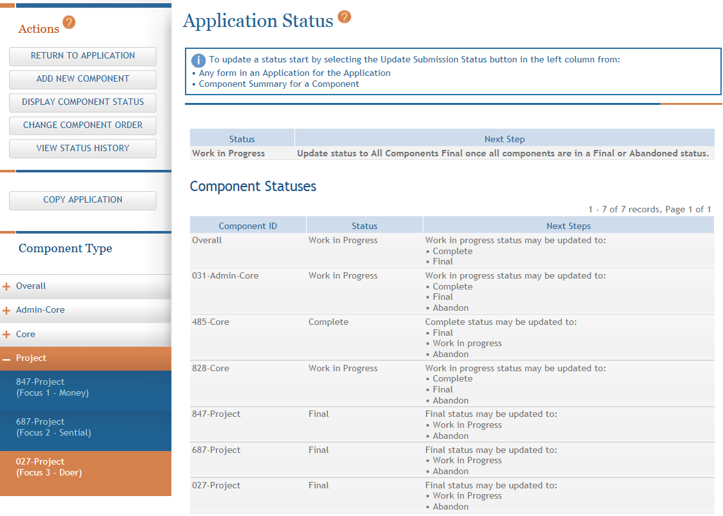
Display Component Status
Provides all application/component status on a single screen

Slide 61
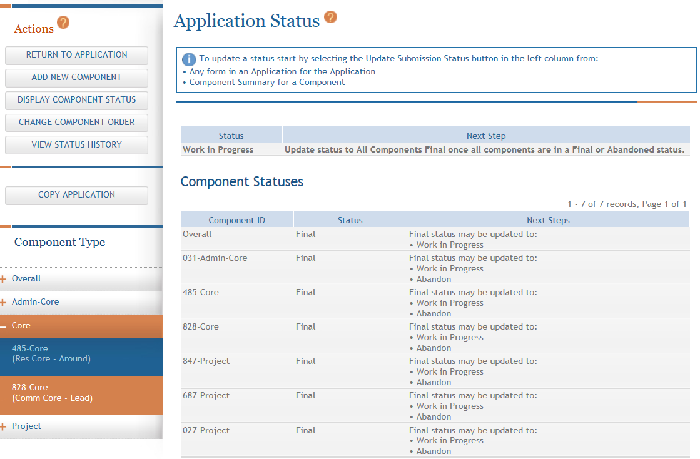
Updating Application Status
Although the Status is set to Final for each component, the Application Information still shows a Status of Work in Progress.

Slide 62
Submission Status Flow
Work In Progress – Allows editing
All Components Final – Can only be updated once each component status is Final
Ready for Submission – Before status is changed, the system does a final validation check on your application
Submitted – Automatically set after submitting to Grants.gov
Before changing your Submission Status, you may want to take another look at your application since you need to be in Work In Progress status to make any changes.

Slide 63
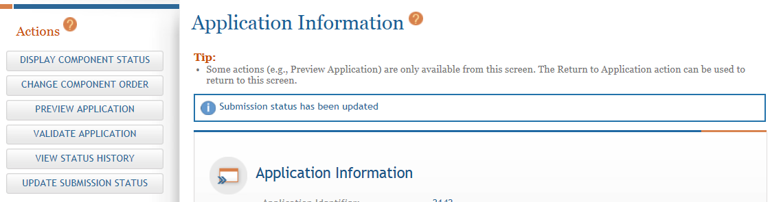
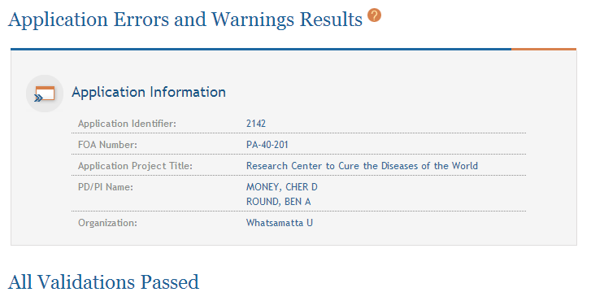
Validate Application

Slide 64
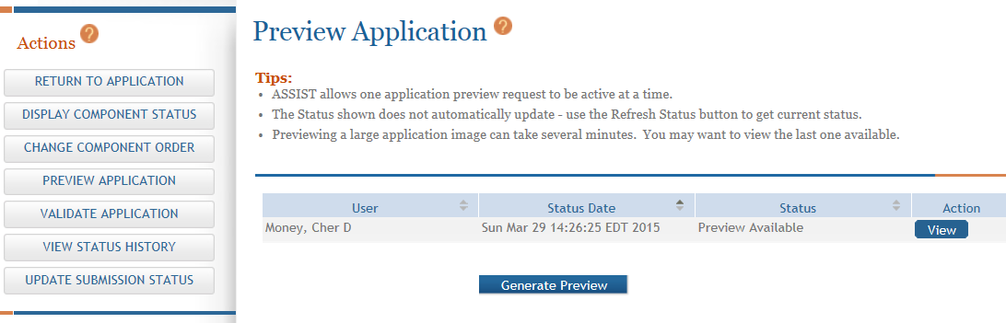
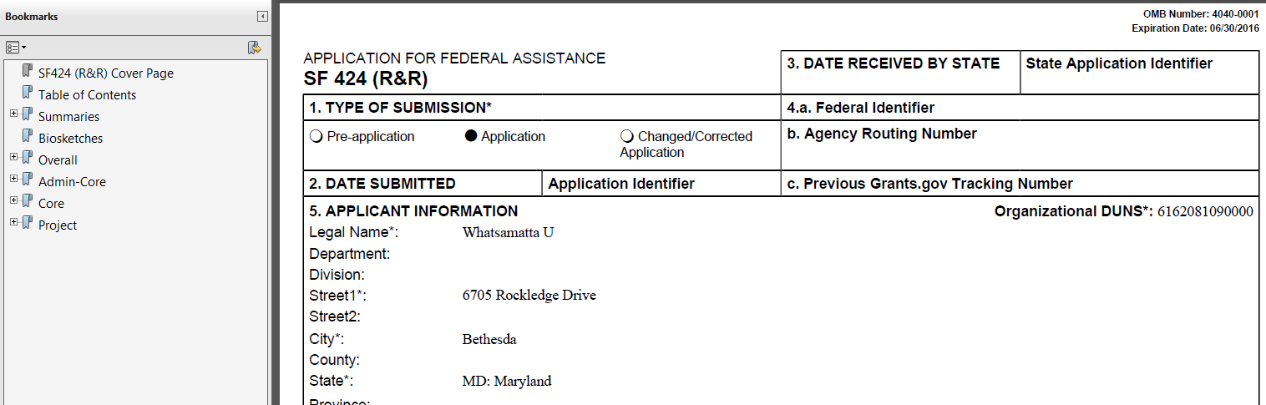
Preview Application
Application preview does not include Cover Letter, PHS Assignment Request Form or Appendices which are maintained separately post-submission.

Slide 65
How does it look?
If you like what you see, then it’s time to run through your internal approval process and take the final steps to prepare for submission.

Slide 66
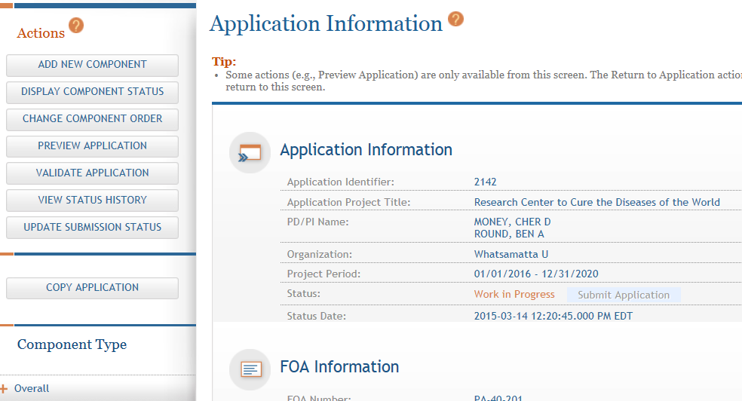
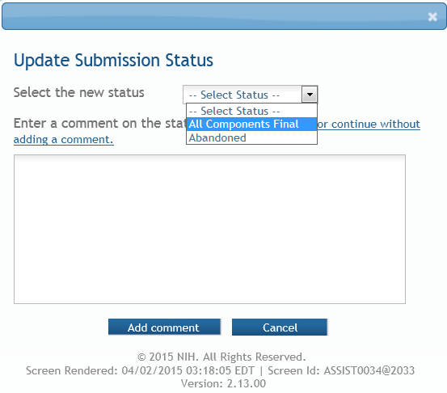
All Components Final
You can prepare your application for submission once the status for all individual components has been set to Final.
Set the application status to All Components Final.

Slide 67
Ready for Submission
Once all internal reviews are complete, update the application status to Ready for Submission.

Slide 68
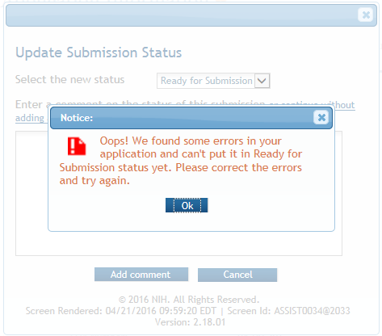

Final Check for Errors
Before an application is changed to Ready for Submission status, it must pass validations (Warnings are OK).

Slide 69
Submit Your Application
Find
Plan
Initiate
Build Team
Enter Data
Finalize
Submit
Track

Slide 70

On-time Submission
Error-free submission must be made by 5:00 p.m. local time (of submitting organization) on due date
  It takes time to prepare your application for submission
  Submit early (days, not minutes)
  to have time to address any
  unforeseen issues and to view
  your assembled application

Slide 71
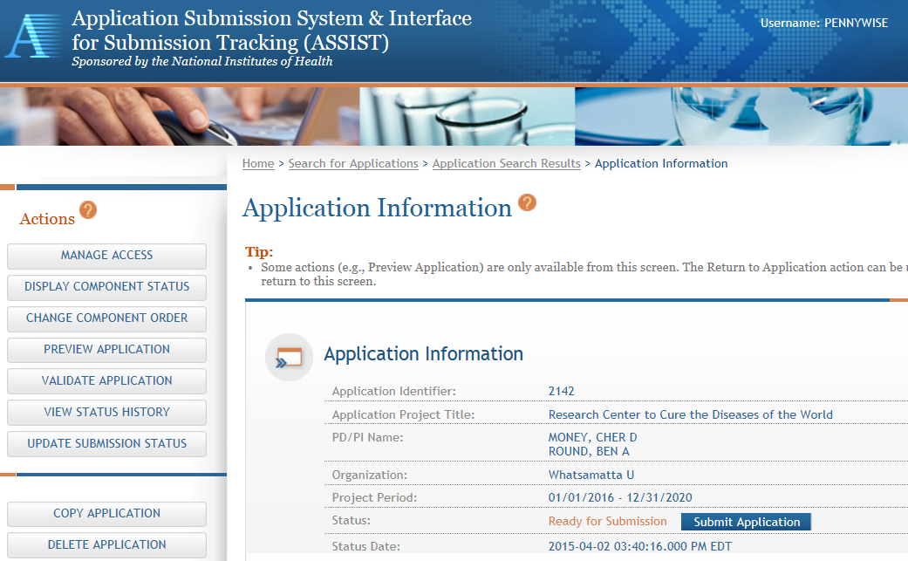
Submit Your Application
Must be a Signing Official (SO) in eRA Commons and an Authorized Organizational Representative (AOR) in Grants.gov to submit.
Application Status must be set to Ready for Submission.

Slide 72
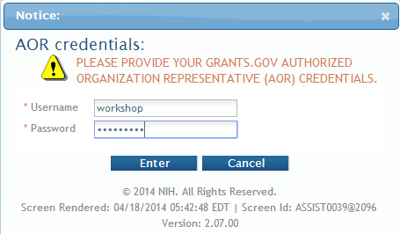

Submit Your Application
Applications are submitted from ASSIST to Grants.gov.
Enter your Grants.gov AOR credentials and click Enter.
Message will appear indicating the application was sent to Grants.gov.

Slide 73
Track Your Application
Find
Plan
Initiate
Build Team
Enter Data
Finalize
Submit
Track

Slide 74

Notifications
ASSIST sends out quite a few email notifications throughout the preparation
and submission process to help you
track your application
  Application access changes, component/application updates, component/application status changes, submission status updates and more
Check out this resource: http://grants.nih.gov/grants/electronicreceipt/files/ASSIST_eNotifications.pdf

Slide 75

Tracking Submission Status - ASSIST
ASSIST provides the ability to track both Grants.gov and NIH status
  Links to the eRA Commons Detailed Status Information to view your assembled application

Slide 76
Tracking Submission Status - ASSIST
After submitting to Grants.gov, submission status can be tracked in ASSIST.
Click View Submission Status Details

Slide 77

Tracking Submission Status - ASSIST
Top of screen
You must click Check for Status Updates to force ASSIST to poll Grants.gov and NIH for status.
ASSIST will indicate if a status change was detected.

Slide 78

Tracking Submission Status - ASSIST
ASSIST, Grants.gov and Agency submission status are available.
Grants.gov status of Agency Tracking Number Assigned and Agency status of Processed is good news!
Agency Tracking # link brings you to the detailed status screen in eRA Commons

Slide 79

Viewing Your Application in Commons
eApplication is the assembled application image reviewers and staff will see - check it carefully.
You will also want to check the
  Cover Letter,
  PHS Assignment Request Form, and
  Component Appendices
which are stored separate from the image.

Slide 80

Application Viewing Window
Applicants have two (2) business days to view the assembled application image in eRA Commons before it automatically moves forward to NIH staff for further processing.
If you can’t VIEW it, we can’t REVIEW it!

Slide 81

Viewing Your Application in Commons
It is your responsibility to carefully review the entire
application to ensure it has been processed correctly!

Slide 82




Automatic Data Summaries

Slide 83

Automatic Data Summaries
The DUNS numbers on budget forms used to differentiate between applicant organization and subaward costs.

Slide 84


Automatic Data Summaries

Slide 85

Rejecting the Application
SO can Reject eApplication in eRA Commons within viewing window and submit a Changed/Corrected application prior to the due date
Coming Soon – direct link from ASSIST to eRA Commons

Slide 86

Submission Complete!
If no action is taken to reject the application during the two business day viewing window, the application automatically moves forward to NIH for further processing.

Slide 87

Dealing with System Issues
Follow NIH’s standard ‘system issue’ procedure if you run into problems beyond your control that threaten your on-time submission: http://grants.nih.gov/grants/ElectronicReceipt/support.htm#guidelines

Slide 88
Making a Copy of Your Application
You can easily make a copy of your application to:
  Work on a Resubmission application
  Move data to a different opportunity
  Move data to a different version of forms during a form update (e.g., FORMS-C to D)
  Take a snapshot, before heading in a different direction

Slide 89

Copy Application
Provide target FOA number.
Select target component type for each component.
Check box if you want to copy attachments.

Slide 90

ASSISTance

Slide 91


On-line ASSIST Help
Logistics of using ASSIST
Click on question mark icon to access ASSIST help
Search feature
Access to application guide for additional guidance on field content information

Slide 92

Links & Resources
ASSIST: public.era.nih.gov/assist
Online help: era.nih.gov/erahelp/ASSIST/
How to Apply – Application Guide
http://grants.nih.gov/grants/how-to-apply-application-guide.htm
Annotated form set
http://grants.nih.gov/grants/how-to-apply-application-guide/resources/annotated-form-sets.htm
eRA ASSIST Training page: http://era.nih.gov/era_training/assist.cfm

Slide 93

Service Desk
eRA Service Desk
Web: http://grants.nih.gov/support/
Toll-free: 1-866-504-9552
Phone: 301-402-7469
Hours: Mon-Fri, 7a.m. to 8 p.m. Eastern Time
(Except for Federal holidays)
Although we’ve worked closely with Grants.gov, ASSIST is a system developed and managed by NIH.
The eRA Service Desk should be your first stop for support.

Slide 94







Questions
Q
S
S
I
U
E
T
O
N

