Slide 1
CRC + OPD Grants Update for Department Representatives
FALL 2018

Slide 2

What are the CRC and OPD?
The CRC is the Council on Research and Creativity, and OPD is the Office of Proposal Development.
OPD
CRC
Located within the Office of the Vice President for Research
Assist with PRE pre-award activities
  Funding announcements
  Proposal development
  Faculty research roadmaps
A separate entity from Sponsored Research
Select faculty council that advises the VP for Research
Staffed by OPD team member
Provides internal “seed” funding for eligible faculty members
Funded by F&A funds received the previous fiscal year
Award files maintained by Sponsored Research
Notes:
GRACE - Intro

Slide 3

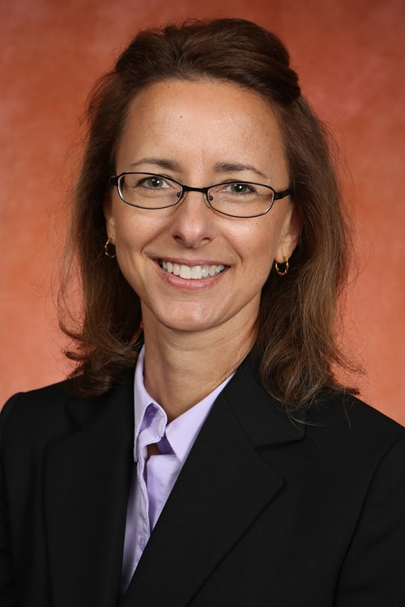
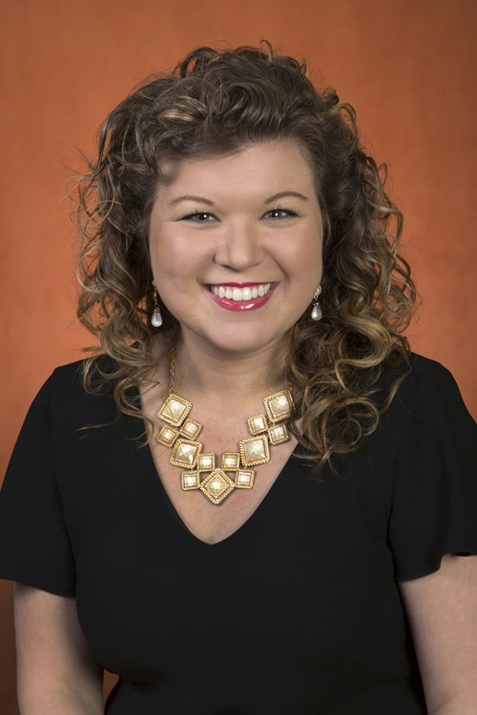
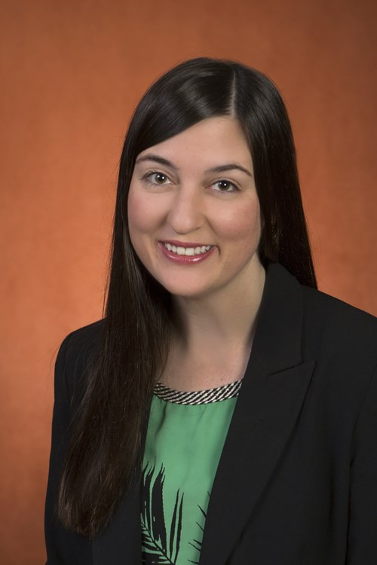
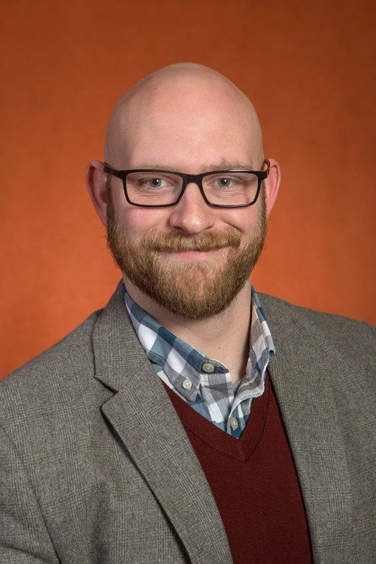

Office of Proposal Development
Beth Hodges
Grace Adkison
Rachel Goff-Albritton
Mike Mitchell
Notes:
GRACE - Intro

Slide 4

OPD.FSU.EDU

Slide 5
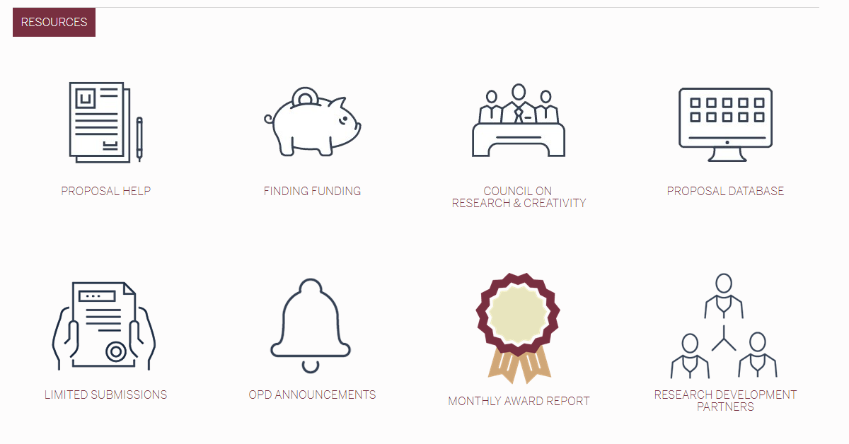
Robust Website of Resources
Notes:
Funding Searches and Trainings
Successful Proposal Database
Faculty Research Networking and Collaborative Events
Grant-related Workshops and Events
One-on-one Meetings with New Faculty
Grant Writing Resource Library
Proposal Narrative Editing Support
Collaborator, Peer-Mentor, and Reviewer Identification Assistance
Limited Submissions Portal

Slide 6
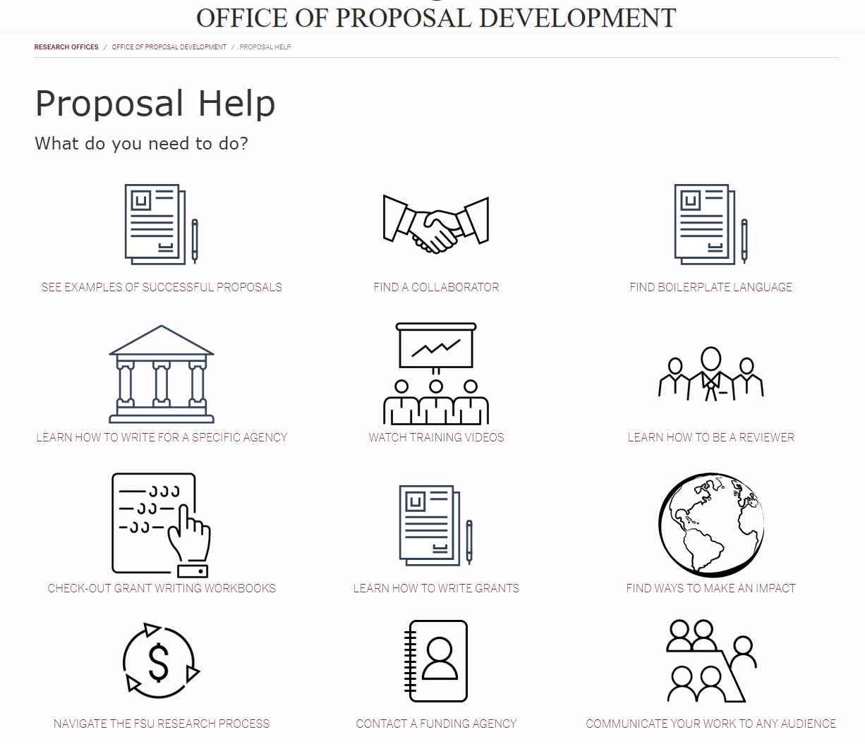
Robust Website of Resources

Slide 7
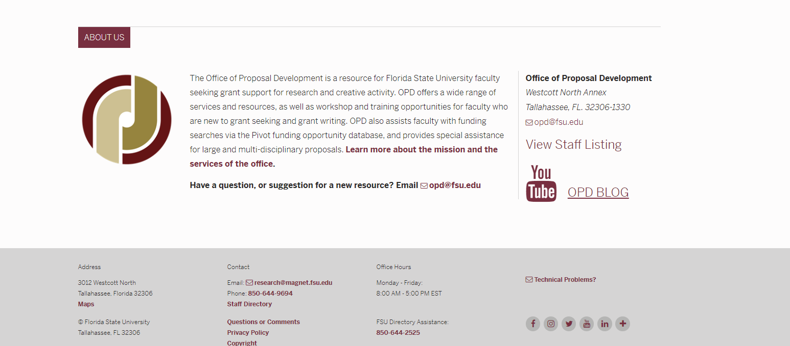
opd.fsu.edu

Slide 8
One-on-one Meetings with New Assistant Professors
In one-on-ones, we…
Provide faculty with our grant resources and university contacts
Introduce them to our services
Learn about their research
Discuss the different roles and offices within the FSU research process
Discuss their research- and grant-seeking goals and develop a plan
Follow-up with second- and third- year assistant professors

Slide 9

Finding Funding
Funding Announcements
  FSU Research Newsletter (Back this Fall)
  OPD listserv (also event announcements)
  Deans, Directors, & Department Chairs
College of Medicine listserv; College of Education Funding Opportunities Database;
Do You Know of Any Others?
Grants.gov targeted funding announcements to individual faculty based on their research topic

Slide 10
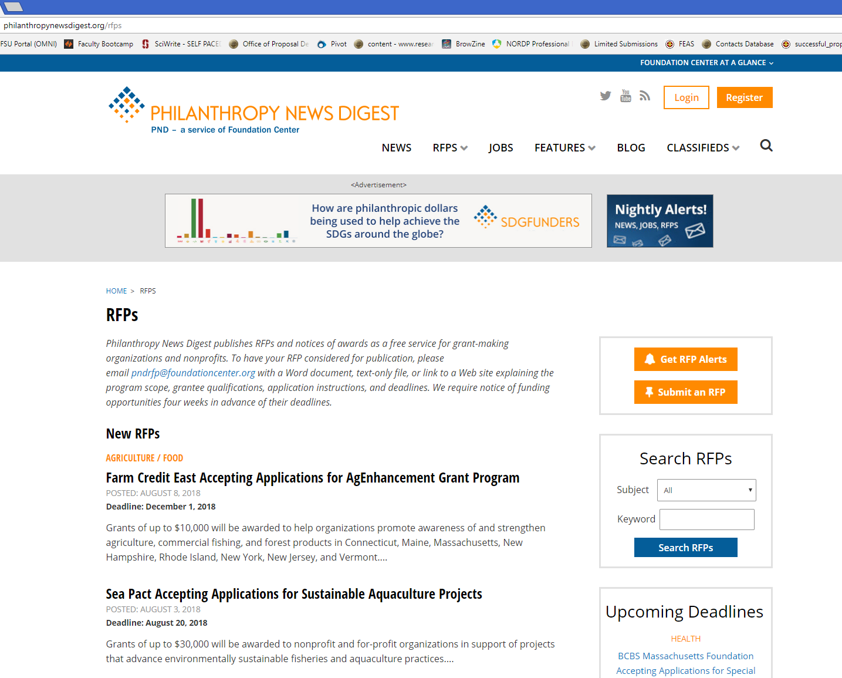

Finding Funding
Foundation Center Grants Directory
http://philanthropynewsdigest.org/rfps

Slide 11

Pivot
Database of Grant Opportunities
Allows you to Set-up Saved Searches and Weekly Funding Alerts
Interested in Providing a Pivot In-Service for your Faculty?

Slide 12
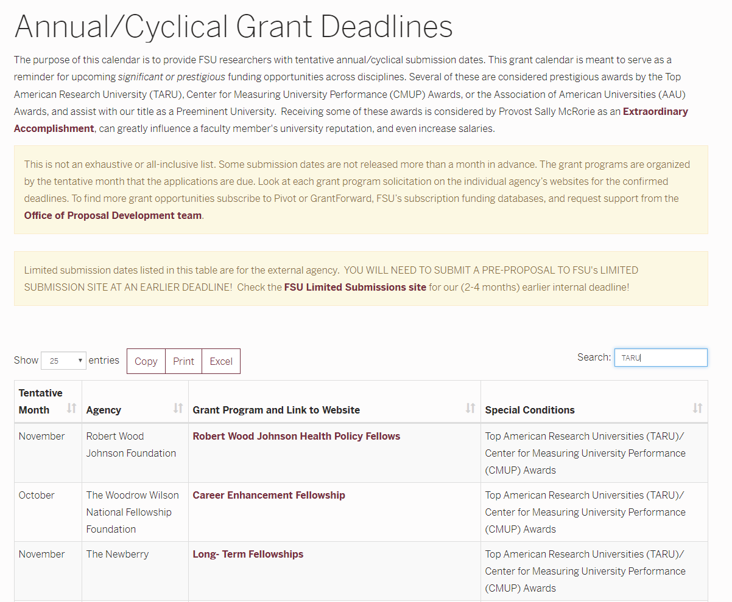
Cyclical Grants Deadlines Calendar

Slide 13
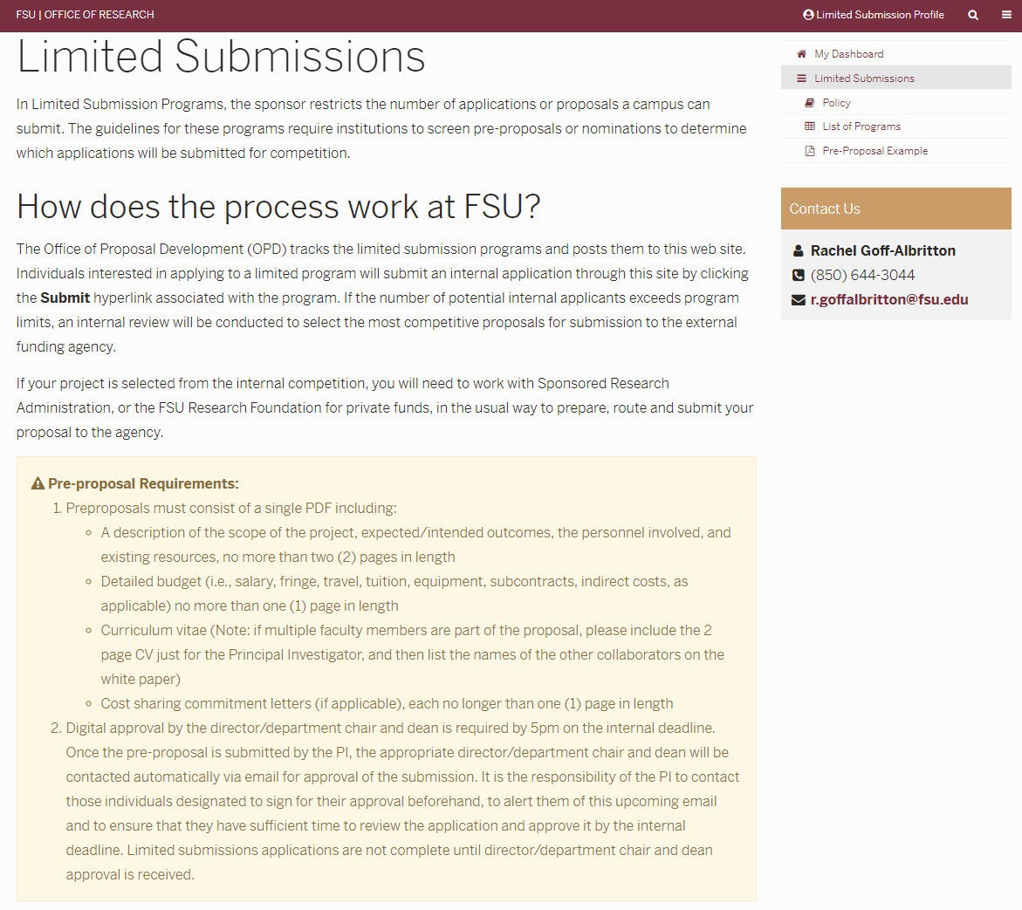
Limited Submissions Portal

Slide 14
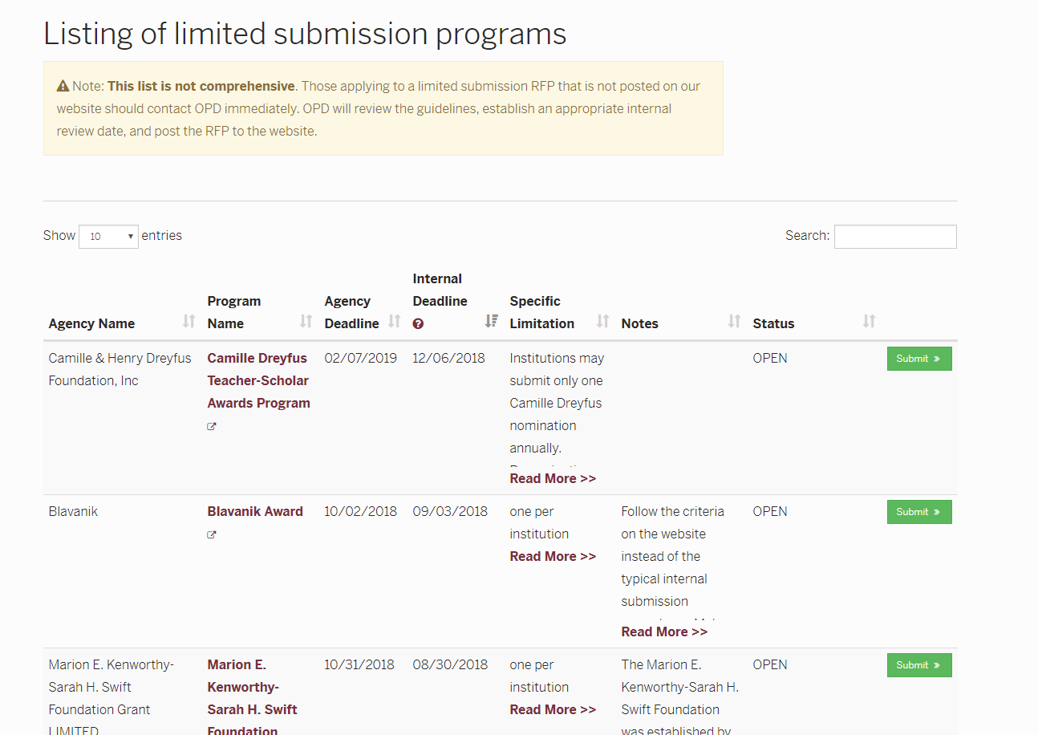
Limited Submissions Portal
searchable

Slide 15


Successful Proposals
Faculty can view examples of Successful Proposals from other FSU Faculty
Password-protected
Notes:
If you know of a really good grant (as compared to others that you have assisted with) help us by letting us know so that we can post it to our password-protected database of successful proposals.
We ask permission from faculty to post a copy of their grant proposals as a sample for faculty new to that grant’s format to post.

Slide 16

Grant Writing Resource Library
Faculty can check out Grant Writing Workbooks for:
  NSF
  NIH
  Any Agency
  New Faculty

Slide 17
Events/Workshops/Trainings
Who…
plans-it, arranges-it, reserves-it, loads-it, brings-it, serves-it, displays-it, lights-it, records-it, reviews-it, posts-it-online
so you don’t have to?
WE DO!

Slide 18

Grant-related Workshops & Events
Examples of Previous OPD Workshops and Events:
“Crafting a Budget”
“Florida Funding for Arts and Humanities”
NIH Career Development Awards Seminar
NSF CAREER Workshop Series
SUGGESTIONS WELCOME!!

Slide 19
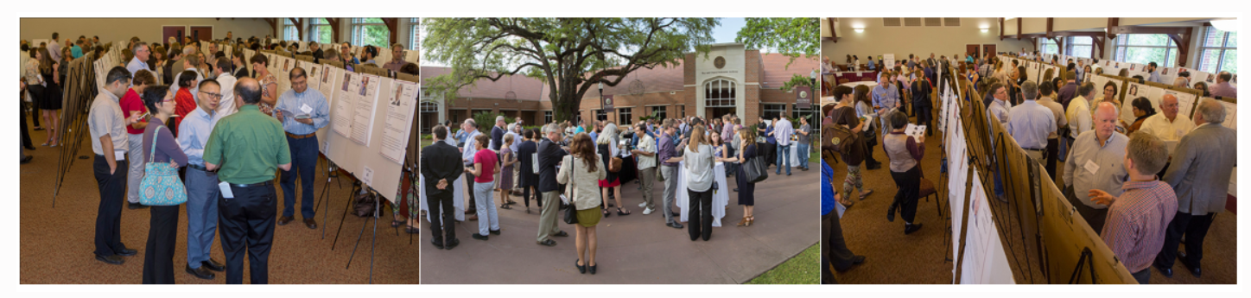
Topic-Based Collaborative Events
NEW THIS YEAR
Competitive
Seed Funding
Grant
Collaborative Collision
Allows researchers from all Colleges, Departments, and Centers to come together to discuss possible collaborations surrounding a defined topics
Provides an atmosphere to discuss researcher’s expertise, potential contributions to a research team, and partnerships to enhance their own research

Slide 20
Proposal Development
Before the PI sends his/her proposal to Sponsored Research, we help by:
Reviewing the Request for Proposals (RFP)
Locating examples of successful proposals
Creating a writing timeline for the team and delegating tasks
Meeting first with grants analysts and department reps to initiate a draft for the budget
Identifying community partners or potential collaborators
Finding and working with internal and external expert reviewers
Editing the proposal

Slide 21
Proposal Narrative Editing Support
Is there a clear objective?
What is the gap in current knowledge or topic?
Why will this project be successful?
Is it described as being a feasible project?
Is this project matching the goals of the funding agency?
Are there any problems with spelling, grammar, page limits, spacing, or graphics?

Slide 22
Large Proposal Assistance
Provide proposal development support for large >$1M grants, e.g., center or multi-disciplinary grants
Strategic planning on agency trends and legislative initiatives
Identifying collaborators or external partners
Tracking and coordinating proposal team responsibilities
Gathering non-technical info and providing institutional data
Developing infographics with OVPR graphic support staff
Editing and reviewing the proposal for style and compliance with agency review criteria

Slide 23
Council on Research and Creativity
…better known as the CRC

Slide 24

CRC – Policy Changes
BUDGETS
  New budgetary restrictions on grant travel
  NO COMPUTER PURCHASES ALLOWED across all CRC grants
  Grant payback is required for faculty leaving the university
Processes
  Instructional videos included throughout the proposal entry portal*
Transparency Upgrades
  Scoring Criteria are more visible
  Pre-review deadlines stated
  Review Committees are stated

Slide 25

Common Myths
the money, the myths, the legends…

Slide 26
Myth or Fact?
The CRC is a “step” program. I apply for my FYAP, then my PG, then my COFRS…..
MYTH Faculty are encouraged to apply for external funding after receiving a CRC grant.
CRC proposals require faculty to list the external funding they have received as a result of any previous CRC funding.

Slide 27
Myth or Fact?
The First Year Assistant Professor grant is automatically guaranteed for all FYAPs.
MYTH FYAPs must submit a competitively-written grant and must attend the FYAP Workshop on September 14 in order to qualify for a FYAP award. Awards are not guaranteed, especially with this year’s large cohort!

Slide 28
Myth or Fact?
The CRC proposal success rate is over 60% on average.
FACT This past year (2017/2018), 123 of 184 competitive proposals were awarded!

Slide 29
Myth or Fact?
Time extension and budget amendment requests can be submitted at any time, or not at all if it’s just a little bit of money.
MYTH (with a tiiiiny bit of FACT) Time extension and budget amendment requests must be submitted at least 30 days prior to the end of the award period.
Any budget changes over 10% of that “line item” must be approved by the CRC prior to the purchase/expenditure.

Slide 30
Myth or Fact?
The CRC is only geared to help faculty in the hard Sciences, not the Arts and Humanities.
MYTH The CRC has a program specifically for the Arts and Humanities (AHPEG), as well as a review group within the Planning Grant (PG) program. Most recent recipients of the Small Grants (SGP) have also been from the Arts and Humanties.

Slide 31

Questions
Now it’s YOUR turn!

Slide 32
