Slide 1
Integrating
Research & Education
Office of proposal development
Florida state university
March 26, 2019

Slide 2
Agenda
Introduction
Panel Presentations
Q&A

Slide 3
Dr. Ellen Granger
Director
Office of Science Teaching Activities
Dr. Austin Mast
Professor
Department of Biological Sciences
Dr. Roxanne Hughes & Kari Roberts
Center for Integrating Research & Learning
National High Magnetic Field Laboratory

Slide 5
Dr. Ellen Granger
Director, Office of Science Teaching Activities

Slide 6
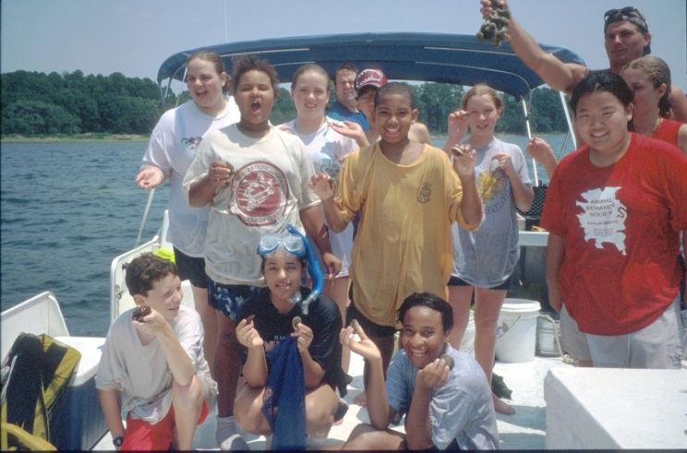
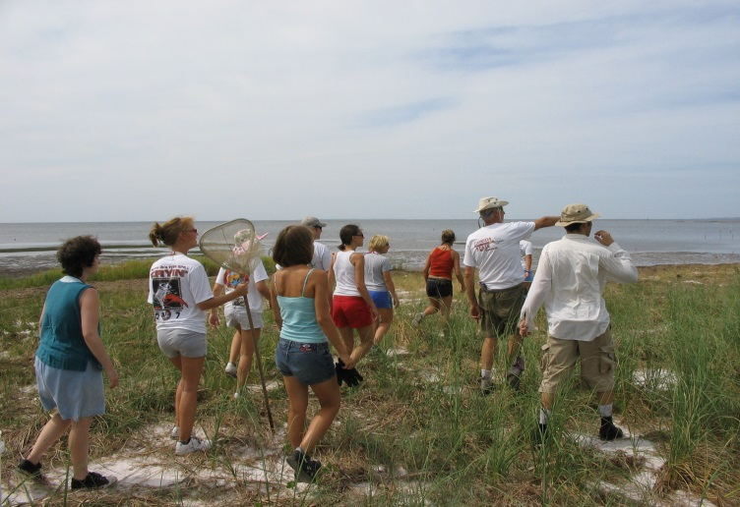
Office of Science Teaching Activities:
Saturday-at-the-Sea Programs
Saturday-at-the-Sea
Middle-School students
Regional school groups
Day of inquiry at the FSUCML
Salt marsh, sea grass, and
  laboratory activities
Saturday-at-the-Sea
Summer Camp
Weeklong inquiry at FSUCML
Middle-School students
Develop a research question, collect data, analyze, develop an explanation, present results

Slide 7
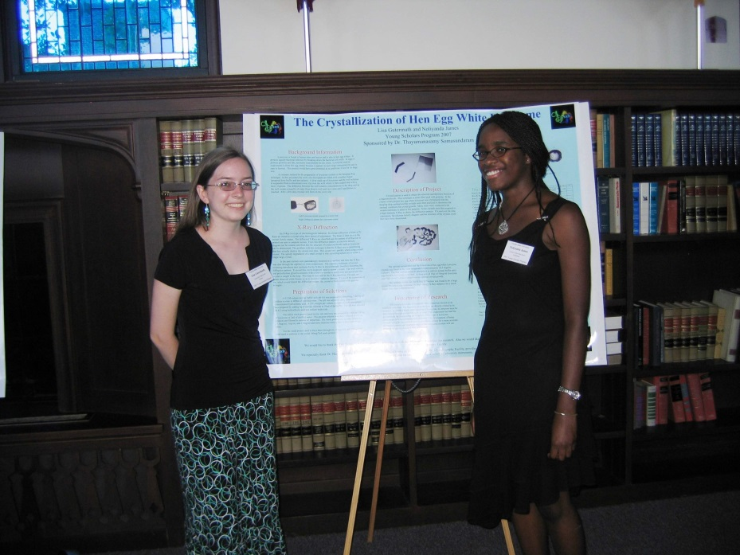
Office of Science Teaching Activities: Young Scholars Program
40 high-school rising seniors
  from all over Florida
Six-week summer residential program
Courses in math, science (biology
  or physics), computer science
Individual research project
  with a faculty sponsor two full
  days/week with a poster
  presentation at the end

Slide 8
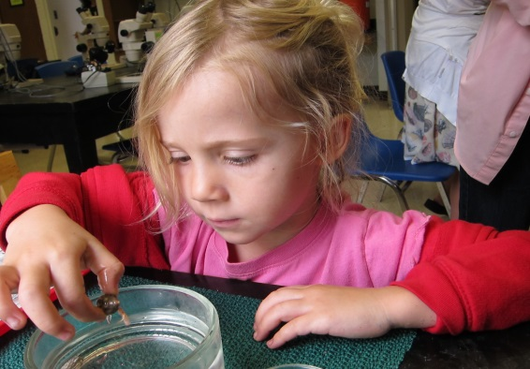
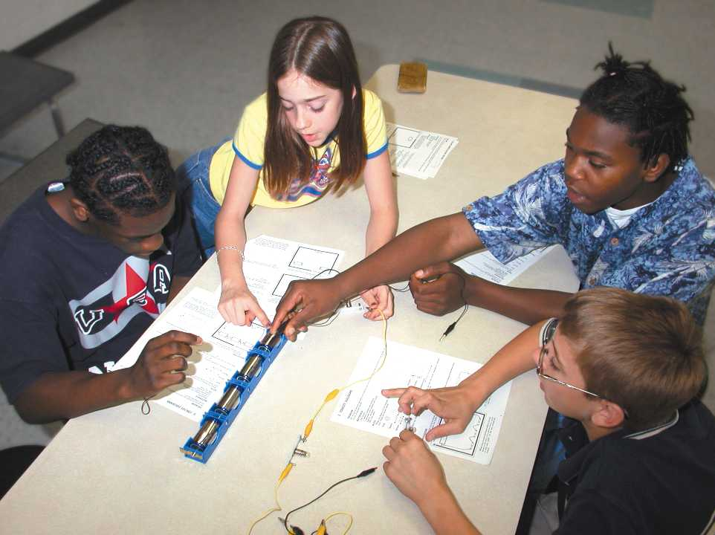
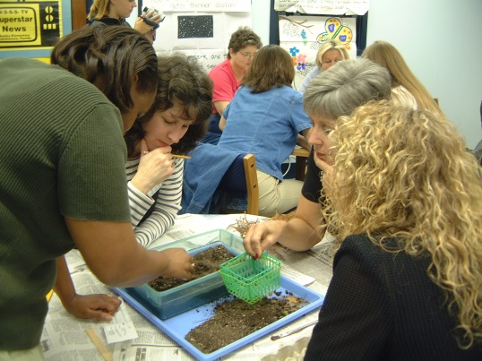
Office of Science Teaching Activities: Other Programs
Sea-to-See: Elementary school
  classrooms program
Science on the Move: K-12
  physical science van classrooms
  program
Teacher Professional Development:
  K-12 workshops for teachers
  to enhance both their STEM content
  and teaching strategies
CONTACT: granger@bio.fsu.edu

Slide 10
Dr. Austin Mast
Department of Biological Science

Slide 11
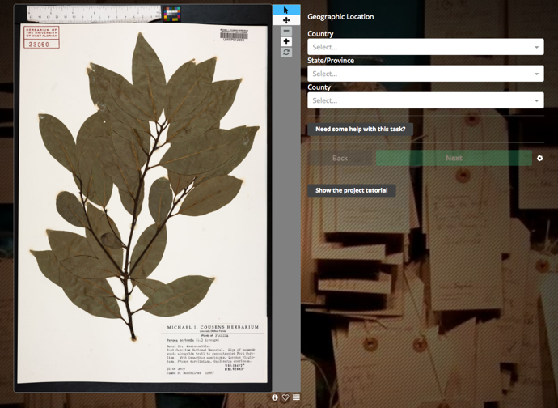






Slide 12
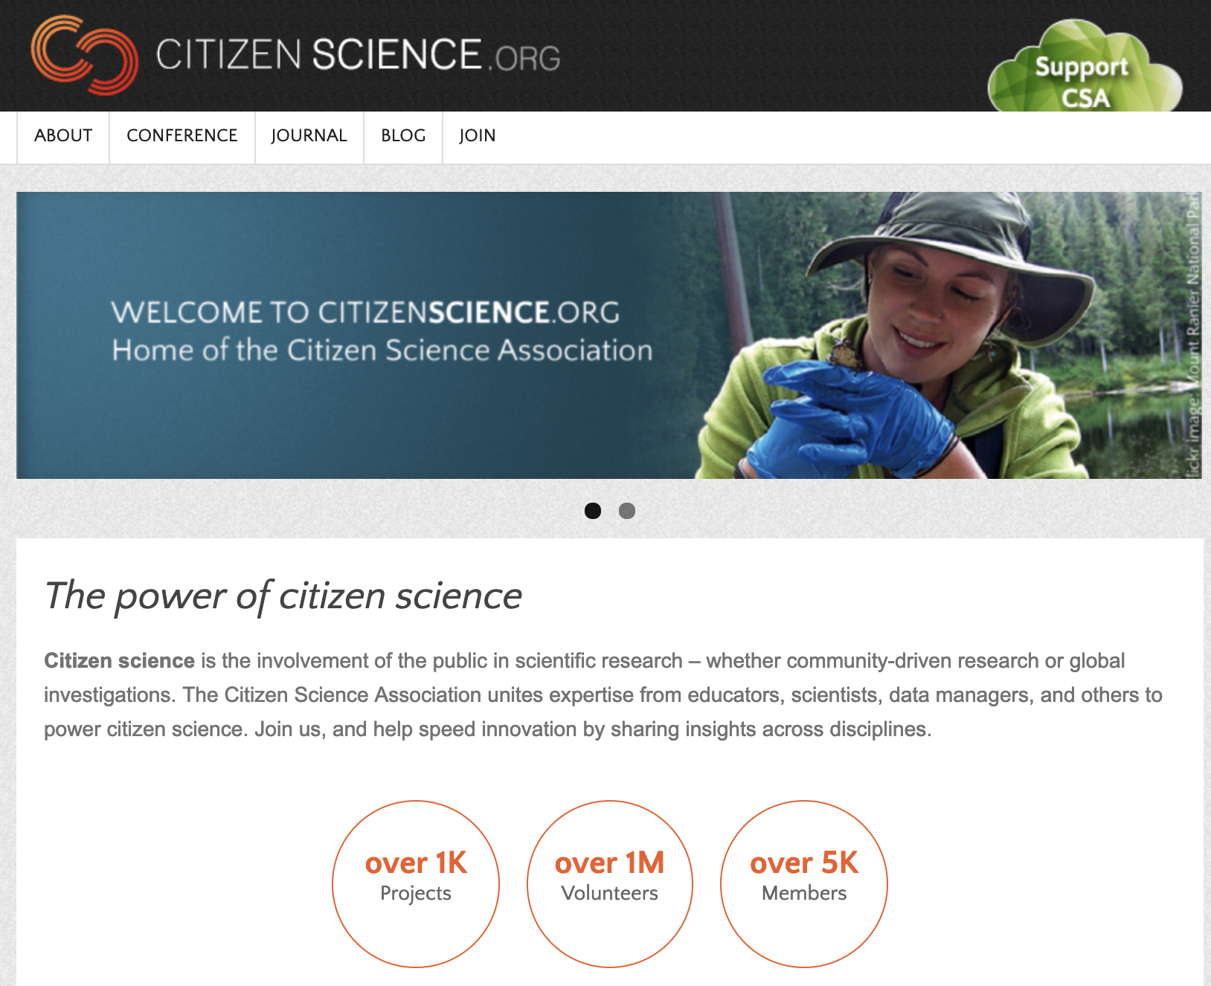

Slide 14
Dr. Roxanne Hughes
& Kari Roberts
Center for Integrating Research & Learning
National High Magnetic Field Laboratory

Slide 15



Education and Outreach: Examples of Broader Impacts

Slide 16
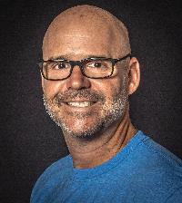
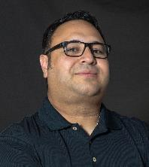
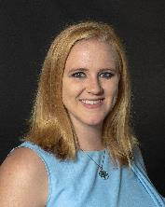

Expertise of Education Staff
Roxanne Hughes: Director of the CIRL
  Science education research, specifically research on the persistence and lack thereof of marginalized groups
Jose Sanchez: Director of REU, RET, and Internship
  Physics education, teacher pedagogy, mentoring at the higher education level
Carlos Villa: Director of Kindergarten-12th grade Outreach
  Physical science informal education, teacher pedagogy, middle school focus
Kari Roberts: Director of Evaluation
  Statistical analysis, evaluation, and mentoring at the higher education level
All have a commitment to diversity and inclusion.
              This combination results in programs that build our STEM workforce beginning at the K-12 level and continuing into college, graduate school, and the postdoc.
Notes:
Roxanne = science education/research specifically qualitative/research on what prevents marginalized populations from persisting at various levels of STEM pipeline.
Jose = science education/teacher training/mentoring + commitment to diversity through recruitment
Carlos = science education/teacher training/middle school focus + commitment to diversity through work with Title I schools
Kari = statistical analysis/evaluation/mentoring at the higher education level + commitment to diversity

Slide 17
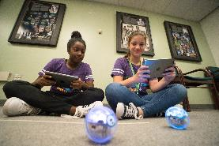
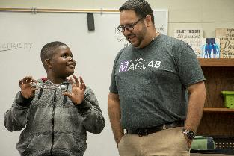
Broadening Participation for K-12 students
Carlos Villa – Project Manager
 | K-12 Educational Outreach (~5000 students/year) | Middle School Mentorship (~20 students/year) | Middle School Summer Camps (~140 students/year)
Description | Visits to K-12 school classrooms. And school groups coming to the lab. Eleven MagLab related curricula. | Middle school students work in pairs with MagLab scientist on a research project during each fall semester | 1-2 week camps for middle school students: Camp TESLA (coed) SciGirls Coding SciGirls Discover SciGirls Quest
Goals | Broaden participation of students by educating teachers Connect MagLab science to K-12 curriculum | Improve STEM Identity and broaden participation Provide students opportunities to engage in hands-on science activities Expose students to science careers and role models | Improve STEM Identity and broaden participation of students Provide students opportunities to engage in hands-on science activities Expose students to science careers and role models

Slide 18
Evaluation of K-12 Programs
Carlos Villa – Project Manager
 | K-12 Educational Outreach | Middle School Mentorship | Middle School Summer Camps
Performance Indicators | Total number of students served Number of Title I schools and students served | Participant Demographics Number of role models in the program | Participant Demographics Number of role models in the program
Metrics | Teachers respond to a post survey to assess how well effective science teaching strategies were modeled and how confident they feel in using them | Quantitative: pre-test/ post-test surveys measure STEM identity Post interview with mentors | Quantitative: pre-test/ post-test surveys measure STEM identity Qualitative: observations during; teachers interviewed after the program Surveys every 5 years.
Notes:
Making the MagLab an annual destination for all 5th grade classes in Leon County
24 Elementary schools each (>1000 students)
Connecting MagLab science directly with science lesson plans for teachers
MagLab partnerships with local Title I elementary and middle school and science and technology focused elementary and middle school
This would connect specific state standards (e.g. magnetism) with MagLab specific examples and content.
This would connect students at these schools with scientists at the MagLab.

Slide 19
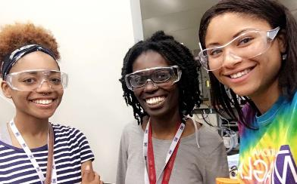
Broadening Participation for Undergraduates and K-12 Teachers
Jose Sanchez – Project Manager
 | Research Experience for Undergraduates (REU) | Research Experience for Teachers (RET) | Internship
Description | 10-week summer program for undergraduate STEM majors, includes $5,000 stipend. (~17 students/yr) | 6-week summer program for K-12 teachers, includes $3600 stipend. (~10 teachers/yr) | Occurs each semester for high school and college students. Hourly rate $10/hour for up to 10-20 hours per week. (~30 students/yr)
Goals | Improve Researcher Identity and broaden participation of students in research Allow students to participate in scientific research Create a network for students | Improve confidence in teaching science content Expose teachers to scientific research and collaboration with peers to inform their pedagogy | Improve Researcher Identity and broaden participation of students in research Introduce students to scientific research

Slide 20
Evaluation of Adult Programs
 | Research Experience for Undergraduates (REU) | Research Experience for Teachers (RET) | Internship
Performance Indicators | Participant Demographics Number of students interested in pursuing a career in research | Participant Demographics Demographics of students taught by RET’s | Participant Demographics Number of students interested in pursuing a career in research
Metrics | Quantitative: pre-test/ post-test surveys measuring researcher identity Qualitative: focus groups, observations, document analysis Mentors interviewed after the program | Quantitative: pre-test/ post-test surveys for confidence in teaching Qualitative: focus groups, observations, document analysis Mentors interviewed after the program | Quantitative: pre-test/ post-test surveys measuring researcher identity Qualitative: focus groups, observations Mentors interviewed after the program
Notes:
Per the NSF 2010 Program User-Friendly Handbook for Program Evaluation , performance indicators are used to measure how well our programs are reaching the broader impact goals of the lab.

Slide 21
Q&A

