Slide 1
Data Management Planning and Public Access Mandates
Presented by Dr. Nick Ruhs and Renaine Julian

Slide 2
Overview
Defining research data and data management
Data management and the research data lifecycle
Data formats
Data repositories
Library data services

Slide 3

What is research data?
“...The recorded factual material commonly accepted in the scientific community as necessary to validate research findings.” (2 CFR 200.315(3))

Slide 4
Examples of Research Data
Obvious
Documents
Spreadsheets
Audiotapes, Videotapes
Photographs, Films
Models, Scripts, Code
Not so Obvious
Lab notebooks, field notes
Questionnaires, survey instruments
Codebooks, data dictionaries
Methodologies, workflows
SOPs, protocols

Slide 5
What is not considered research data?
Preliminary Analysis
Drafts of papers
Plans for future research
Peer reviews
Communication with colleagues

Slide 6
What is not considered research data?
Trade secrets, commercial information, materials necessary to be held confidential by a researcher until they are published, or similar information which is protected under law
Personnel and medical information and similar information the disclosure of which would constitute a clearly unwarranted invasion of personal privacy, such as information that could be used to identify a particular person in a research study.

Slide 7
What is research data management?
"Research data management concerns the organisation of data, from its entry to the research cycle through to the dissemination and archiving of valuable results.
It aims to ensure reliable verification of results, and permits new and innovative research built on existing information."
Whyte, A., Tedds, J. (2011)

Slide 8

Common data management issues
Obtaining original file set
Proprietary file formats
Incomplete and/or incoherent data
Lack of data documentation

Slide 9
Federal Response
“The Administration is committed to ensuring that…the direct results of federally funded scientific research are made available to and useful for the public, industry, and the scientific community. Such results include peer-reviewed publications and digital data” (Holdren 2013).

Slide 10









Slide 11
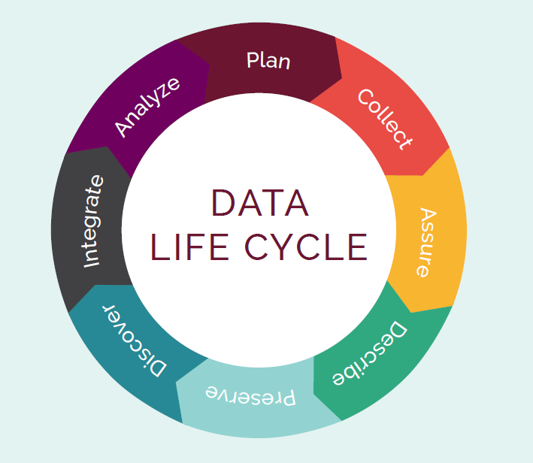
Research Data Lifecycle
A DMP will encompass all phases
A DMP will ideally be written in the “plan” stage
Ensures good data stewardship during the project

Slide 12
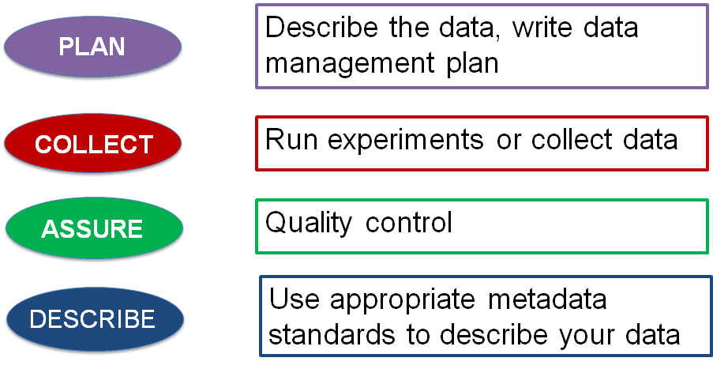
RDLC further explained

Slide 13
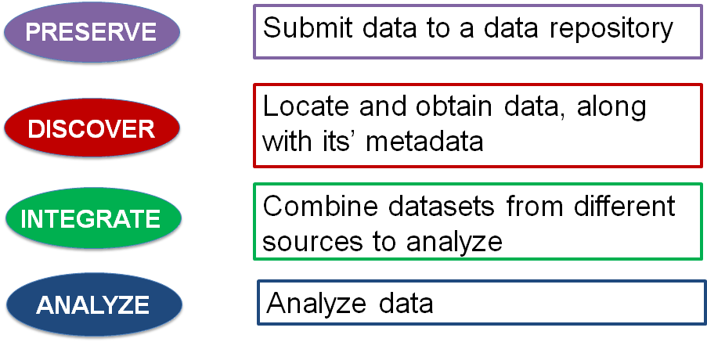
RDLC further explained

Slide 14
Data Formats
Text
•Microsoft Word (.docx)
•Portable Document Format (.pdf)
•Extensible Markup Language (.xml)
Numerical
•SPSS (.sav)
•Microsoft Excel (.xls)
•Comma-separated values file (.csv)
Models
•3D
•Statistical
•Econometric
Software
•MATLAB
•Python*
•Perl*
Multimedia
•Jpeg
•Png
•Tiff
•mpeg

Slide 15
Data Formats
Discipline Specific
•Flexible Image Transport System (FITS), astronomy
•Crystallographic Information File (CIF), chemistry
•GRIdded Binary (GRIB), meteorology
Instrument Specific
•Olympus Confocal Microscope Data Format
•Carl Zeiss Digital Microscopic Image Format (ZVI)

Slide 16
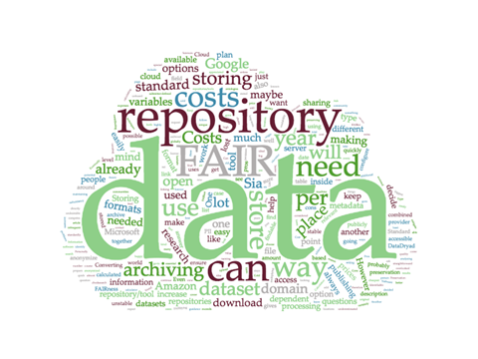
Data Repositories
Think about long-term preservation of data at each phase of the data life cycle
Select an archive or repository early and write into DMP

Slide 17


How do I find a data repository?
Discipline specific: re3data (re3data.org)
Institutional repository: Diginole

Slide 18
General DMP Requirements
Data types and formats
Data documentation and metadata
Ownership and responsibility
Methods for dissemination

Slide 19


Data @ FSU Libraries
Data management plan consultations
Data intellectual property and copyright questions
Finding and selecting data repositories
Archiving datasets into Diginole
Help with data management tools like:
DMPTool
Open Science Framework

Slide 20
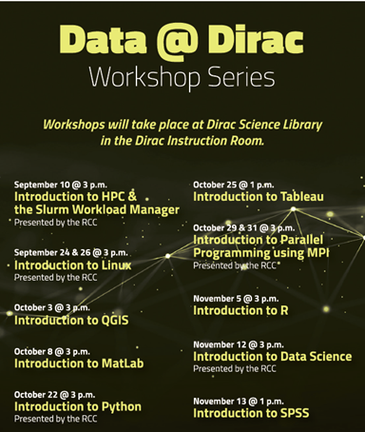
Data Literacy Initiatives
Workshop series focused on data analysis/visualization tools
Partnerships with RCC and DRS
Similar workshop series in Strozier
  Data @ Strozier
  Data Discovery Webinar Series

Slide 21
Contact Information
Nick Ruhs - STEM Data and Research Librarian nruhs@fsu.edu
Jesse Klein - Social Sciences Research and Data Librarian jrk06e@fsu.edu

Slide 22
Questions/Discussion

