Slide 1
Conflicts of Interest
Diana Key, Director
Research Compliance Programs
2019 Westcott North Annex
dkey@fsu.edu
www.research.fsu.edu/research-compliance/

Slide 2
Today’s Discussion
Federal Financial Conflict of Interest Disclosures
Conflict of Interest and Commitment related to Outside Activities
Conflict of Interest in Procurement and Intellectual Property Licensing
Monitoring and Reporting Conflicts
Foreign Influence

Slide 3
Conflict of Interest in Research
Definition
  Refers to situations in which financial considerations may compromise, or have the appearance of compromising, an investigator’s professional judgment in conducting or reporting research

Slide 4
Federal Financial Conflict of Interest
Most funding agencies have implemented regulations promoting objectivity in research by requiring that a university ensure that there is no reasonable expectation that the design, conduct, and reporting of the research will be biased by any significant financial interest of any Investigator working on the research.
The University created Policy 7A-21, Financial Conflict of Interest Disclosure to prevent or resolve, through management and/or mitigation, real or apparent conflicts that may exist in relation to research, instruction, and service activities undertaken by University investigators.

Slide 5
FSU Policy 7A-21
Financial Conflict of Interest Disclosure
FSU is committed to ensuring that research and scholarly activities are carried out under the highest standards of ethical conduct and adhere to applicable governmental regulations and University policies governing the conduct of research.
The University’s overall policy on conflict of interest is that no faculty/staff member or student shall engage in any activity that places them in a conflict of interest between their official activities and any other interest or obligation.

Slide 6
FSU Policy 7A-21
Definitions related to significant financial interest disclosure regulations vary among funding agencies.
Investigators should consult the applicable funding agency regulations and FSU’s disclosure procedures for definitions of terms such as significant financial interests (SFIs), financial conflict of interest (FCOI), and investigator.
Definitions from PHS and NSF follow on the next slides.

Slide 7
PHS Significant Financial Interest
With regard to a publicly traded entity, an SFI exists if the value of any remuneration received from the entity in the twelve months preceding the disclosure and the value of any equity interest in the entity as of the date of disclosure, when aggregated for a single entity, exceeds $5,000.
With regard to a non-publicly traded entity, an SFI exists if the value of any remuneration received from the entity in the twelve months preceding the disclosure, when aggregated for a single entity, exceeds $5,000, or when the Investigator (or the Investigator’s spouse or dependent children) holds any equity interest (e.g. stock, stock option, or other ownership interest).
Intellectual Property Rights and Interests income which exceeds $5,000 from a single entity.
Reimbursed/Sponsored Travel when aggregated for a single occurrence exceeds $5,000, related to their institutional responsibilities.

Slide 8
NSF Significant Financial Interest
An equity interest that, when aggregated for the investigator (and the investigator’s spouse and dependent children), meets both of the following tests: (i) exceeds $10,000 in value as determined through reference to public prices or other reasonable measures of fair market value; and (ii) represents more than a 5% ownership interest in any single entity;
Anything of monetary value, including but not limited to, salary or other payments for services (e.g., consulting fees or honoraria), and intellectual property rights (e.g., patents, copyrights and royalties from such rights) that are expected to exceed $10,000 during the prior twelve-month period.

Slide 9
FSU Policy 7A-21
PHS and NSF Definitions
Financial Conflict of Interest (FCOI) means a significant financial interest that could directly and significantly affect the design, conduct, or reporting of PHS-funded or NSF-funded research.
Investigator means the project director or principal investigator and any other person, regardless of title or position, who is responsible for the design, conduct, or reporting of research, including collaborators or consultants.
Financial Interest means anything of monetary value, whether or not the value is readily ascertainable.
Institutional responsibilities means an Investigator’s professional responsibilities on behalf of the Institution such as research, teaching, professional practice, institutional committee memberships, etc.

Slide 10
What Must Be Disclosed – PHS and any other entity adopting PHS FCOI regulations
All significant financial interests (SFI) of the Investigator (and those of his/her spouse and dependent children) that:
Meet PHS’s definition of SFI; and
Are related to the investigator’s institutional responsibilities.

Slide 11
What Must Be Disclosed - NSF
Only those significant financial interests (SFI) of the Investigator (and those of his/her spouse and dependent children) that:
Meet NSF’s definition of SFI;
Are related to the investigator’s institutional responsibilities; and
Would reasonably appear to be affected by the research proposed to or funded by NSF; or in entities whose financial interests would reasonably appear to be affected by such activities.

Slide 12
When to Disclose – PHS and NSF
Prior to the time a proposal is submitted;
Prior to any expenditures made to a resulting award;
During the period of the award on July 1 of each year following initial disclosure; and
Within thirty days of discovering or acquiring (e.g., through purchase, marriage, or inheritance) a new significant financial interest.

Slide 13
Subrecipient Disclosures
The subaward between FSU and the subrecipient shall establish whether the financial conflicts of interest policy of FSU or that of the subrecipient shall apply to the subrecipient’s investigators.
If the subrecipient’s policy applies, the subrecipient must certify as part of the agreement that its policy complies with the funding agency regulations regarding financial conflicts of interest.
If the subrecipient cannot certify as described above, then the agreement shall state that the subrecipient investigators are subject to FSU’s financial conflicts of interest policy for disclosing SFI’s that are directly related to the subrecipient’s work for FSU.

Slide 14
Disclosure Review Process
Prior to initiating work and expending any funds related a research project subject to disclosure requirements, the designated Institutional Official (IO) shall:
Review all Investigator disclosures of SFIs;
Determine whether any SFIs relate to the funded research;
Determine whether a financial conflict of interest exists; and if so,
Develop and implement a management plan that shall specify the actions that have been or shall be, taken to manage such financial conflict of interest.

Slide 15
Managing a Conflict
Managing a conflict means finding a way to prevent the interest from adversely influencing the research. Some management options used by the University include (but are not limited to):
Requiring disclosure of financial interests in presentations, publications, and (when human subjects research is involved) the informed consent process so that others are aware of potential conflicts and can act accordingly;
Monitoring the research or checking research results for accuracy and objectivity;
Reducing the personal income received from the research, or removing the person with the conflict from crucial steps in the research process, such as the interpretation of data or participating in a particular review decision.
If conflicts cannot be effectively managed they must be eliminated. Elimination of the conflict may require such measures as divesting equity or resigning from a board.

Slide 16
Non-Compliance with Disclosure Requirements
Any failure by an Investigator to adhere to FSU or agency COI regulations may be cause for disciplinary action pursuant to the FSU Faculty Handbook, Collective Bargaining Agreement, and other applicable employee disciplinary policies.
FSU may also suspend all relevant activities or take other disciplinary action until the matter is resolved, or other action deemed appropriate by institutional officials.

Slide 17
State of Florida Conflict of Interest
Florida Statutes, Part III, Chapter 112, provide that:
No faculty or staff member shall engage in any outside activity that interferes with the full performance of his or her assigned duties.
Such activities shall not create a conflict of interest.

Slide 18
State of Florida Standards of Conduct
F.S. 112.313, Standards of conduct for public officers, employees of agencies, and local government attorneys
This statute outlines a variety of standards that university employees are to uphold. The following are two examples of the standards identified in the statute which are of particular interest to FSU researchers:

Slide 19
State of Florida Conflict of Interest
Doing Business With One’s Agency [Subsection (3)]: —No employee of [FSU] acting in his or her official capacity as a purchasing agent, or public officer acting in his or her official capacity, shall either directly or indirectly purchase, rent, or lease any realty, goods, or services for [FSU] from any business entity of which the officer or employee or the officer’s or employee’s spouse or child is an officer, partner, director, or proprietor or in which such officer or employee or the officer’s or employee’s spouse or child, or any combination of them, has a material interest. Nor shall a public officer or employee [of FSU], acting in a private capacity, rent, lease, or sell any realty, goods, or services to [FSU], if he or she is a state officer or employee, or to any political subdivision or any agency thereof, if he or she is serving as an officer or employee of that political subdivision.

Slide 20
State of Florida Conflict of Interest
Conflicting Employment or Contractual Relationship [Subsection (7)](a) — No public officer or employee of [FSU] shall have or hold any employment or contractual relationship with any business entity or any agency which is subject to the regulation of, or is doing business with, [FSU], excluding those organizations and their officers who, when acting in their official capacity, enter into or negotiate a collective bargaining contract with the state or any municipality, county, or other political subdivision of the state; nor shall an officer or employee of [FSU] have or hold any employment or contractual relationship that will create a continuing or frequently recurring conflict between his or her private interests and the performance of his or her public duties or that would impede the full and faithful discharge of his or her public duties.

Slide 21
Exemption from State of Florida Conflict of Interest Statute
F.S. 112.313(12)(h), states that “…no person shall be held in violation of subsection (3) or subsection (7) if…the transaction is made pursuant to s. 1004.22 or s. 1004.23 and is specifically approved by the president and the chair of the university board of trustees.
To request an exemption for a research-related activity, complete the Request for Exemption from Conflict of Interest Laws form
Most approved exemptions require implementation of a Management Plan.

Slide 22
Management Plan
A management plan addresses:
  Expectation of integrity of research programs
  University rights to intellectual property
  Dissemination of research results
  Use of University name, equipment, facilities, services, or personnel
  Disclosure of the conflict to laboratory, project personnel
  Disclosure in proposals and publications
  Disclosure in human subject research informed consent
  No competition with the University
  Requirement for annual report

Slide 23
Conflict of Interest in Procurement
Excerpt from 2 CFR 200: Uniform Administrative Requirements, Cost Principles, and Audit Requirements for Federal Awards (aka, Uniform Guidance):
  § 200.318(c)(1) General procurement standards: The non-Federal entity must maintain written standards of conduct covering conflicts of interest and governing the actions of its employees engaged in the selection, award and administration of contracts. No employee, officer, or agent may participate in the selection, award, or administration of a contract supported by a Federal award if he or she has a real or apparent conflict of interest.

Slide 24
Conflict of Interest and
Intellectual Property
Three areas of potential conflict of interest in Technology Transfer:
  Licensing to companies in which an investigator has a financial interest at bargain royalty rates
  Equity participation (by inventor/investigator) in start-up companies that are funding research in the inventor’s lab
  Consulting relationships with companies that may directly benefit from the investigator’s research

Slide 25
Conflict of Interest and
Intellectual Property
Commonly-used management tactics
Limit inventor’s activity with the start-up
Restrict and carefully monitor research funding from a licensee; watch licensing of improvements
Limit licensee’s use of students
Require faculty to advise students of start-up activities
Insist upon arm’s length negotiations between licensee and FSU
Limit faculty inventor’s participation on board or in management

Slide 26
Conflict of Commitment
Conflicts of commitment exist when individuals have difficulty balancing the effort necessary to perform their job duties while engaging in other activities that may or may not be job-related. This type of conflict can also occur when an individual's research or work output is affected due to a competing influence.
A researcher may be tempted to give extra work to students on a project that delays the students' progress on their own research and degree requirements. This is a conflict of commitment between the goals of the individual students and the goals of the researcher.

Slide 27
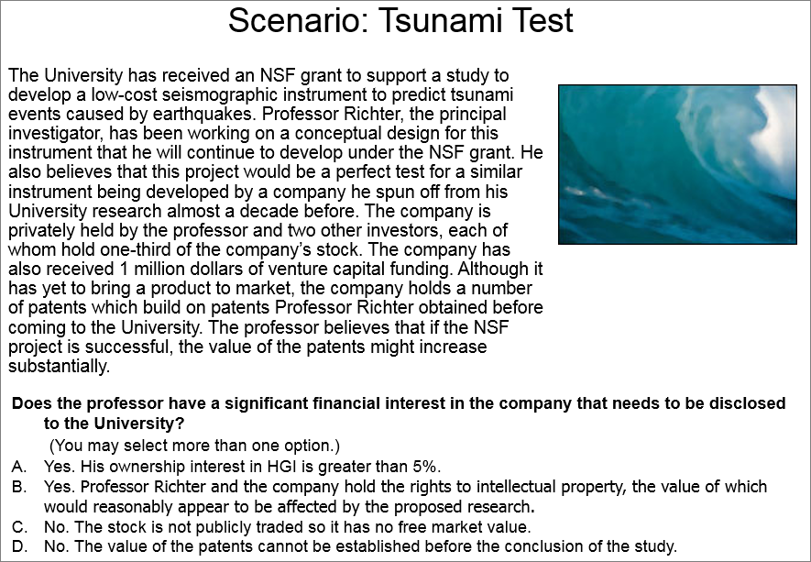
Notes:
The best answers are A and B.

Slide 28
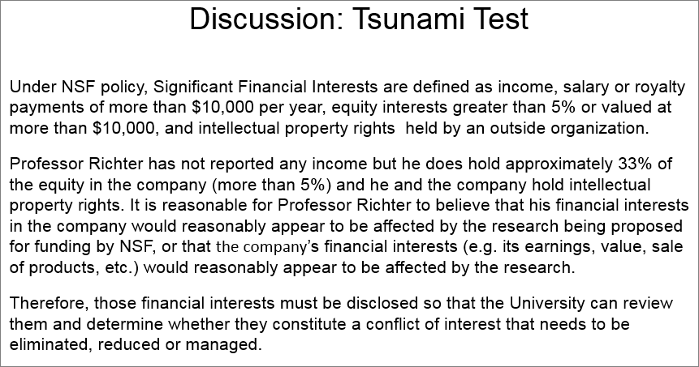

Slide 29
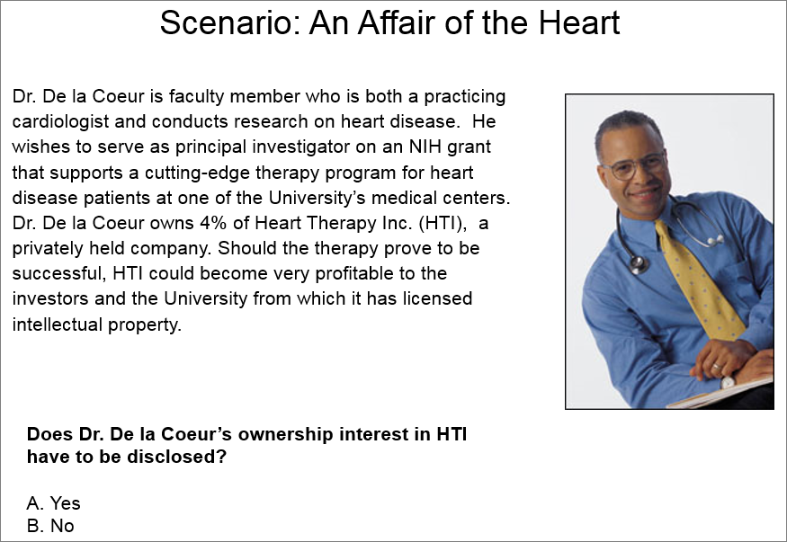
Notes:
The best answer is A.

Slide 30
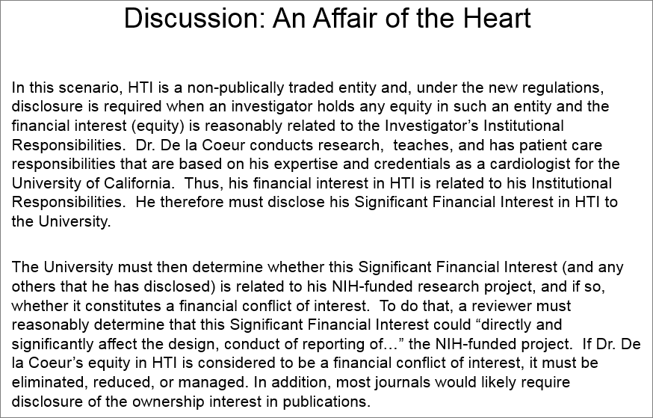

Slide 31
Additional Training
CITI Conflict of Interest Course – a web-based tutorial that was developed by experts in the research community.
  https://www.research.fsu.edu/research-compliance/training/

Slide 32

Questions

Slide 33
Foreign Influence

Slide 34
International Collaborations
FSU strongly supports and encourages international collaboration and values our partnerships with universities and other organizations worldwide.
To support continued collaborations, it is important that all faculty and staff understand the concerns being raised about foreign influence and how we can partner together to address them.

Slide 35
Government Concerns
Through a variety of mechanisms, the U.S. Government has raised concerns about foreign threats to the integrity of research at national academic and research institutions. The concerns revolve around three main areas:
Diversion of intellectual property to foreign entities
Disclosing confidential grant application information by peer reviewers to third parties
Failure of researchers to disclose research resources and support provided by other organizations, including foreign entities

Slide 36
Heightened Focus
In keeping with the above examples, federal funding agencies have advised that there will be a heightened focus on ensuring compliance with respect to mandatory reporting of all sources of research support, financial interests and relevant affiliations, as well as steps to reduce risk to IP security.

Slide 37
How to Disclose
Review and update other support information
Review and update biosketches
Ensure appropriate disclosure of foreign components
Include changes of support in progress reports
Review Conflict of Interest disclosures and Outside Activity Statements and update as necessary.

Slide 38
Activities to Disclose
Academic, research, or administrative appointments at a foreign institution, even if the appointment is uncompensated. This includes appointments that are full-time, part-time, honorary, adjunct, or voluntary.
Any agreement with a foreign university for which the FSU faculty member directs non-FSU students, postdocs, or other personnel affiliated with that university.

Slide 39
Other Activities to Disclose
Any contractual agreement with a foreign institution, company, or government agency.
Any non-FSU agreement in which foreign funds or other resources are provided to the faculty for activities either at FSU or at a foreign institution.

Slide 40
Other Activities to Disclose
Any agreement or relationship that assigns intellectual property (IP) rights to the foreign institution.
Any agreement or relationship with a foreign entity in which the FSU faculty member receives payments for salary, stipends, or living expenses.
Any consulting agreements with a foreign entity.

Slide 41
Other Activities to Disclose
Holding a position such as founder, partner, employee, or board member at a company, non-profit, governmental agency, or other foreign entity.
Receiving living/lodging funds or reimbursements from a foreign entity.
Having significant ownership interest in a foreign company.

Slide 42
Other Activities to Disclose
Receiving travel funds or reimbursements from a foreign entity.
Receiving an honorarium from a foreign entity.

Slide 43
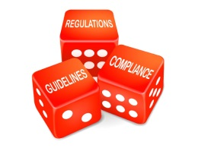
Contact
Diana Key, Director,
Research Compliance Programs
2021 Westcott North Annex
dkey@fsu.edu
www.research.fsu.edu/research-compliance/

