Slide 1
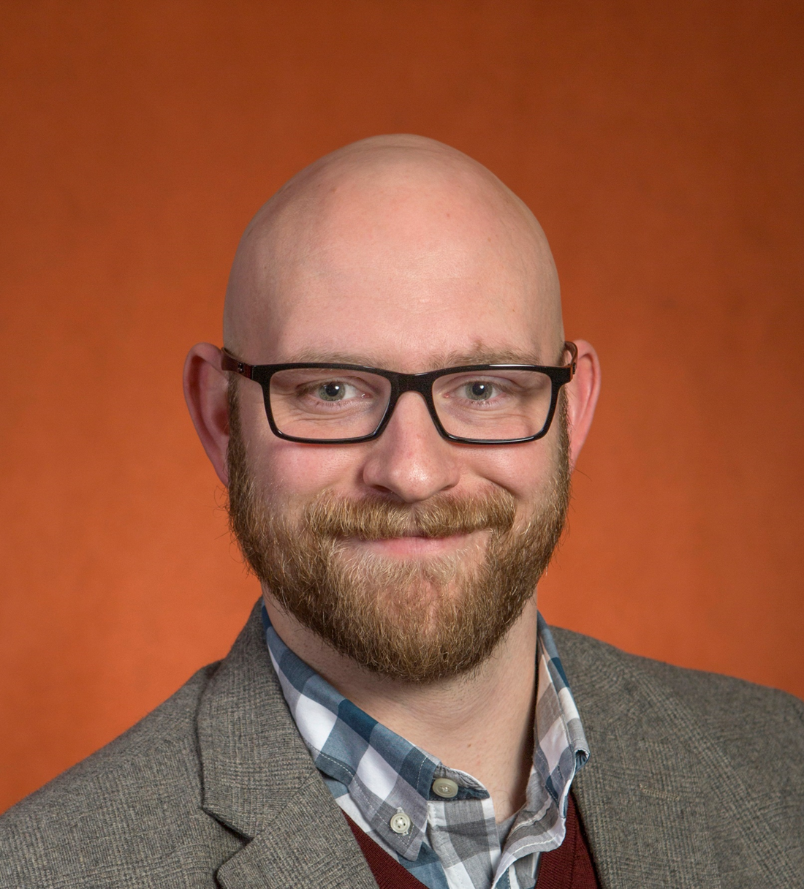
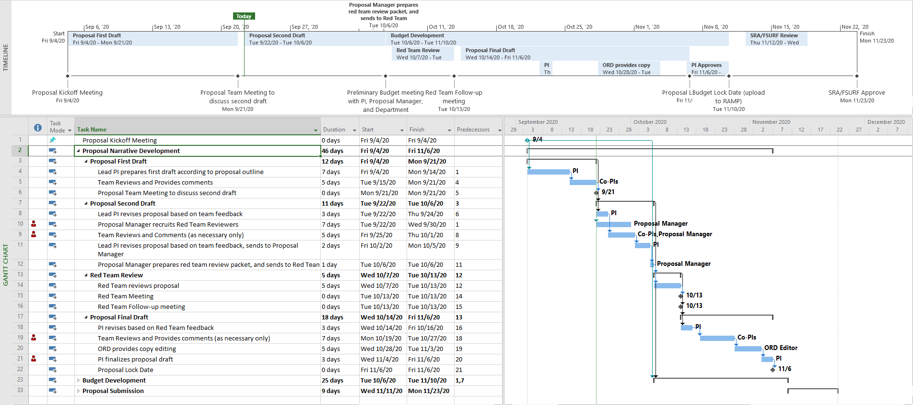
Hello there! Thanks for registering for Collaborative Collision: Climate Solutions. This is the template slide for the event; all participants must use this format for continuity.
I’ve included my own slide here as an example, along with descriptions of what we hope to see in each field (more examples of past slides can be found here). The second slide is a blank template for you to use to create your own Collaborative Collision research profile.
When you are done please save as a PowerPoint file with the title LastName_FirstName_CC_CSProfile.ppt (filling in your name of course) and email the file to me at mike.mitchell@fsu.edu as soon as possible, but no later than February 24th, 2021
A professional headshot or other photo helps put a face with the name! We also accept organization/lab logos.
Tell us a little bit about your interest in this Collaborative Collision topic. What is your background in the area, what are you hoping to learn, what are the opportunities you see for collaboration, etc.
Identifying and building collaborative research teams, and positioning them to complete for external funding.
Connecting with individuals and teams working on tech and society research to explore ways to further their interests.
Exploring ways to translate research into societal impact
Connecting with other individuals at FSU who are interested in the social, political, and economic impacts of technology development and deployment .
Your Name
Organizational Affiliation
Email address
Link to an online profile*
*We recommend either your ORCID profile, LinkedIn profile, or a dedicated webpage
I manage the Collaborative Collision program at FSU to connect faculty with shared research interests, and build new interdisciplinary teams
Mike Mitchell
Office of Research Development
mike.mitchell@fsu.edu
orcid.org/0000-0003-1653-0164
EXAMPLE
This section is totally up to you! Many people put photos, diagrams, figures, etc. to help describe their research. We’ve also seen data tables/graphs, links to additional content, and lists of publications.
Grant proposal management and editing
Connection to local non-profit and government organizations
Grant writing presentations for faculty and/or classes.
Research experience in diffusion of innovations (electric vehicles)
Consult on AEI practices in team building efforts
Assist with survey-design and data analysis
Collaborate to develop AEI in research programs
Allow me to help you!
I provide project management leadership to teams developing large external funding proposals of strategic interest to FSU.
Program Development
Project Management
Research Impact
Collaborative Team Development
3-4 keywords to describe your areas of expertise, research interests, or project interests
Recent Proposals/Publications:
2030 Climate Challenge
Equality Can’t Wait Challenge
NSF-ADVANCE
Collaborative Collison: COVID-19
Bullet points describing your skills and expertise that potential collaborators might find useful. Could include skills, disciplinary background, methodology experience, etc
Bullet points describing how a collaborator could help your project. Might include needed skills, disciplinary backgrounds, methodologies, etc.

